Slide 1
Climate Benchmarking and Attribution
Yolanda Shea & Peter Pilewskie

Slide 2
Climate Benchmarking, Fingerprinting & Attribution
What is a climate benchmark?
What are typical magnitudes of climate change?
Trend detection
Examples of spectral fingerprints in the long- and short-wave
Spectral un-mixing
Climate Attribution: Dominant Spectral Modes of Variability

Slide 3
Establishing a Shortwave Climate Benchmark
A high accuracy record of climate change.
  Accuracy verified on-orbit.
  Guarantees the consistency required over long time periods.
  It does not require a perfectly accurate retrieval algorithm.
Must have high accuracy and information content necessary to detect and attribute long-term climate change trends and to test climate predictions.
Accuracy and sampling to assess and predict the impact of changes in the climate forcing variables on climate change.
Benchmark variables are direct observables: reflected shortwave spectral radiance or spectral reflectance.

Slide 4
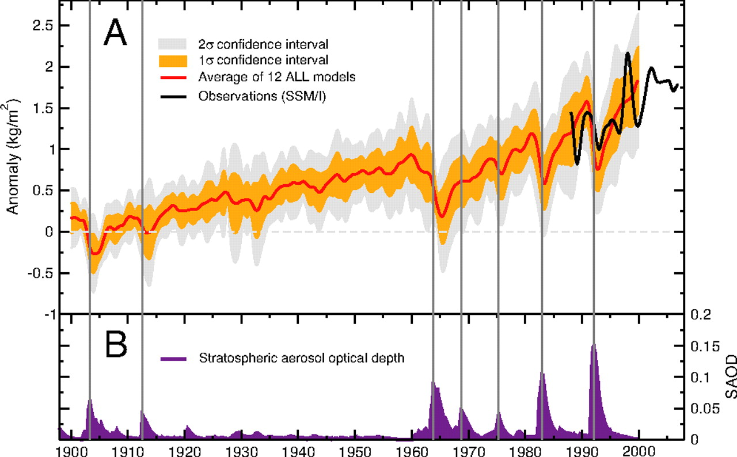
Water Vapor Trend
0.4 kg/m² per decade
Santer et al., PNAS, 2007.

Slide 5
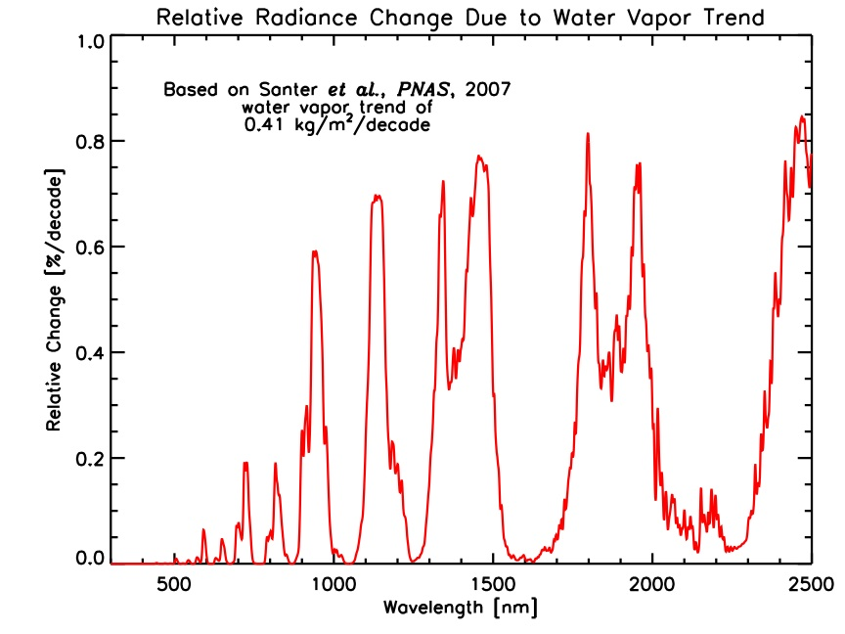
Sensitivity of Reflected Solar Radiance to Water Vapor Trend
Radiative transfer simulations used to derive changes in outgoing top-of-atmosphere spectral radiance due to 0.4 kg/m² per decade trend in water vapor.
Largest absolute changes occur in the weak (sub-saturated) VNIR water band; largest fractional changes in the wings of the stronger SWIR bands.

Slide 6
Time Required to Detect Trends
90% prob. of detecting a trend to a 0.05 statistical level
Trend/decade (%)
^
Variability in monthly anomaly time series s_{y}/⟨y⟩ (%)
(adapted from Weatherhead et al. [1998])

Slide 7
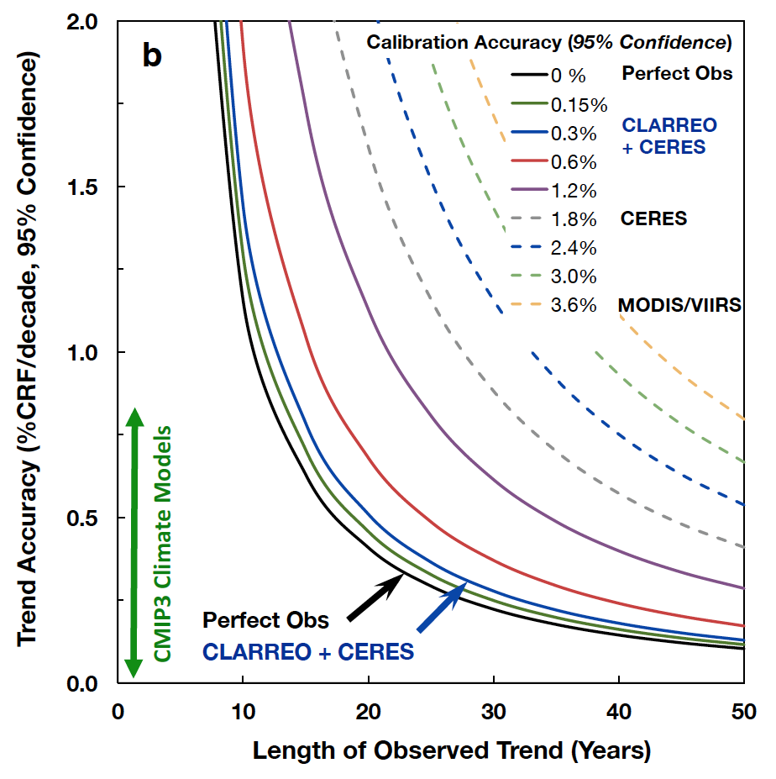
Trend Detection and Measurement Accuracy
Wielicki et al. Bull. Amer. Meteorol. Soc., 2013.
Notes:
Left figure: The black line shows climate trend uncertainty for a perfect observing system limited only by natural variability. The dashed lines add the absolute calibration uncertainty of the current highest accuracy cloud related space instruments including MODIS (cloud physical properties) and CERES (broadband reflected solar radiation to observe SW CRF directly). The blue line shows the accuracy from the future CLARREO (Climate Absolute Radiance and
Refractivity Observatory) mission which advances accuracy a factor of 5 to 10 over current instruments (Wielicki et al., 2013).
Or directly from paper: The relationship between absolute calibration accuracy and the accuracy of global average decadal cli-mate change trends. Trend accuracy shown for a perfect observing system (black), varying levels of instrument ab-solute accuracy (solid color lines) for possible CLARREO requirements, and current instruments in orbit (dashed lines). Shown is the relationship between reflected solar spectra and changes in broadband CRF (cloud radiative forcing) and cloud feedback. The figures show the dramatic effect of instrument accuracy on both climate trend accuracy (vertical axis) as well as the time to detect trends (horizontal axis). The green vertical line for reflected solar shows the range of CMIP3 climate model simulations (Soden and Vecchi 2011). Larger values of decadal change in SW CRF indicate larger values of cloud feedback (Soden et al. 2008).

Slide 8
Spectral Fingerprinting: Emission
a) Global, annual average spectrally resolved OLR as simulated by MODTRAN5 using CCSM3 output for selected years during the twenty-first century under the SRES A2 scenario.
b) Change in OLR relative to year 2000. Regions of influence of key greenhouse gases are indicated
Brindley & Bantges, Curr. Clim. Change Rep. (2016) 2:112–126 DOI 10.1007/s40641-016-0039-5

Slide 9
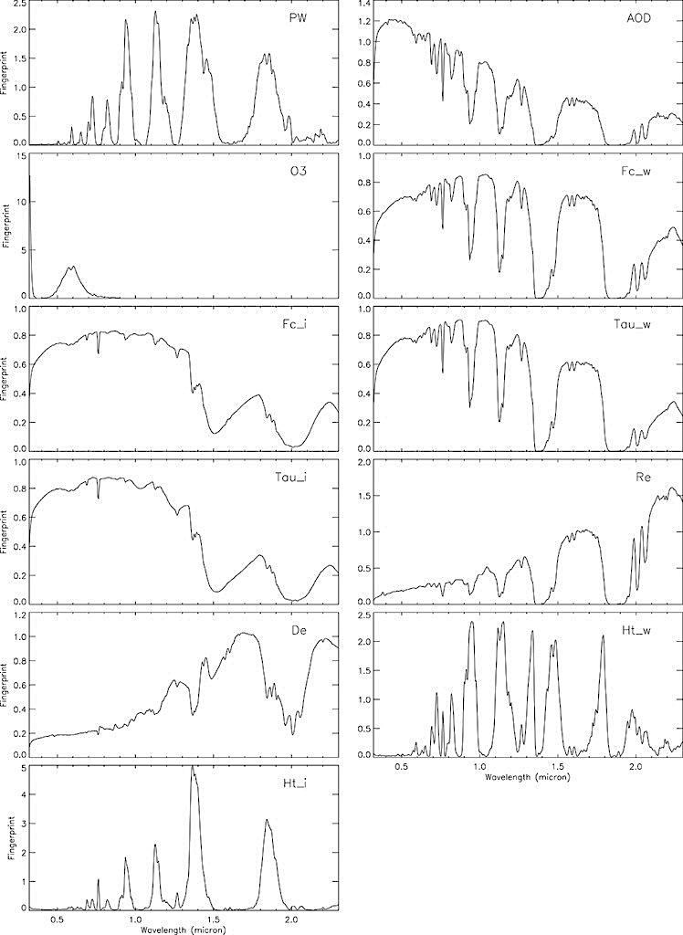
Spectral Fingerprinting:
Reflected Shortwave
The global-mean spectral ﬁngerprints for the 11 variables in the month of January. Each panel represents a different climate variable.
Jin and Sun, (2015) Journal of Climate 29, 8; 10.1175/JCLI-D-15-0297.1

Slide 10
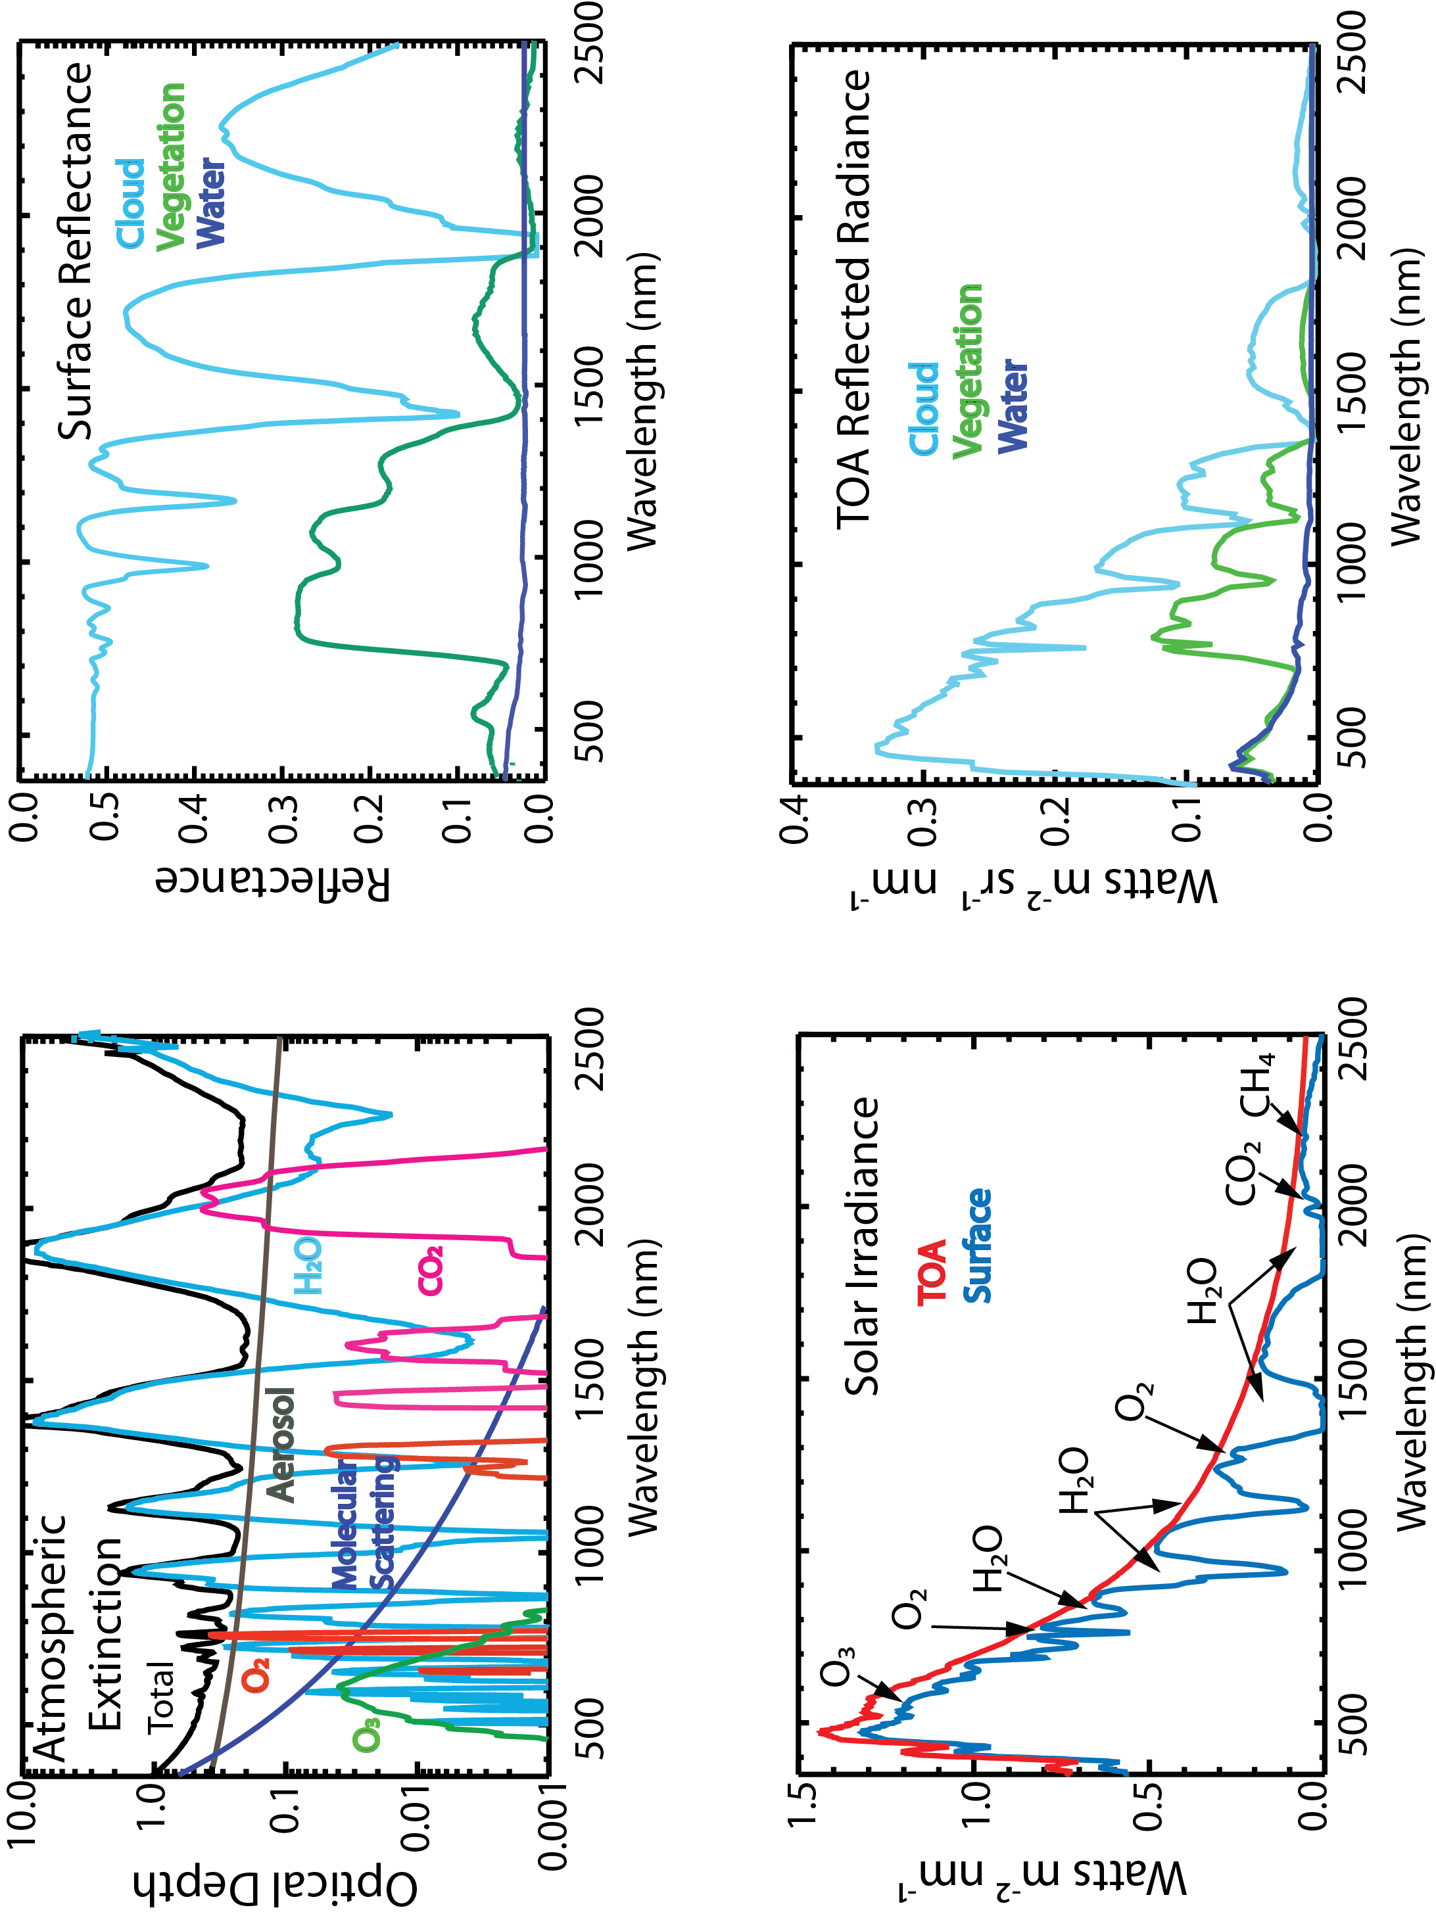
Attribution: Spectral Un-mixing

Slide 11
Dominant Spectral Variables Exhibit Physical Spectral Signatures
Green Peak
NIR Edge
Roberts et al., 2011
Roberts et al., 2011

Slide 12
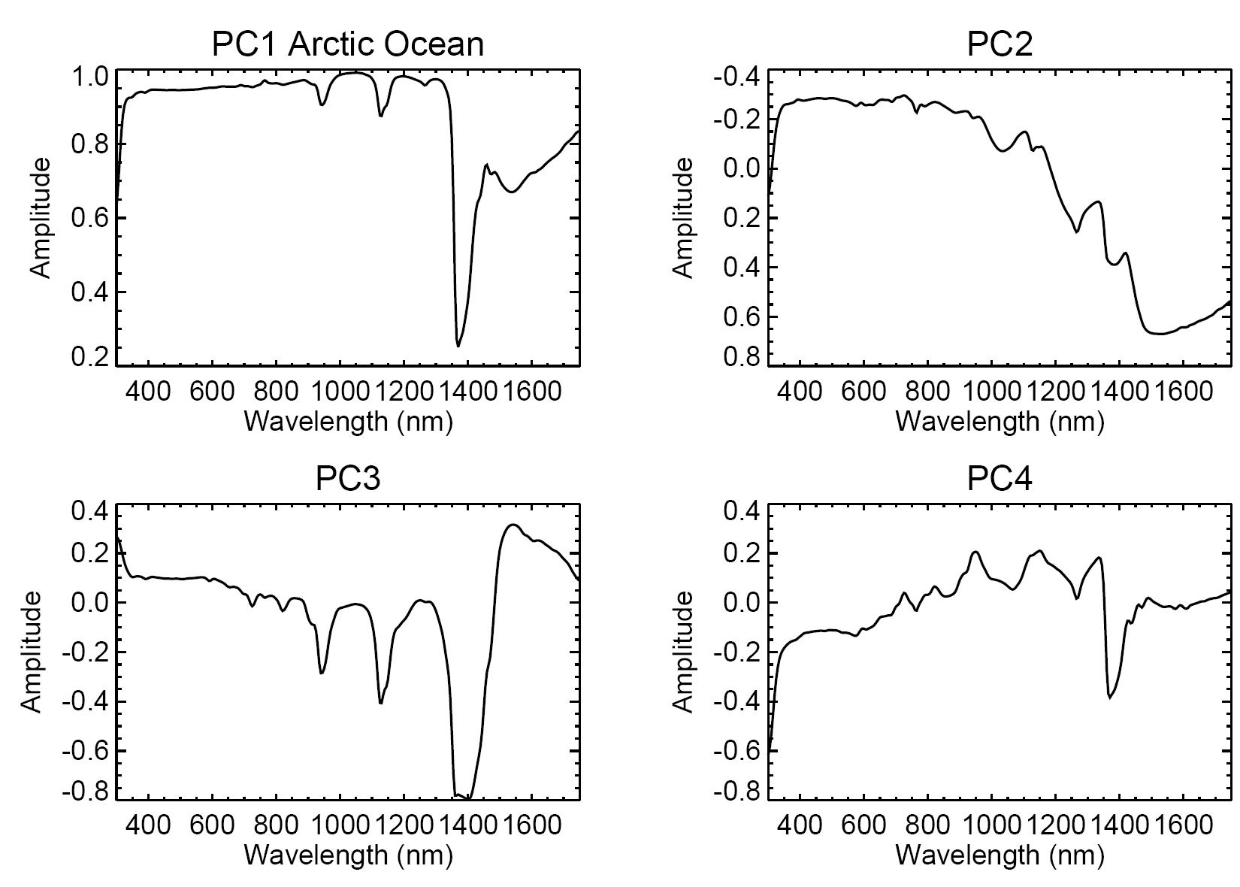
Separation of Cloud and Sea Ice Albedo Contributions
Cloud Albedo
Sea Ice Albedo
78.6%
91.3%
97.2%
99.1%
Roberts et al., 2011
Roberts et al., 2011

Slide 13
Spectral and Temporal Variability – A Step Toward Climate Attribution
Despite PC spectral shape not necessarily exhibiting clear signature of the physical drivers, the time series gave clues regarding physical drivers of variability.
PC1: Aerosol Optical Depth Temporal Variability
PC4: Total Column Precipitable Water Temporal Variability
Roberts et al., 2014

Slide 14
Summary
Climate Benchmark measurements
  Have the accuracy for unambiguous climate change detection
  Are Information-packed for climate change attribution
Climate Attribution Methods
  Spectral Signal Source Separation – Understanding the physical drivers contributing to spectral signal informative for climate change attribution
  Multivariate Analysis Approaches – leverage spectral variability and redundancy in benchmark measurements
  Climate Fingerprinting – identifying geophysical drivers of climate trends using spectral benchmarks. A significant challenge in the SW compared to IR
CPF measurements will have the attributes of a climate benchmark

