Slide 1
CLARREO Pathfinder Mission Overview
Yolanda Shea (CPF Project Scientist)
& CPF Team
November 2, 2021

Slide 2
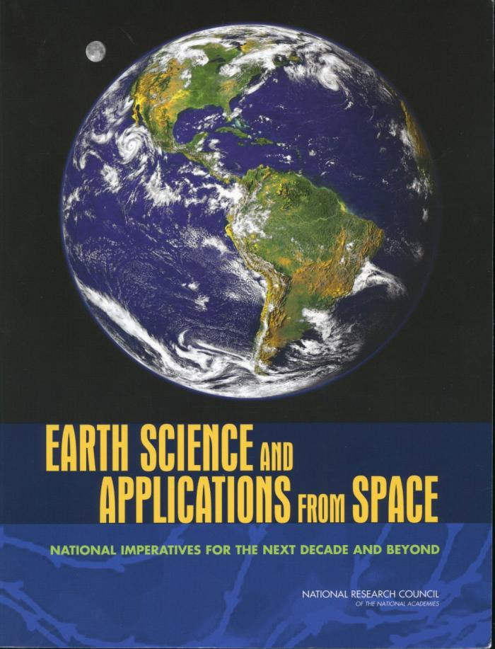

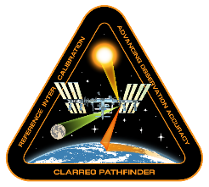
A Brief History: The Path to Pathfinder
Climate Absolute Radiance and Refractivity Observatory
2007: Decadal Survey Recommended CLARREO as Tier 1 Mission
2010: CLARREO passed Mission Concept Review
2011: CLARREO Mission was pulled back into Pre-formulation “indefinitely”
2016: RS CLARREO Pathfinder on ISS mission started!
2017: 2nd Decadal Survey supported continuation of CPF
Full CLARREO Purpose: To address critical need for high accuracy climate change observations and establish a climate benchmark.
  Scope: 5-year mission with RS and IR spectrometers, GNSS-RO receivers for climate benchmarking and inter-calibration

Slide 3
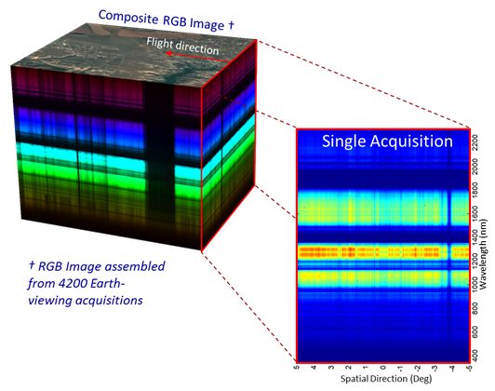
CLARREO Pathfinder on ISS Summary
Core Mission Objectives: Demonstrate ability to achieve climate-critical high accuracy measurements of Earth reflectance and to inter-calibrate with CERES (broadband) & VIIRS (multi-spectral)
LASP-Led Payload & Reflected Solar Spectrometer (350 – 2300 nm)
Nominal 1-year mission operations + 1-year science data analysis
Currently in Phase C – Passed [Virtual] CDR in March 2020
Launch Estimated in Late CY 2023
Spectrally-Resolved Earth Reflectance
https://clarreo-pathfinder.larc.nasa.gov/

Slide 4
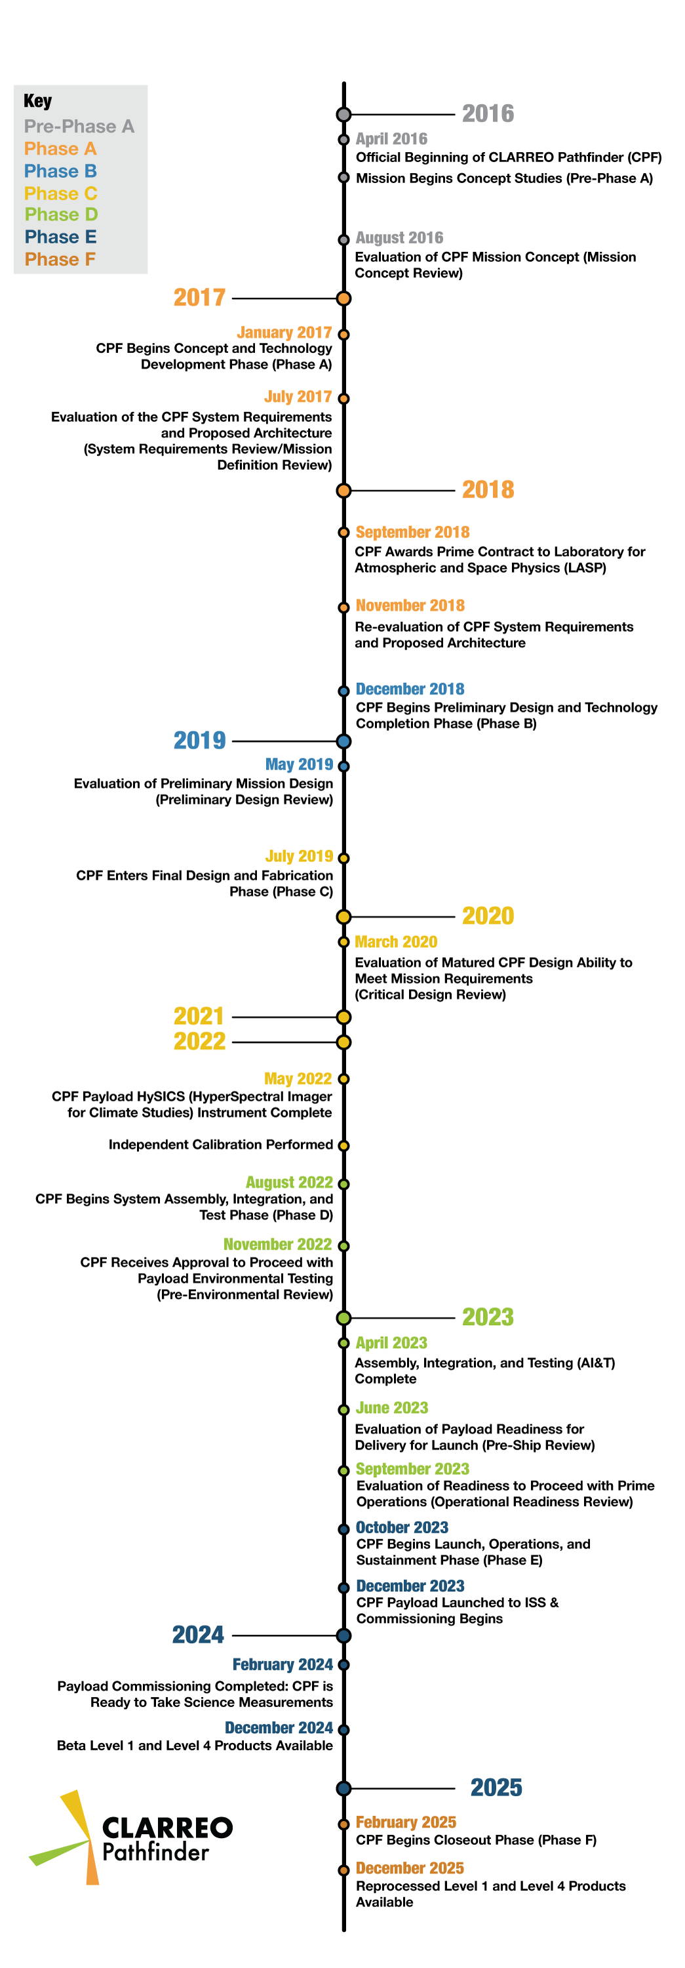
CLARREO Pathfinder Schedule
Key Dates – Prime Mission
  ~December 2023: Launch!
  February 2024: Start Science Operations
  October 2024: Beta L1 Data Products Available
  December 2024: Beta L4 Data Products Available
  December 2024: Estimated start timeframe of CPF Science Team
Possible Extended Mission
  ISS Occupancy through 2027
  Tentative ISS Occupancy through 2030

Slide 5
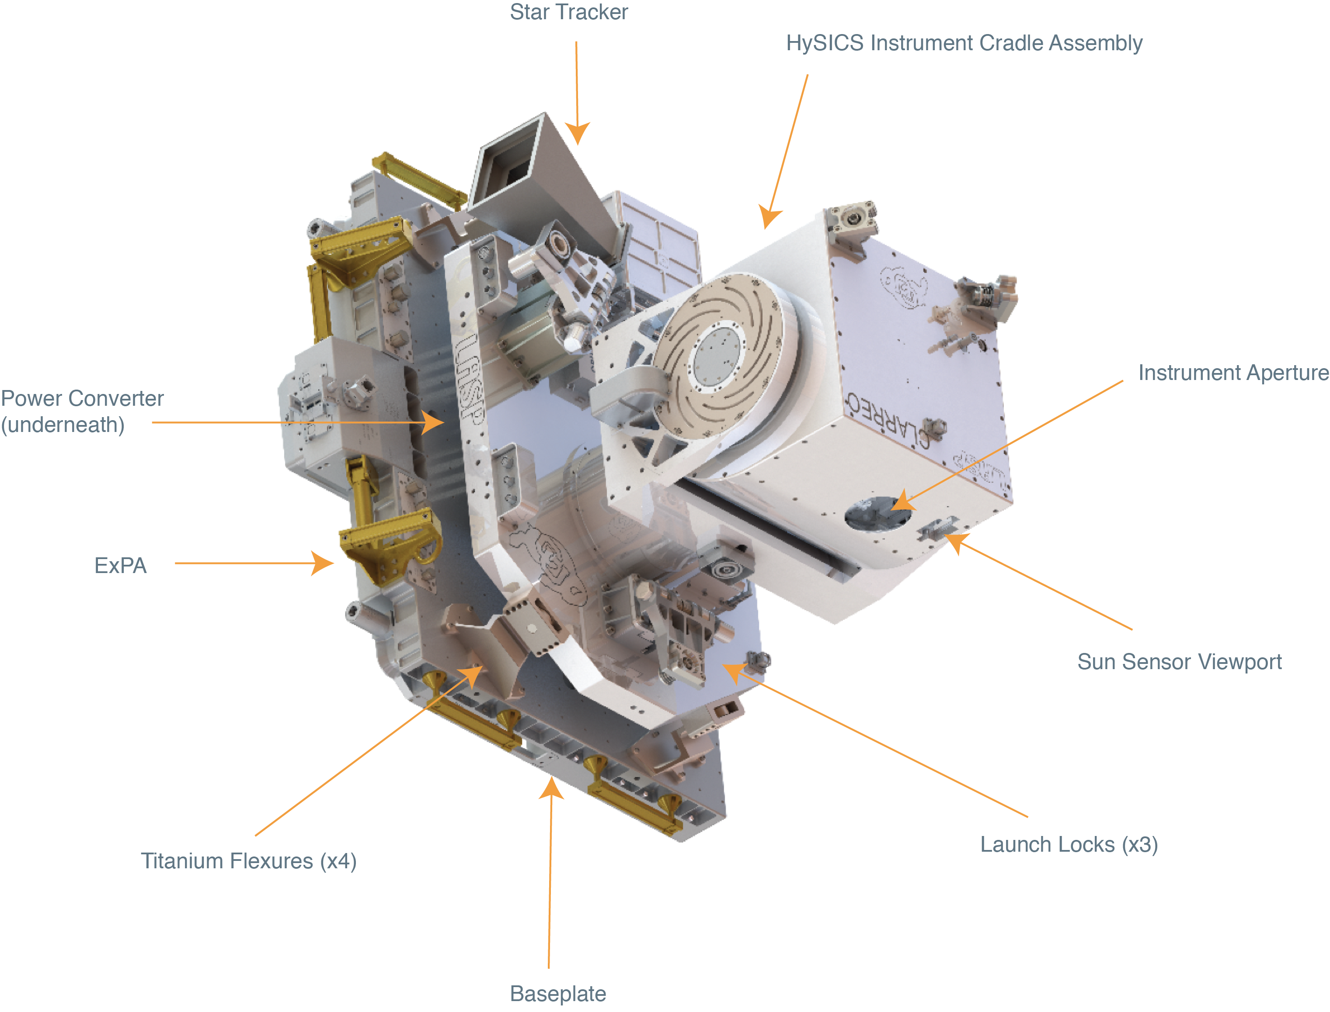
LASP Leadership: CLARREO Pathfinder Payload
HySICS: Hyperspectral Imager for Climate Science
Radiometric Uncertainty | 0.3% (1-sigma)
Spectral Range | 350 nm – 2300 nm
Spectral Sampling | 3 nm
Swath Width | 10° (70 km nadir)
Spatial Sampling | 0.5 km
Sampling Rate | 15 Hz
https://clarreo-pathfinder.larc.nasa.gov/

Slide 6
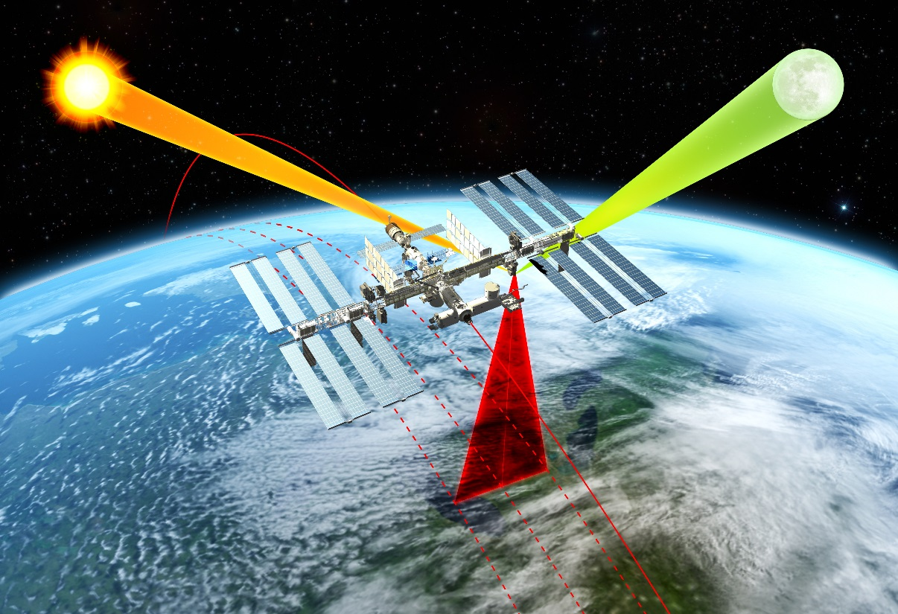
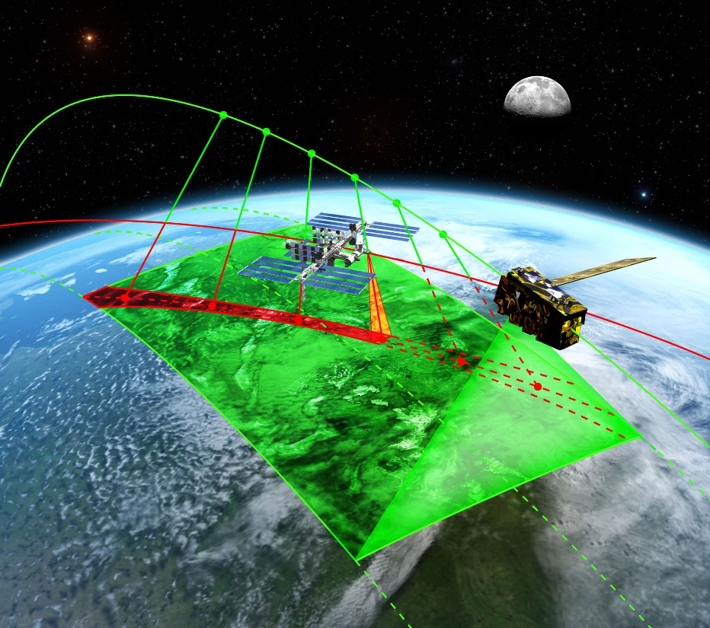
CPF Science Objectives
Objective #1: High Accuracy SI-Traceable Reflectance Measurements
Objective #2: Inter-Calibration Capabilities
Demonstrate ability to transfer calibration other key RS satellite sensors by inter-calibrating with CERES & VIIRS.
Demonstrate on-orbit calibration ability to reduce reflectance uncertainty by a factor of 5-10 times compared to the best operational sensors on orbit.
 | Objective #1 | Objective #2
Uncertainty | Spectrally-resolved & broadband reflectance: ≤0.3% (1σ) | Intercalibration Methodology Uncertainty: ≤0.3% (1σ)
Data Product | Level 1A: Highest accuracy, best for inter-cal, lunar obs Level 1B: Approx. consistent spectral & spatial sampling, best for science studies using nadir spectra | Level 4: One each for CPF-VIIRS & CPF-CERES inter-cal. Merged data products including all required info for inter-cal analysis
https://clarreo-pathfinder.larc.nasa.gov/

Slide 7
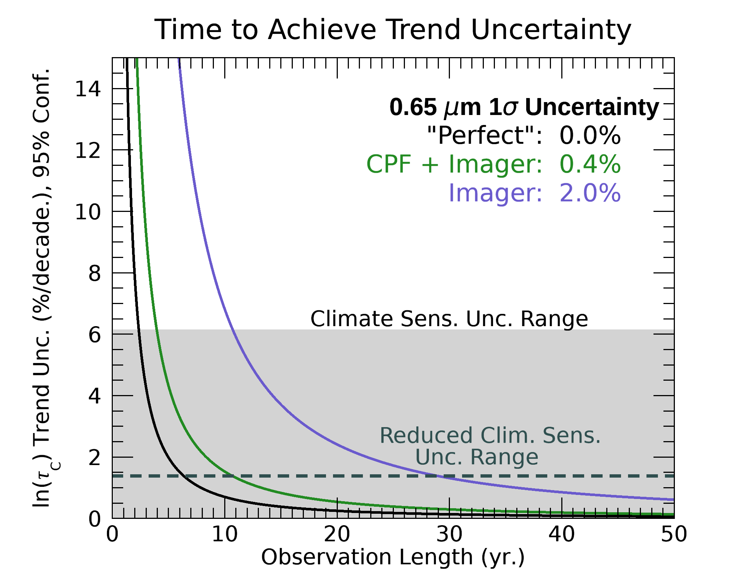
CLARREO Pathfinder is Critical for Observing Climate
High accuracy, information-packed measurements are critical for both detecting climate change and identifying what is driving Earth’s changing climate.
High Accuracy Benefits (5-10x better than current sensors)
Provides an on-orbit reference for other sensors (via Inter-calibration)
Gap Resistance for Earth observations
  Calibration with SI-traceability reduces risks of potential gaps in monitoring Earth’s climate
Enables the beginning of climate benchmark
Inter-calibration Benefits
Studies show that CPF + Imager Inter-calibration enables faster detection of essential climate variable trends as shown on the right (e.g.)
Enables reduced on-orbit calibration uncertainty of other Earth-observing instruments, thus offering the potential to also improve their data product quality
20 Years Faster
with CPF
Shea et al., 2017

Slide 8
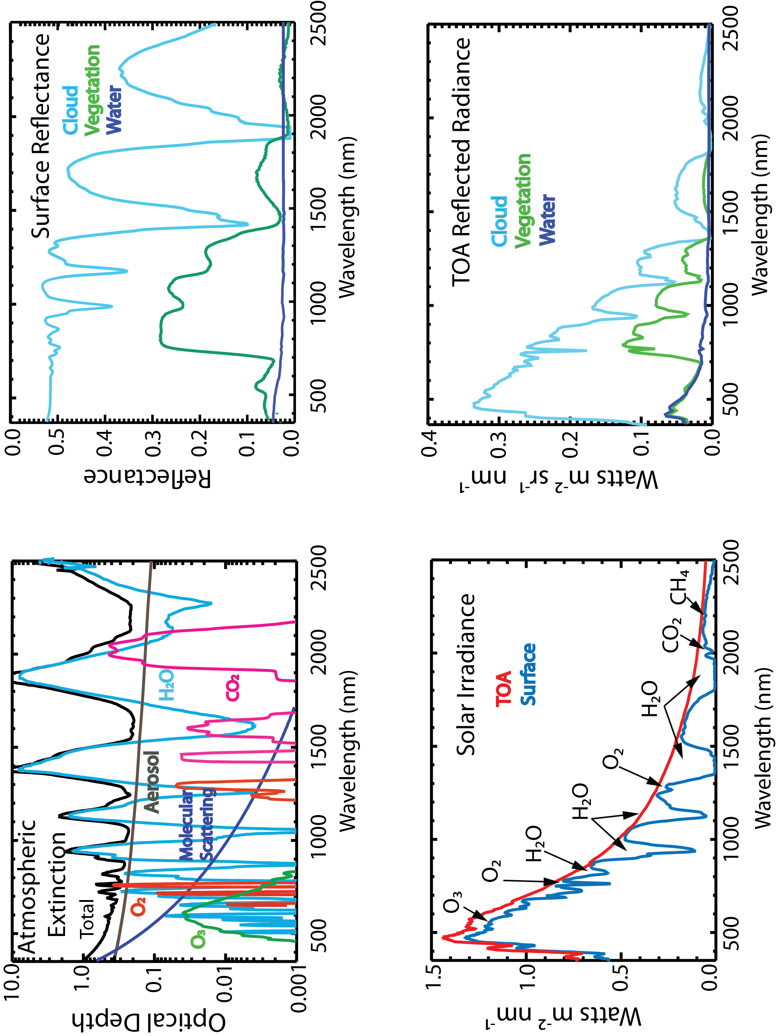
Nadir CPF Hyperspectral Measurements
High accuracy, information-packed measurements are critical for both detecting climate change and identifying what is driving Earth’s changing climate.
Hyperspectral Benefits (350-2300 nm)
Several key geophysical variables have slowly varying spectral signatures
The spectral information enables novel studies
  Develop hyperspectral geophysical retrieval algorithms (e.g. getting vertical info of cloud effective particle size [Zhang & Platnick, 2011])
  Augment Information in existing retrieval algorithms [Coddington et al., 2012; 2017]
  TOA Hyperspectral Scene Classification Studies [e.g. Roberts et al., 2011]
  Development of a climate benchmark prototype

Slide 9
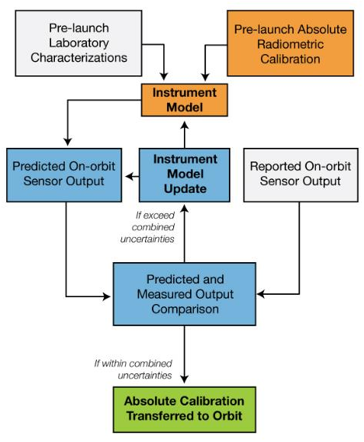
GSFC Partnership: CPF Independent Calibration Effort
Supports demonstration that the HySICS ratioing radiometer approach provides CLARREO-level accuracy
An independent calibration traceability relying on the traditional pathway using a laboratory & detector-based absolute radiometric calibration
Provides an independent test of CPF's calibrated product with minimal cost and schedule impact to project
  Strong collaborative effort between instrument developer (CU/LASP) and project
  Requires a multi-agency and multi-center efforts to be successful
https://clarreo-pathfinder.larc.nasa.gov/

Slide 10
Versatility in CPF Observations
Launch-Ready: Late 2023
Prime Mission Ops
Extended Mission Ops (TBD)
Observation Type | 1-Year Mission | 1+ Years
On-orbit Instrument Calibration | Demonstrate success of calibration approach over 1 year | Confirm success of calibration approach over longer period
Earth Reflectance and Radiance Nadir Spectra | Will be used to demonstrate achieved calibration, geolocation, etc requirements | Develop partial (nearly-global) climate benchmark prototype Potential for overlap with TRUTHS Additional opportunities for use in science studies
LEO On-orbit Inter-calibration | Measurements and data analysis for CERES and VIIRS Only | Additional flexibility to inter-calibrate other on-orbit LEO sensors (e.g. PACE, Sentinel, Landsat, etc)
GEO On-orbit Inter-Calibration | Demonstration measurements with 1 GEO | Expand GEO inter-calibration measurements (e.g. TEMPO, GOES, GERB, Himawari series, GeoCarb)
Enhanced Land/DCC Pseudo-Invariant Calibration Site (PICS) Characterization | Measurements over high priority PICS | Additional PICS added with additional viewing opportunities
Improved characterization of the Moon | Leveraging existing ops mode to cover libration and phase angles available | Additional sampling within libration and phase angles to further make lunar models more robust
https://clarreo-pathfinder.larc.nasa.gov/

