Slide 1
Inter-calibration RSR Difference Corrections
Benjamin Scarinoª, David R. Doelling^{b}, Arun Gopalanª, Thad Cheeª, Rajendra Bhattª, and Conor Haneyª
ªSSAI, One Enterprise Pkwy Ste 200, Hampton, VA 23666 USA
^{b}NASA Langley Research Center, 21 Langley Blvd MS 420, Hampton, VA 23681-2199 USA
CLARREO Pathfinder Inter-Calibration Workshop
16 November 2017 NIA, Hampton, VA

Slide 2
Outline
Purpose
Spectral Band Adjustment Factor (SBAF)
Accounts for inter-calibration relative spectral response (RSR), or spectral response function (SRF), disparities
Overview
Applications
Online SBAF Tools
SCIAMACHY
GOME-2
Hyperion
IASI
AIRS
Other Tools
Spectral response function comparison tool
Visible band solar constant comparison tool
Earth-spectra plotting tool
Summary

Slide 3
Purpose
Provide SBAF tools for the GSICS and calibration communities
Goal: Consistent inter-sensor calibration and retrievals
Customizable
Based on hyperspectral datasets
Capture scene conditions during inter-calibration events
Single web location for SBAFs based on best practices of the community
Success dependent on feedback
Inputs desired from users
New/updated/recommended SRFs
New/recalibrated/updated versions, hyperspectral datasets, and/or paramaters
Welcoming suggestions
Spectral domains or scene types
Tool features
New subsetting options
Interface changes
Plotting controls

Slide 4
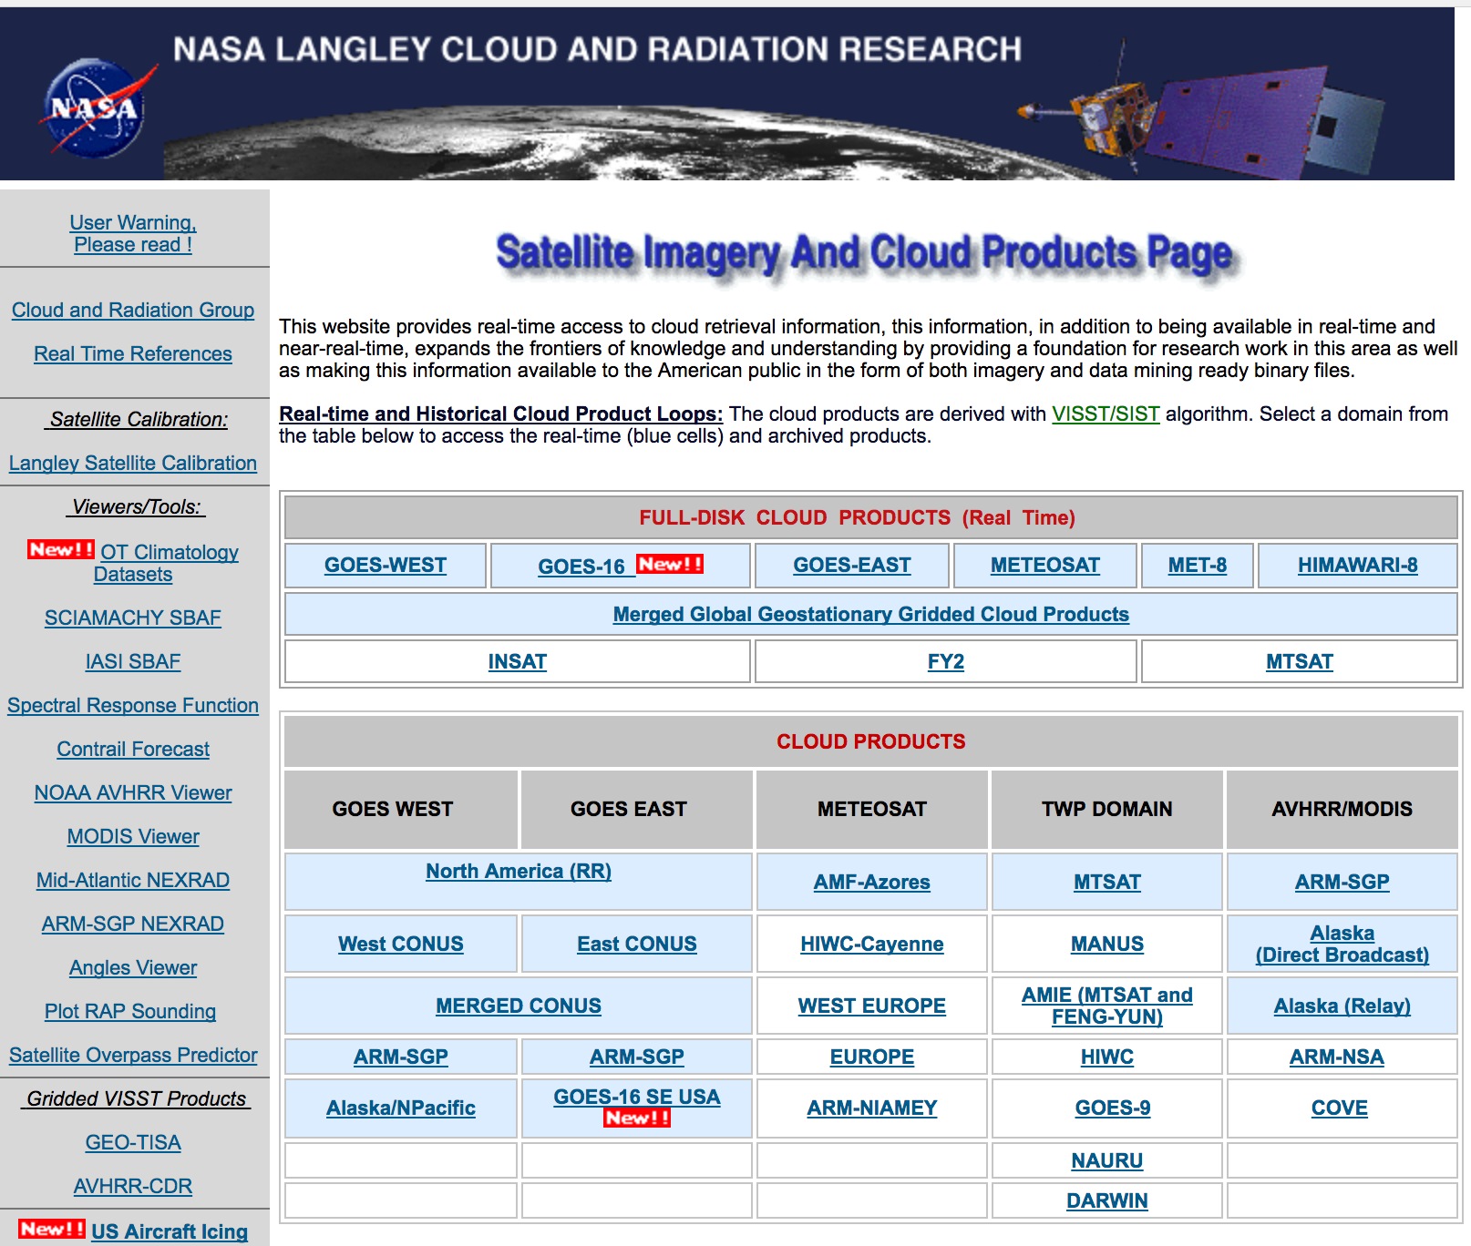
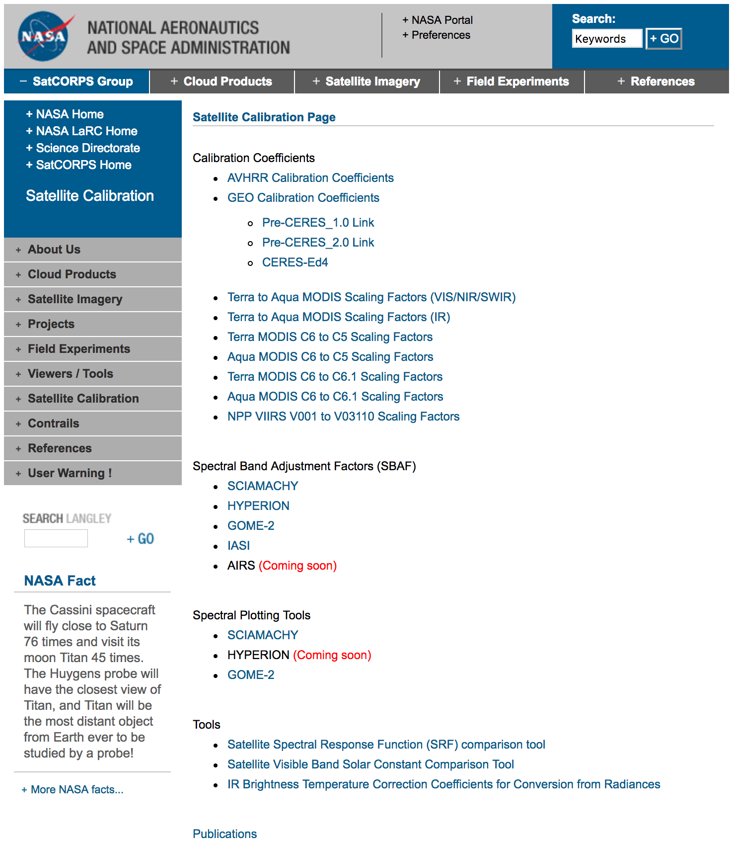
NASA Langley Satellite Calibration Webpage
https://satcorps.larc.nasa.gov
https://satcorps.larc.nasa.gov/cgi-bin/site/showdoc?mnemonic=SAT_CALIB_USER

Slide 5
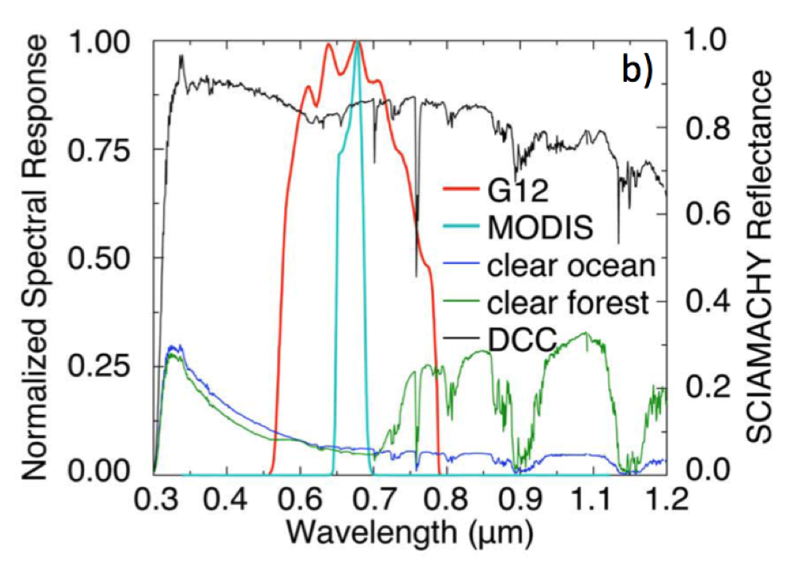
Spectral Band Adjustment Factor (SBAF)
Every Earth scene has a unique spectral reflectance signature
Derive reference- and target-sensor pseudo radiance/reflectance (L_{p}) via hyperspectral convolution over each RSR to account for band difference/out-of-band absorption
Derive reference- and target-sensor pseudo radiance/reflectance (L_{p}) via hyperspectral convolution over each RSR to account for band difference/out-of-band absorption

Slide 6
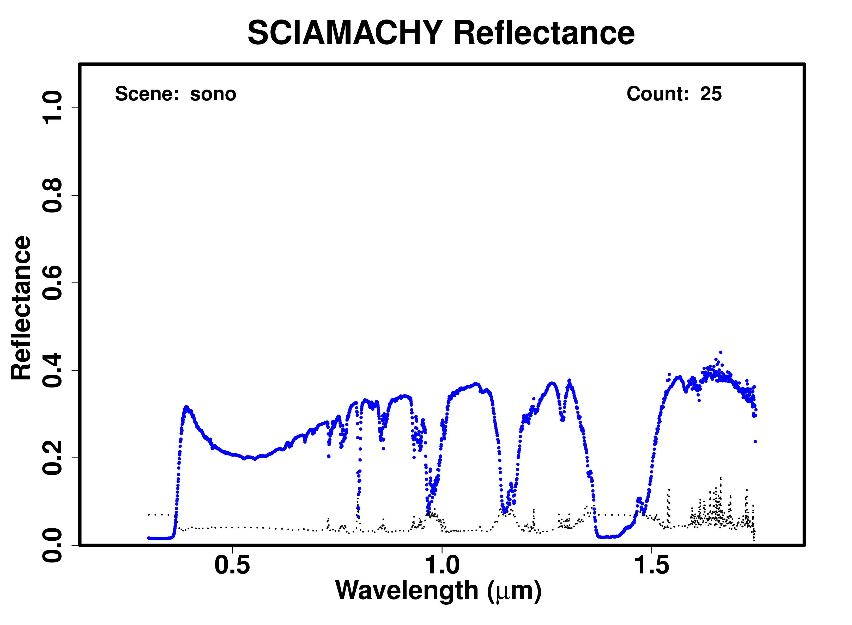
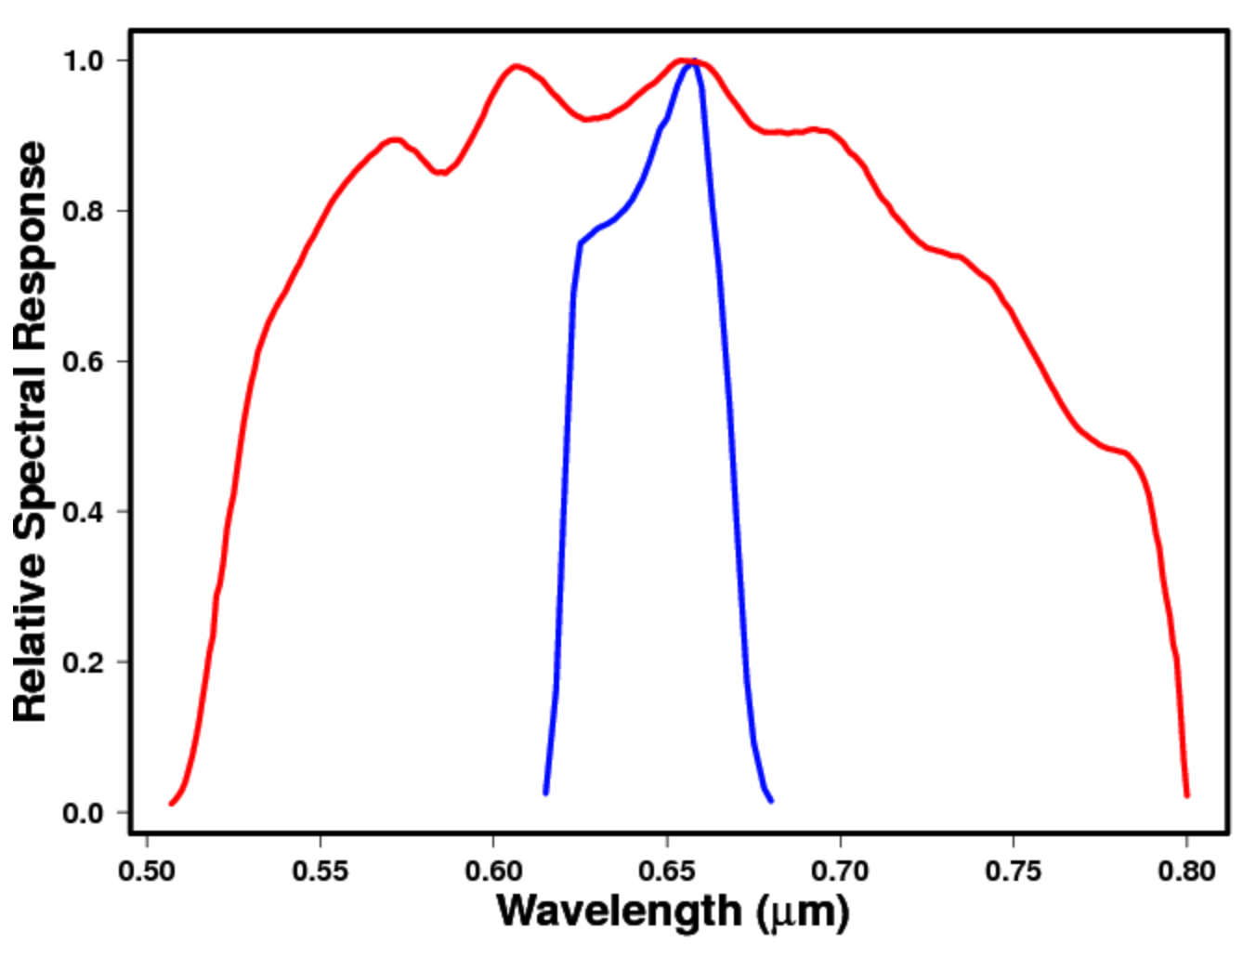
Spectral Band Adjustment Factor (SBAF)
Earth spectra plotting tool
(Sonoran Desert)
Spectral response function comparison tool
Derive Aqua-MODIS B1 and GOES-12 Ch1 pseudo radiance/reflectance (L_{p}) via SCIAMACHY convolution over each RSR to account for band difference/out-of-band absorption

Slide 7
SCIAMACHY-based Visible SBAF Tool
Regression coefficient(s) define the SBAF
L_{Met-9-equivalent,MODIS} = A2xL_{Actual,MODIS}² + A1xL_{Actual,MODIS} + A0

Slide 8
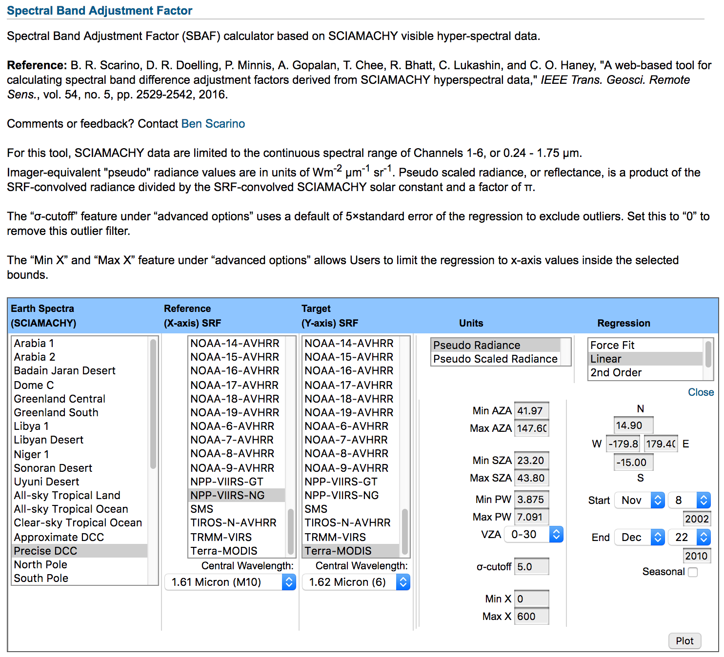
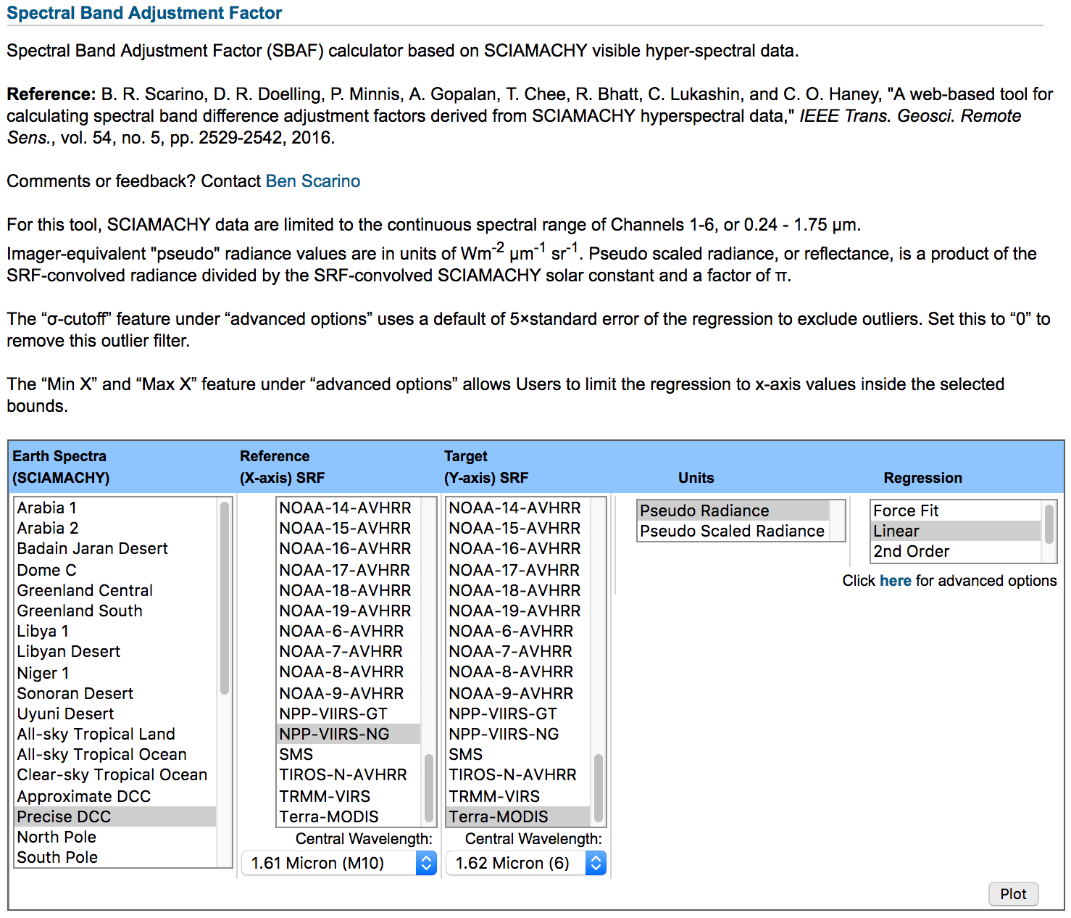
SCIAMACHY-based Visible SBAF Tool
Choose from common Earth target (e.g., desert PICS, DCC, IGBP)
Full database of instrument/channel RSRs
Units in either radiance or reflectance
Linear or non-linear characterization
SBAFs computed on the spot
Advanced subsetting options can lead to reduce SBAF uncertainty for known conditions

Slide 9
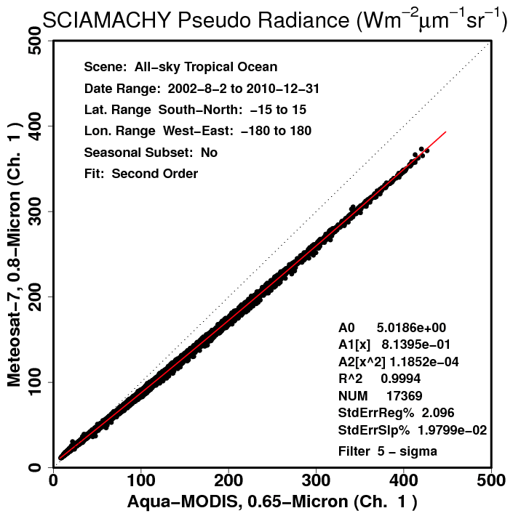
SCIAMACHY-based Visible SBAF Tool
All-sky Tropical Ocean
Met-7 pseudo radiance from convolution of Met-7 Ch. 1 SRF over the SCIAMACHY footprint spectra
Bright Clouds
Clear-sky Ocean
Regression coefficient(s) define the SBAF
L_{Met-7-equivalent,MODIS} = A2xL_{Actual,MODIS}² + A1xL_{Actual,MODIS} + A0

Slide 10
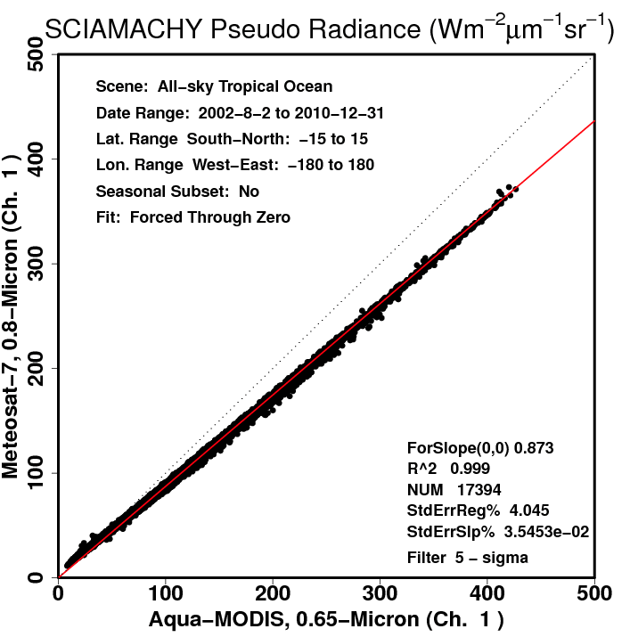
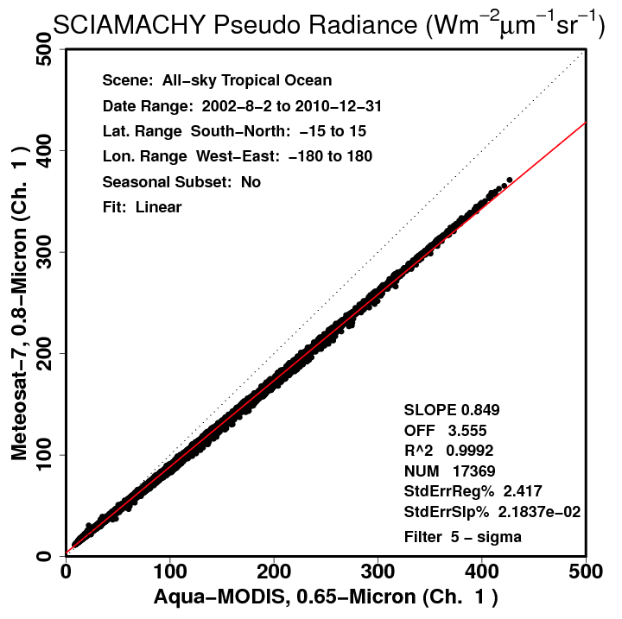
SBAF Dependency on Scene
Force Fit
Linear
2nd order
All-sky tropical ocean (ATO) SBAF is a function of scene type
Unique SBAF for clear ocean
Unique SBAF for clouds
Unique SBAF for thick clouds
Radiance is dependent on the scene type
2nd-order fit accurately defines an SBAF that represent the multiple scene conditions
Regression | StdErr (%)
Linear through 0 | 4.0
Linear | 2.4
2nd order | 2.10
3rd order | 2.07

Slide 11
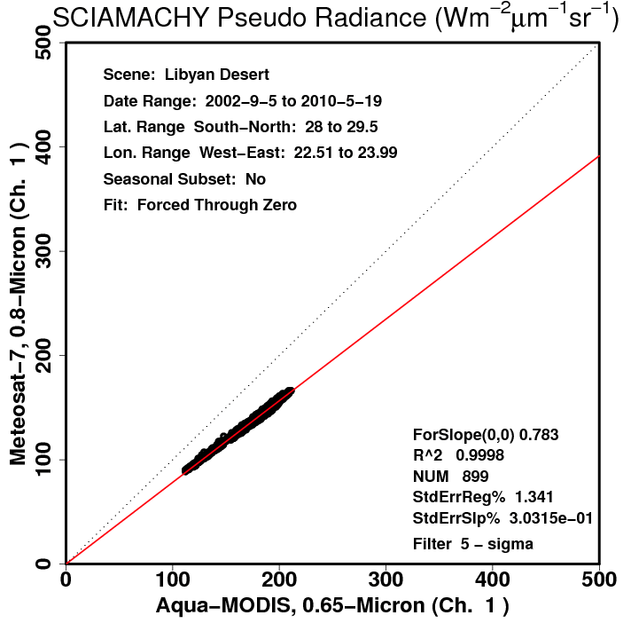
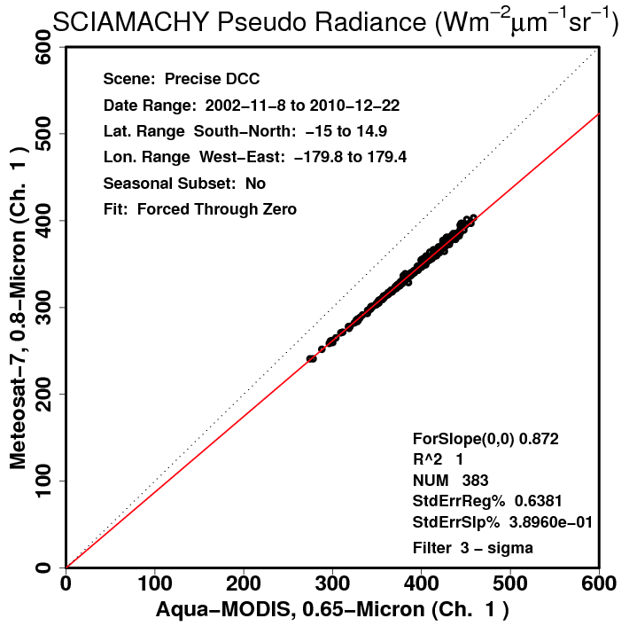
SBAF Dependency on Scene
Libyan Desert
Deep Convective Clouds
Scene Type | SBAF
Clear ocean (ATO) | 0.912
Bright cloud (ATO) | 0.880
Libyan Desert (annual) | 0.783
DCC | 0.872
Equal reflectance | 0.876
10% spectral-band-induced radiance difference between DCC and the Libyan Desert
DCC SBAF and equal reflectance (convolution over the solar constant) are similar because DCC are spectrally flat

Slide 12
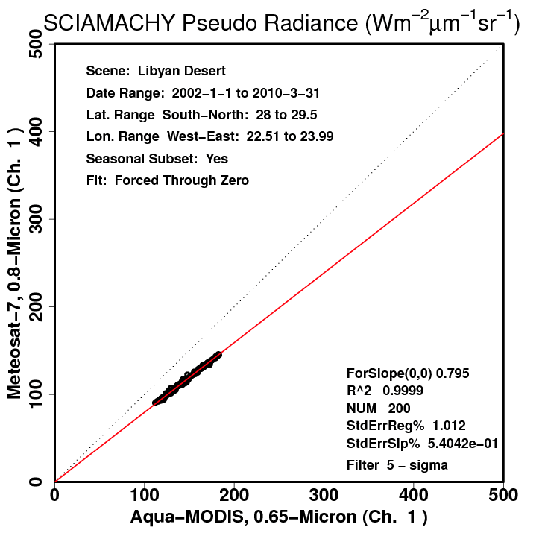
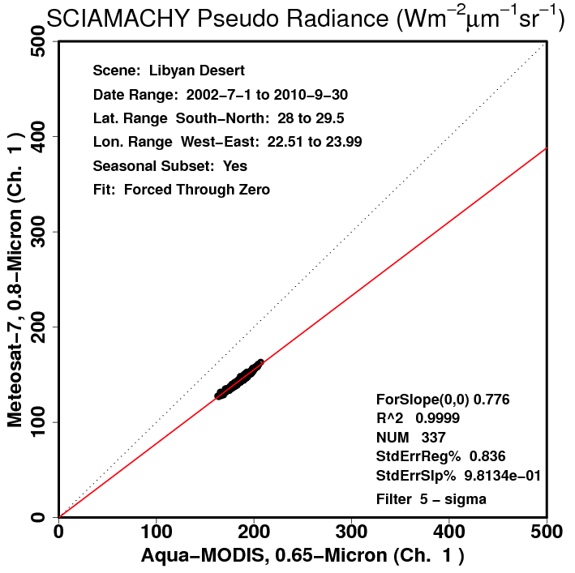
Seasonal/PW Spectral Dependency
Winter
Summer
Libya | SBAF | SE (%)
Winter | 0.795 | 1.01
Spring | 0.788 | 1.08
Summer | 0.776 | 0.84
Fall | 0.780 | 1.06
Annual | 0.783 | 1.34
Libyan Desert seasonal SBAFs have reduced uncertainty compared to annual
Likely due to the seasonal water vapor burden (highest in summer)
I.E. - 2.4% Libya-4 SBAF difference between summer and winter seasons

Slide 13
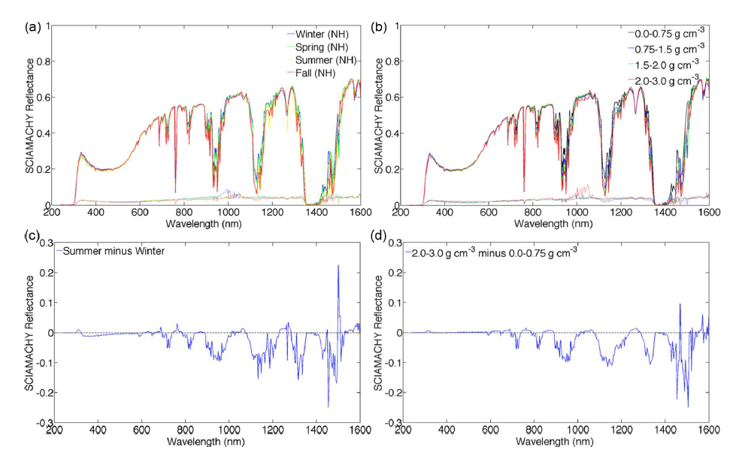
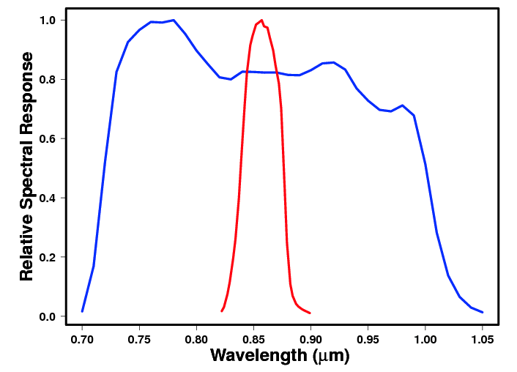
Seasonal/PW Spectral Dependency
Season
PW
Precipitable water (PW) load spectral difference follows seasonal spectral difference
Can have significant impact on SBAF for some bands (water absorption)

Slide 14
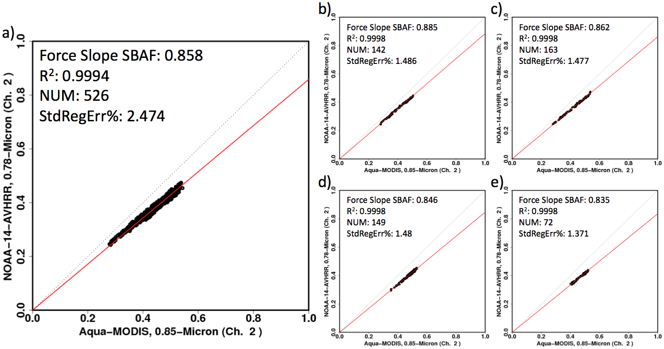
Seasonal/PW Spectral Dependency
PW: 0-0.75 g cm⁻²
PW: 0.75-1.5 g cm⁻²
PW: 0-3 g cm⁻²
PW: 1.5-2 g cm⁻²
PW: 2-3 g cm⁻²
a) Simple forced linear SBAF for Libyan Desert for a full PW range
b-e) SBAFs for specified precipitable water intervals: 6% ΔSBAF
Uncertainy for each subset less than overall uncertainty
SBAF changes systematically with adjusted precipitable water

Slide 15
Applications
0.4%
2.7%
ATO-RM
ATO-RM
SBAF reduces relative gain difference of multiple independent calibration methods over various Earth spectra

Slide 16
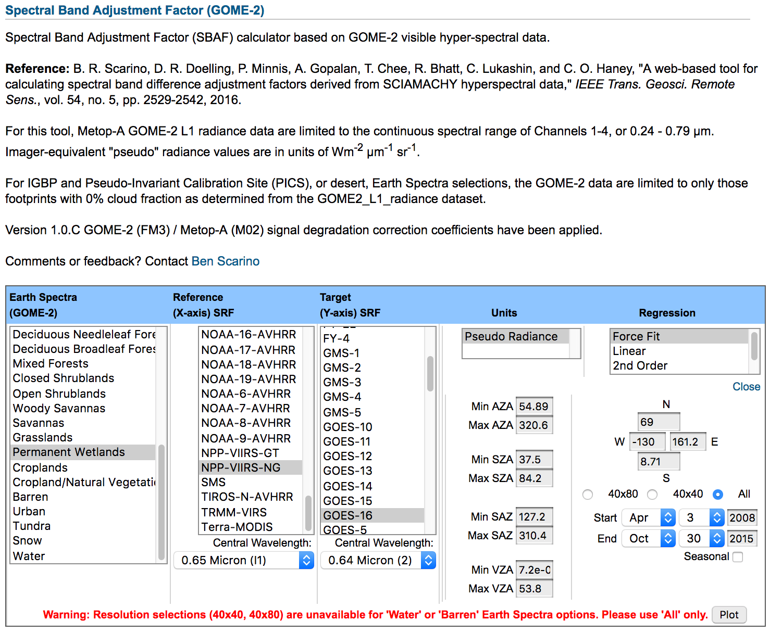
GOME-2-based Visible SBAF Tool
Currently based on 4 seasonal months from 2008 and 2015
Balance between sampling and processing time
GOME-2 SBAF based on smaller footprint than SCIAMCHY
40x80 km² before July 2013
40x40 km² after July 2013
SCIAMACHY is 30x240 km²
Homogeneity more likely in smaller footprints

Slide 17
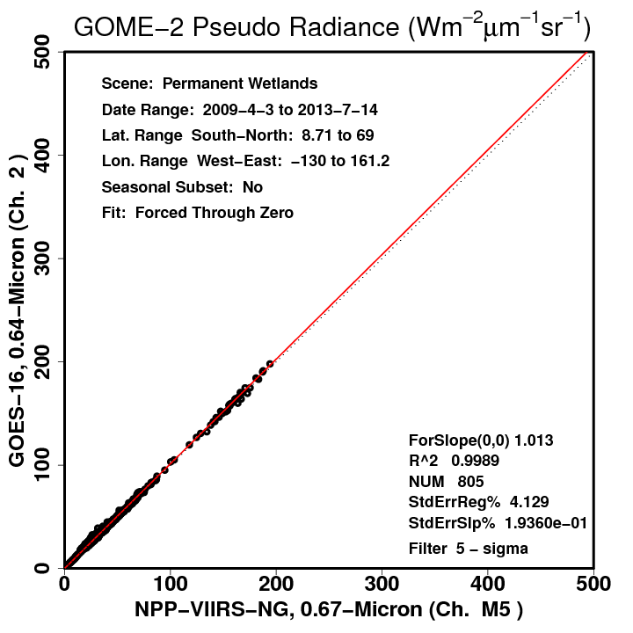
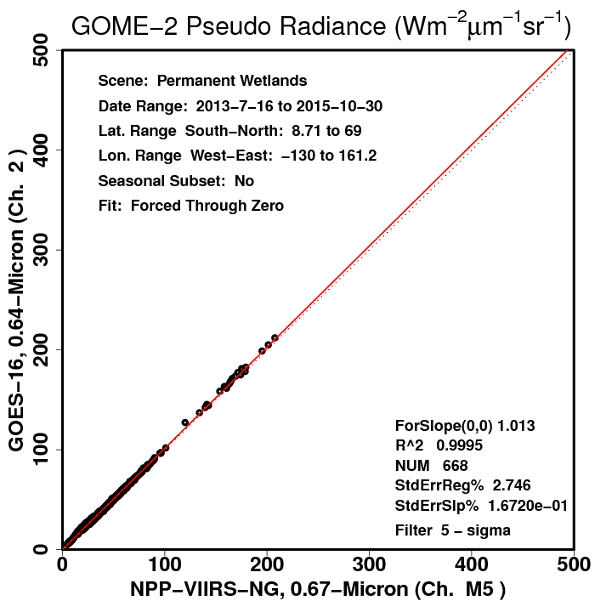
GOME-2-based Visible SBAF Tool
40x80 km²
40x80 km²
40x40 km²
40x40 km²
SBAF uncertainty 1.4% smaller using smaller footprints
SBAF does not change, however

Slide 18
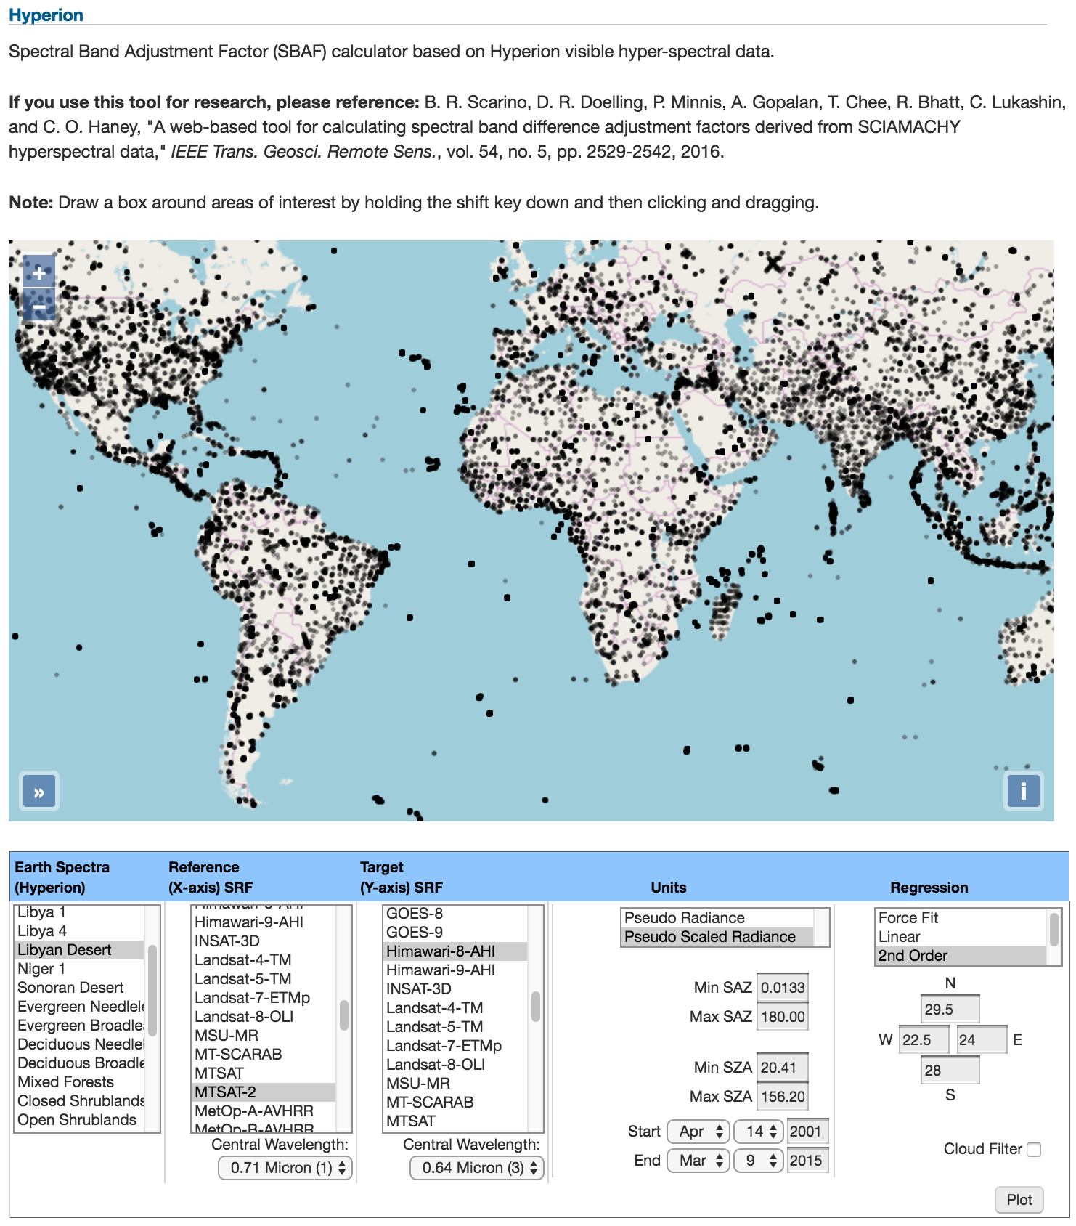
Hyperion-based Visible SBAF Tool
Map displays entire record of Hyperion ground measurements
Irregular distribution due to nature of tasked retrieval

Slide 19
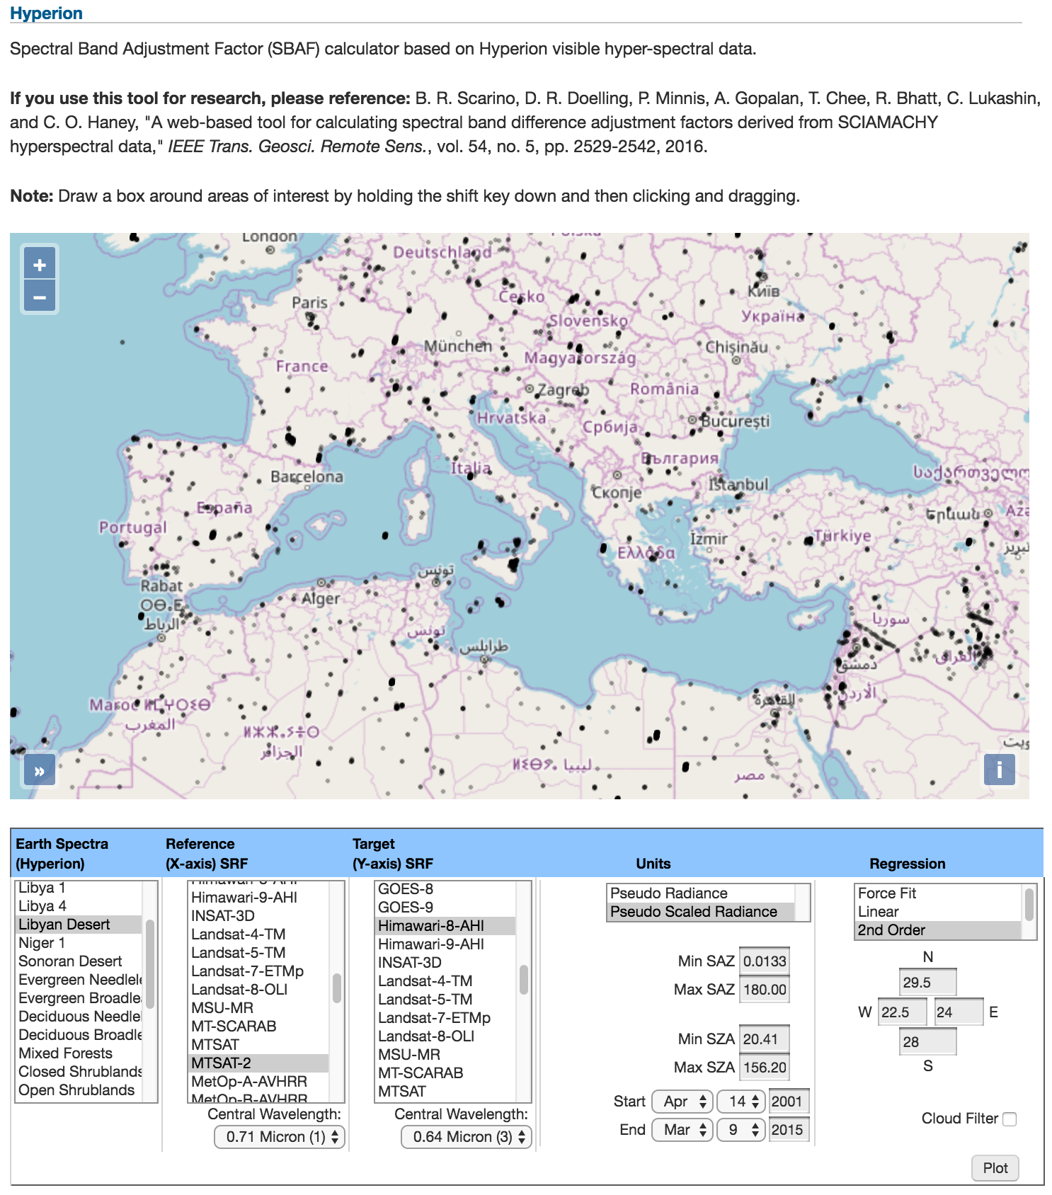
Hyperion-based Visible SBAF Tool
Map displays entire record of Hyperion ground measurements
Irregular distribution due to nature of tasked retrieval
Choose from pre-selections, enter own coordinates, or draw a box

Slide 20
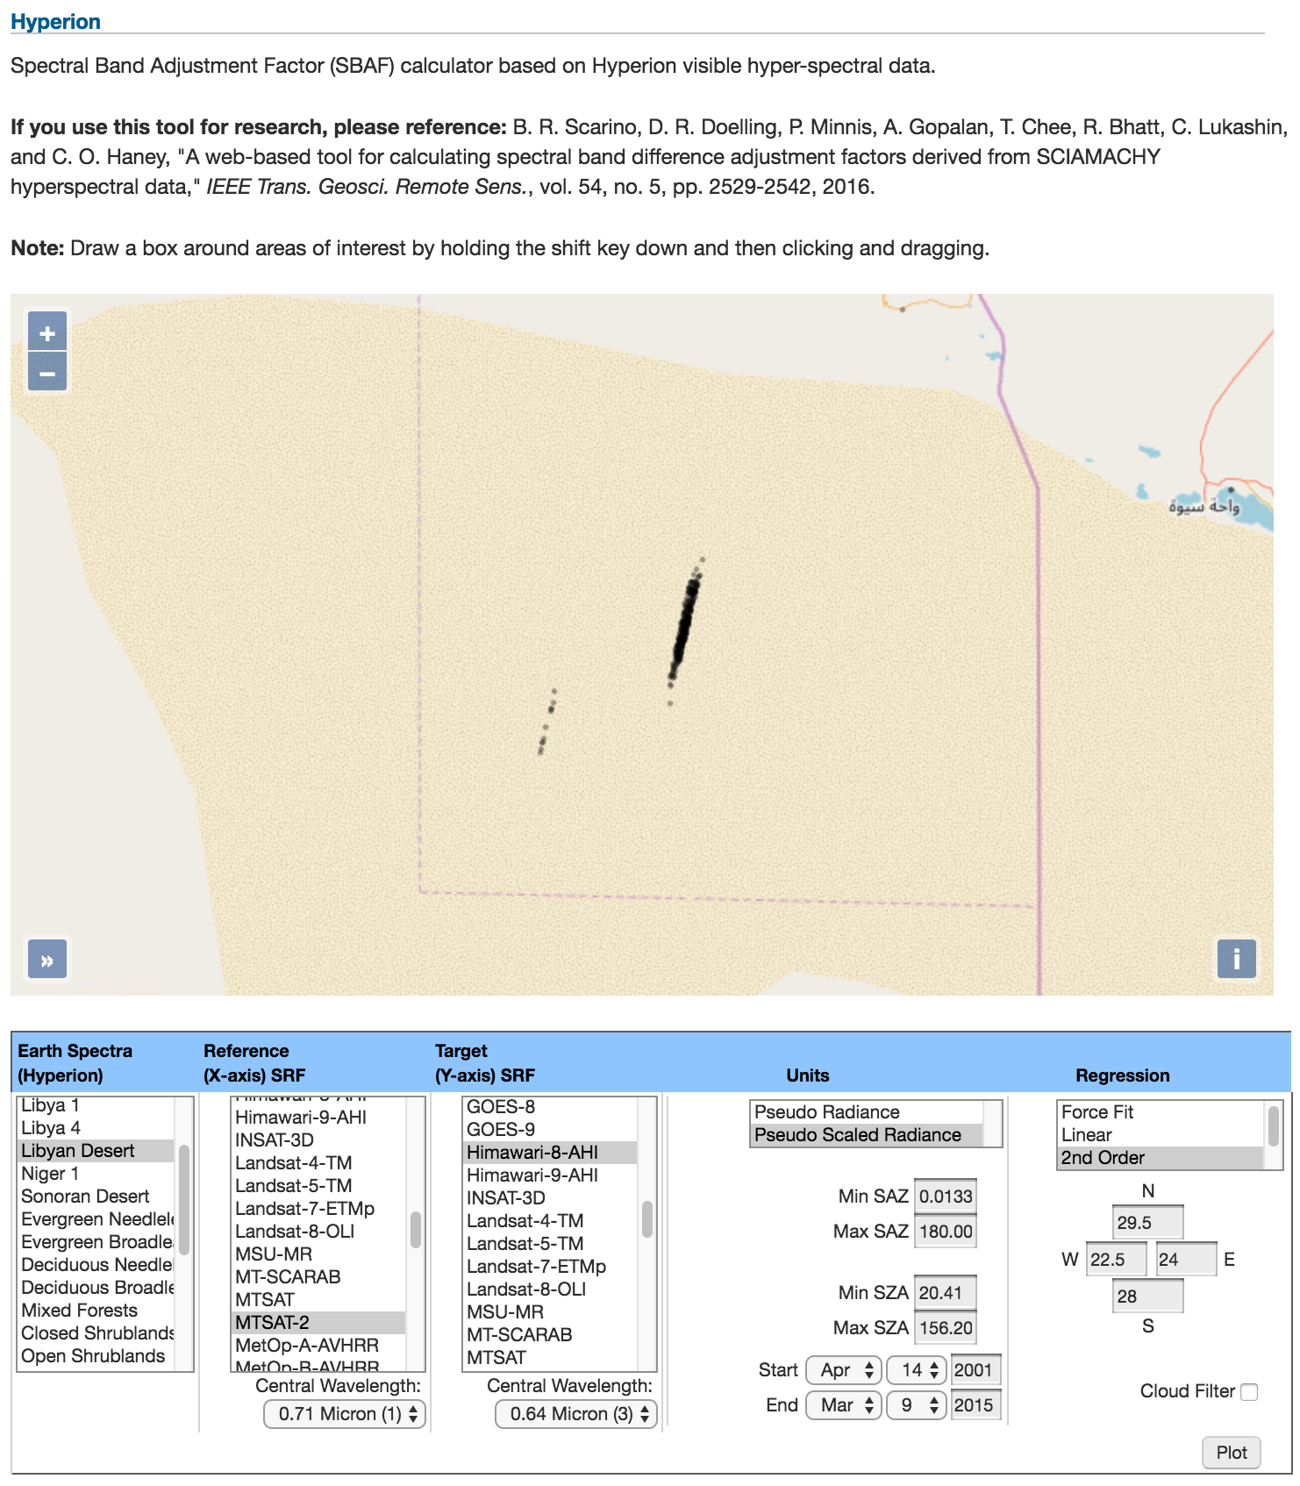
Hyperion-based Visible SBAF Tool
Map displays entire record of Hyperion ground measurements
Irregular distribution due to nature of tasked retrieval
Choose from pre-selections, enter own coordinates, or draw a box
Can be very selective

Slide 21
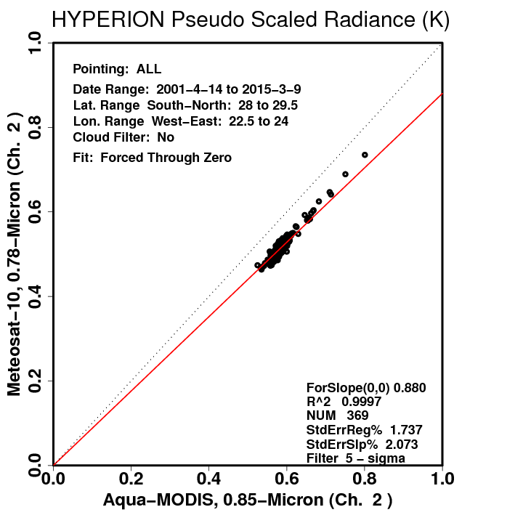
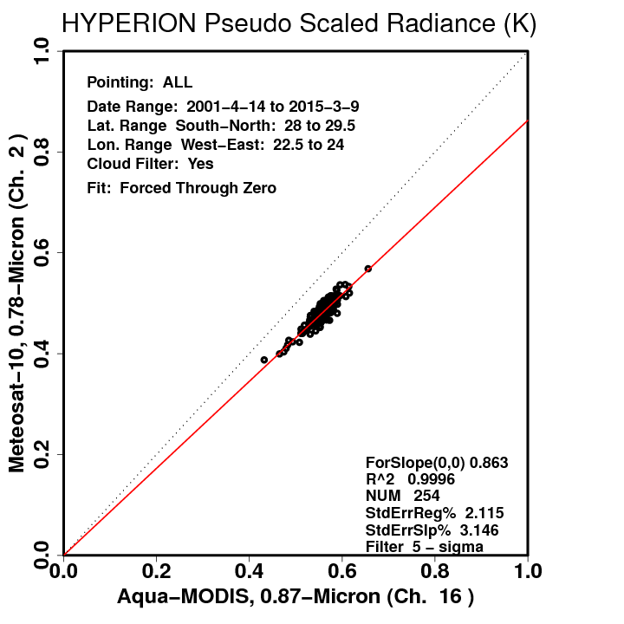
Hyperion-based Visible SBAF Tool
No Cloud Filter
No Cloud Filter
Cloud Filter
Cloud Filter
Simple cloud filter based on standard deviation thresholds across decimated Hyperion swath
Can have significant impact on derived SBAF

Slide 22
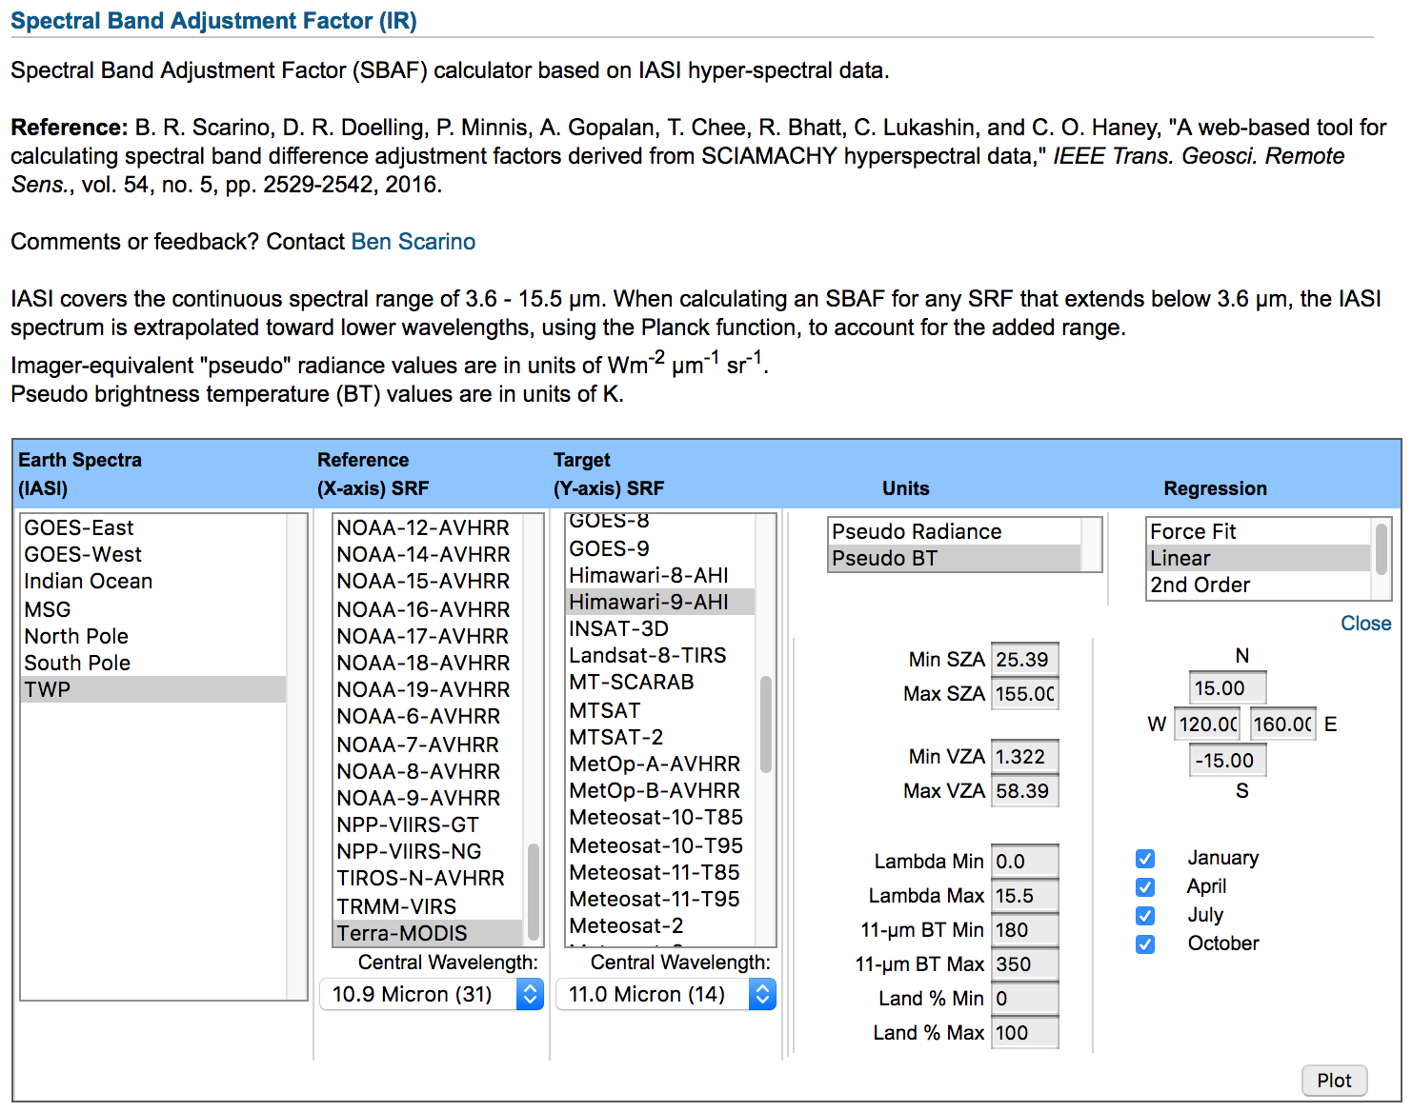
IASI-based IR SBAF Tool Update
Spectra domains geared toward satellite coverage
SBAF available in either radiance or brightness temperature units
11-μm BT subsetting, wavelength cutoff, and land mask additions driven by user requests

Slide 23
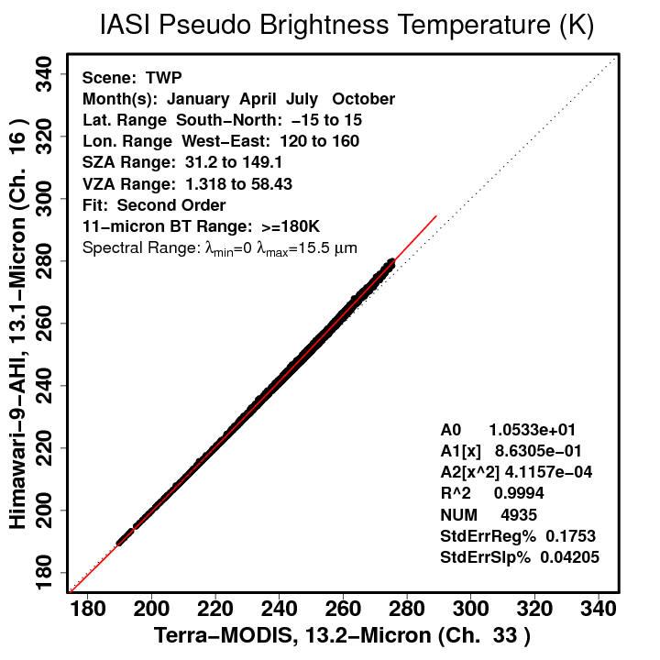
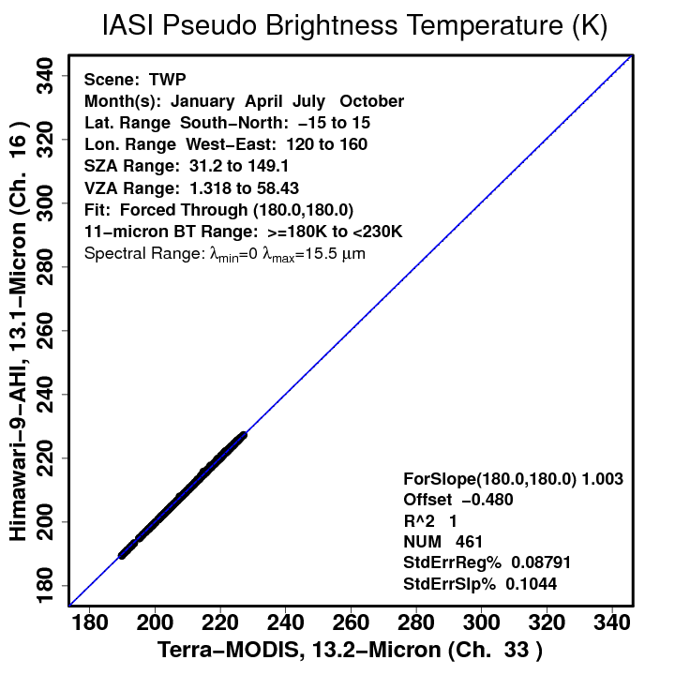
IASI-based IR SBAF Tool Update
Users conducting Overshooting Convective Top studies found it helpful to construct piece-wise SBAFs using limited ranges of 11-μm BT
Works for any channel SBAF, not just 11-μm

Slide 24
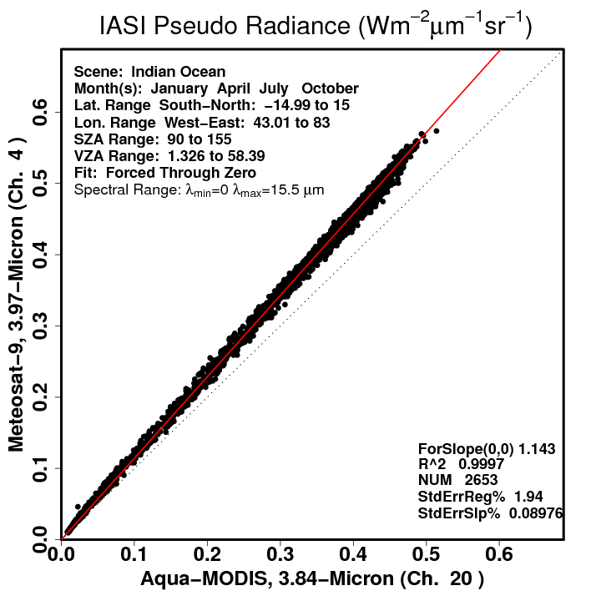
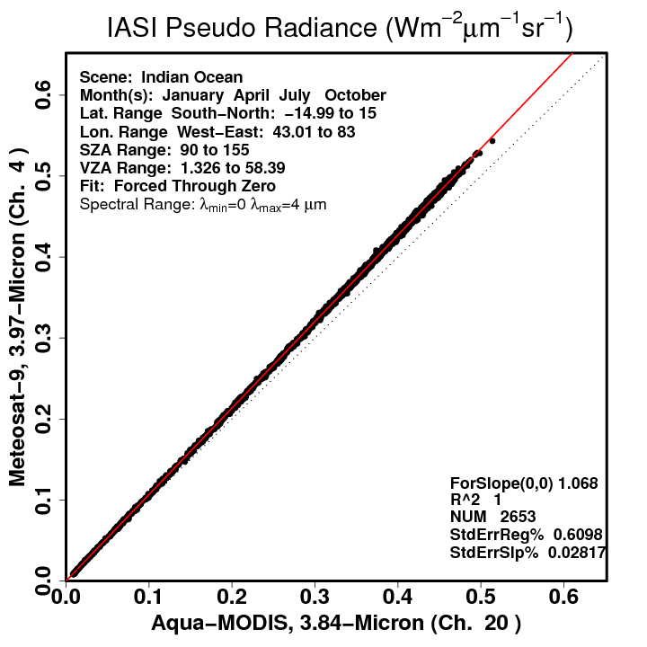
IASI-based IR SBAF Tool Update
A user suspected SBAF uncertainty was caused by CO₂ absorption band just beyond 4.0 μm

Slide 25
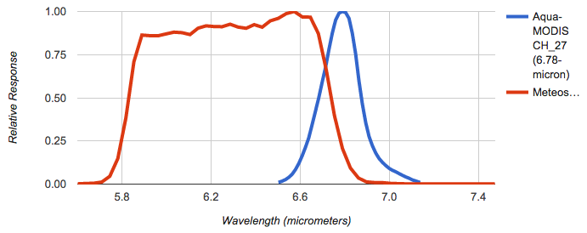
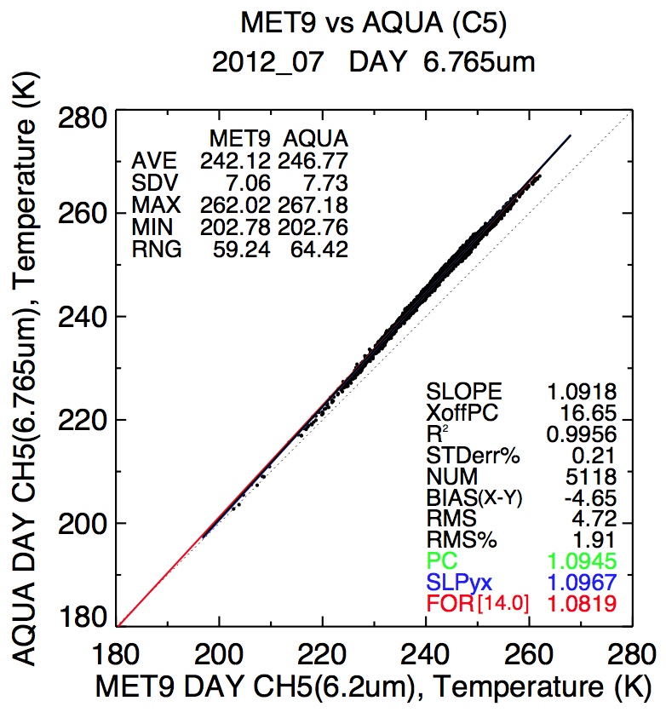
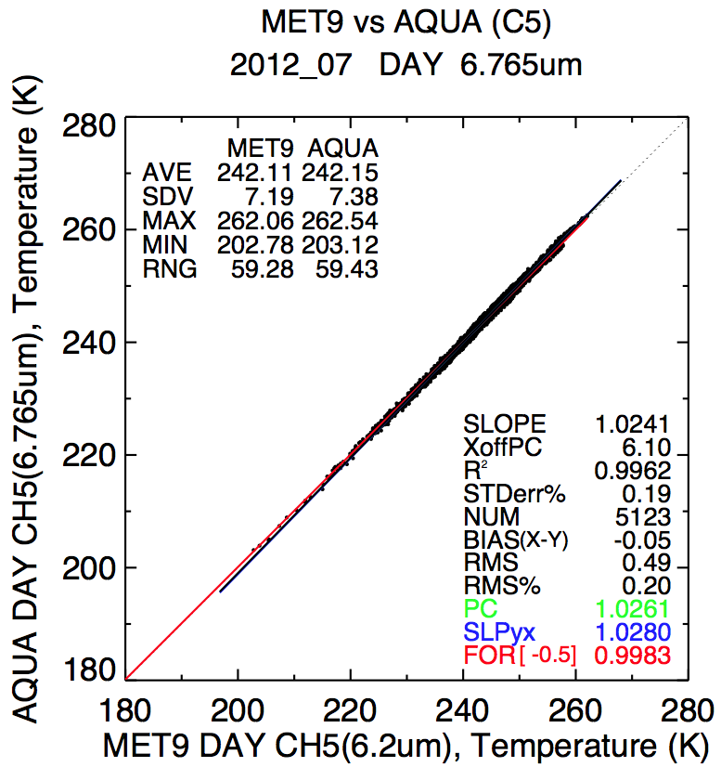
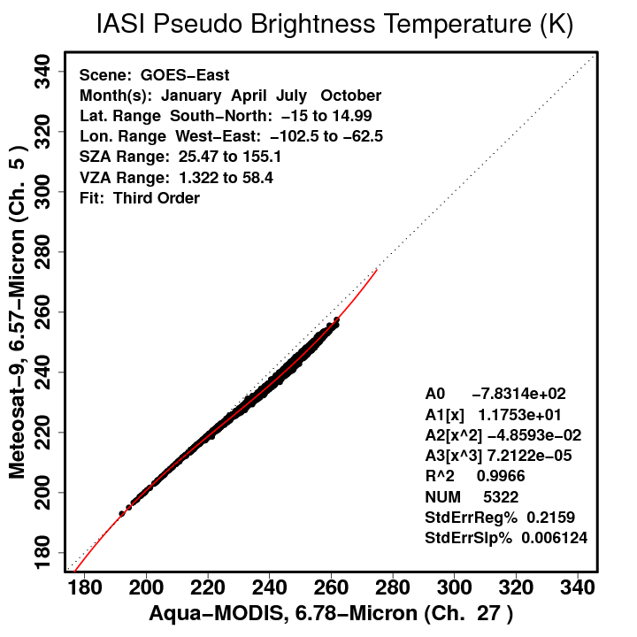
Applications
Met-9 CH_5
Before SBAF
3rd-order Adjustment
After SBAF

Slide 26
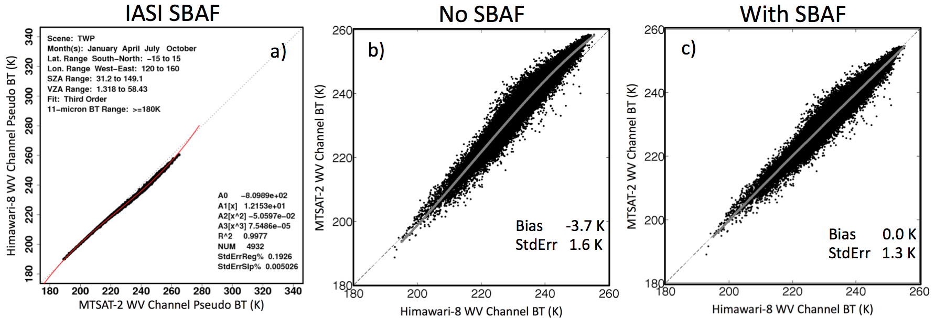
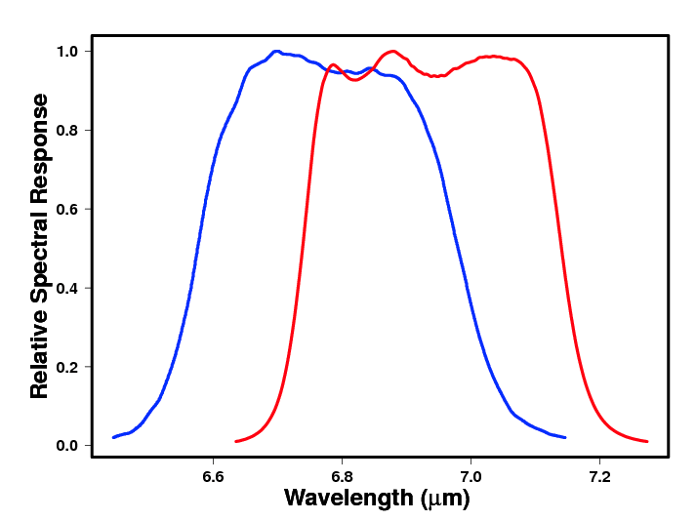
Applications
3rd-order relationship of WV channels resolved by 3rd-order SBAF application

Slide 27
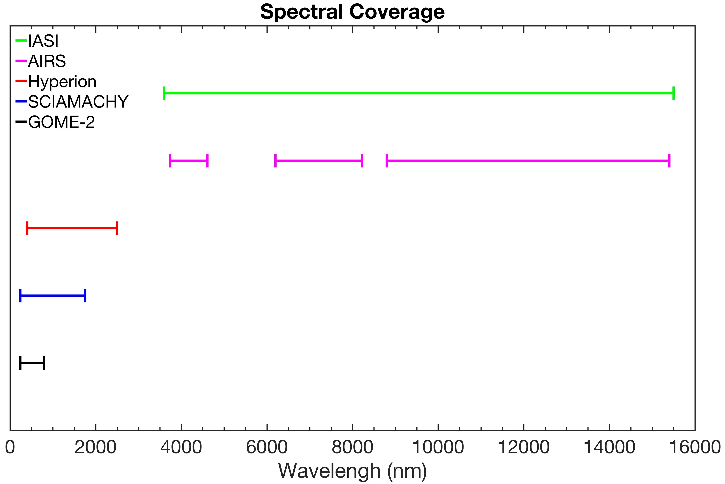
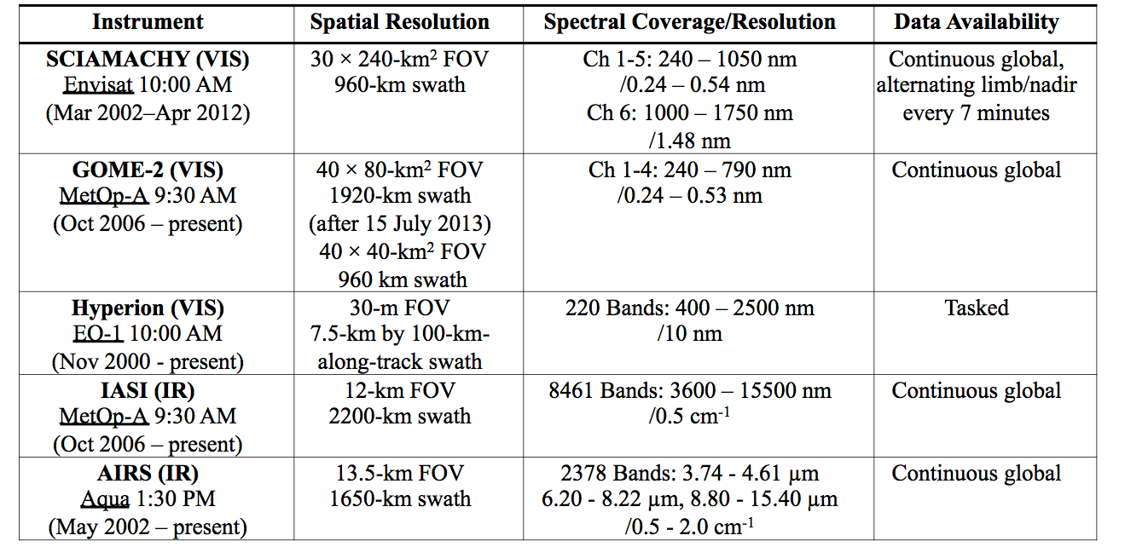
Applications
3600 – 15500 nm
3740 – 4610 nm
6200 – 8220 nm
8800 – 15400 nm
400 – 2500 nm
240 – 1750 nm
240 – 790 nm
SBAF possible for 0.24-2.50 μm via SCIAMACHY, Hyperion, and GOME-2
GOME-2 affords smaller footprint from shorter spectra range
IASI covers 3.60-15.5 μm
AIRS (NEW!) support grants enhanced scene selection for IR SBAFs
CLARREO Pathfinder, HySICS (??)

Slide 28
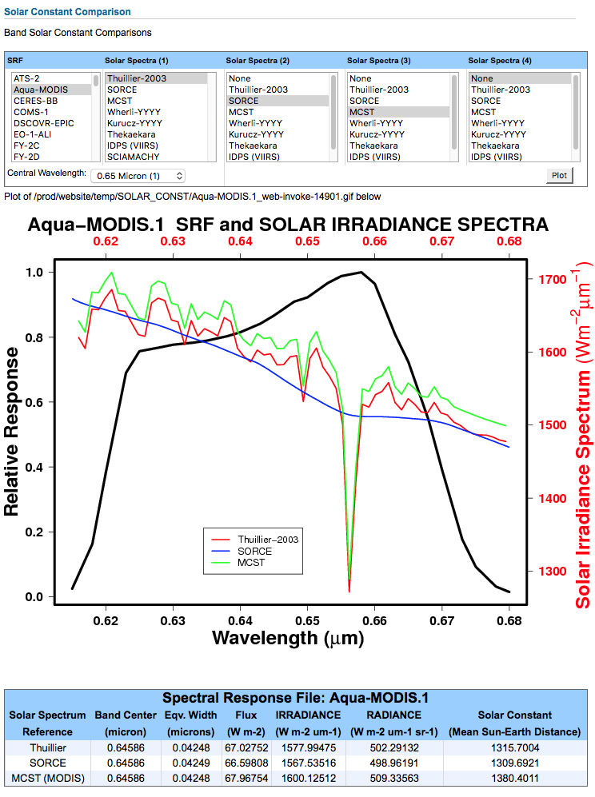
Solar Constant comparison tool
MODIS uses the MCST solar spectra to convert between reflectance and radiance
Important to use the same solar spectra when comparing multiple instruments

Slide 29
Summary
Scene specific SBAF crucial to account for spectral induced radiance differences when inter-calibrating two sensors
Subsetting for known scene conditions, angular, etc., will significantly reduce uncertainty of SBAF
Supporting the calibration community by providing open-access SBAF computation tools for consistent inter-satellite calibration and retrievals
Want to work with instrument teams to showcase highest-quality hyperspectral and scene information datasets, and latest RSRs
Welcoming user feedback, suggestions, and requests in order to keep the tool in the forefront of SBAF best practices

