Slide 1
Landsat & surface sites inter-calibration needs and priorities
K. Thome
CPF Intercalibration Workshop
16 November 2017 Hampton, VA

Slide 2
CPF and land sensors
CPF can provide intercalibration data, characterize test sites, provide high quality data for algorithm evaluation
Key issues to consider
Expected constellations of land sensors
Difference between absolute and relative radiometric calibration
Pointing versus non-pointing activities
Most of the discussion will concentrate on pointing versus non-pointing
Psuedo Invariant Calibration Sites (PICS)
Instrumented vicarious calibration sites
Calibration of land imagers with direct intercalibration to CPF is not recommended
Ensuring support for the land community to access nadir-view CPF data for intercalibration is an important role for CPF

Slide 3
CPF and land sensors
Land imagers are well suited for inter-calibration due to wide range of experience, near-nadir views, narrow swath systems
Coordinating with additional sensor teams for direct intercalibration will require additional resources
Loss of direct benchmark measurements
Conflicts with other sensors for inter-calibration
Alternate approach to direct intercalibration is to provide support for opportunistic nadir-view, near coincident cases
Mid-inclination orbit provides multiple opportunities
Tools already exist to provide the community with knowledge of intercalibration opportunities (e.g., CEOS COVE tool)
Providing tools for band convolution, image registration, atmospheric and solar view corrections will benefit users

Slide 4
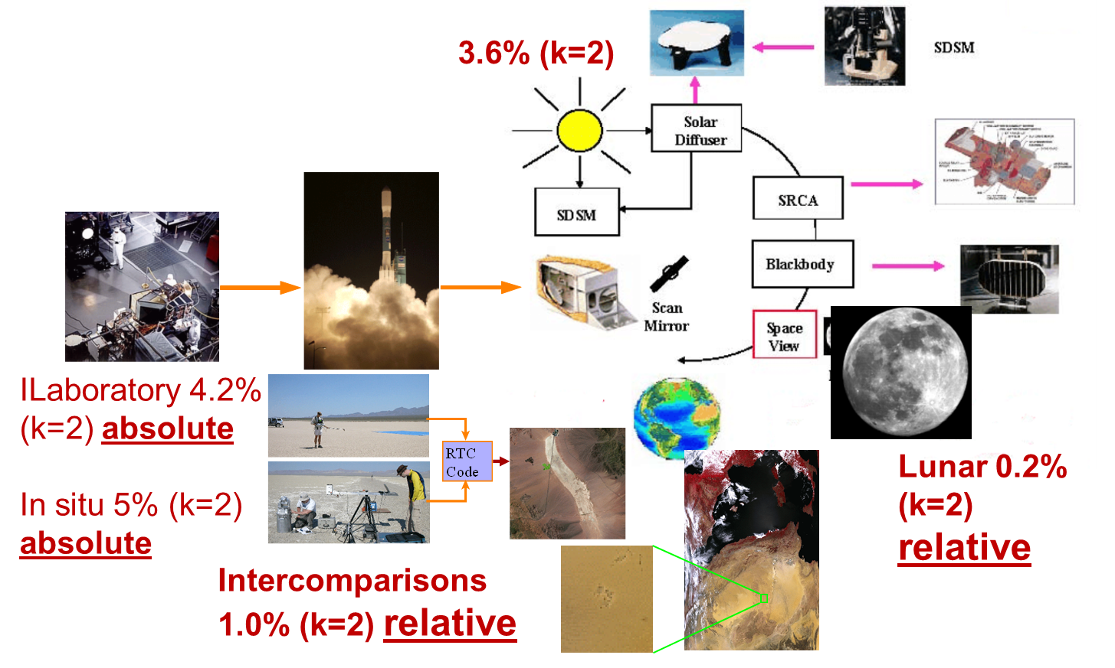
Required Accuracies for Land Applications
There are no current land applications that have shown a need for absolute uncertainty <3% (k=1)
Best current sensors have reflectance uncertainty of 3.6% (k=2) in mid-visible
Interconsistency has traditionally played a bigger role
Should be kept in mind that many users will want identical results from multiple sensors when viewing the same scene

Slide 5
Harmonized Landsat / Sentinel-2 Products - Laramie County, WY
Noise in the plot at right can be due to
- Intercalibration differences
- Residual spectral effects
- BRDF effects
- Residual atmospheric impacts
Users will often want the differences to be forced to zero

Slide 6
Pointing versus not pointing
Rest of discussion will concentrate on a list of sites recommended for evaluation for land applications
Propose a minimum list
Smaller number of sites with more extensive measurements better than many sites with fewer measurements
Selected site should be acquired whenever allowed within the conops
Goals of collections will be to provide data to evaluate key uncertainties for a small number of widely-used sites
Spectral effects – both atmospheric and surface
BRDF effects
BRDF characterization will drive the pointing of CPF
ISS precessing orbit and CPF pointing capability offer numerous benefits for test site characterization

Slide 7
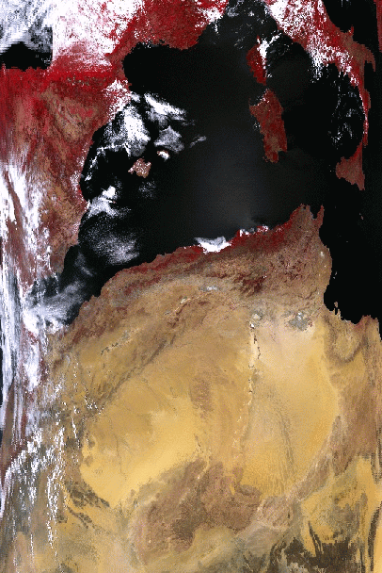
Pseudo-Invariant Calibration Sites (PICS)
PICS used for more than two decades for trending data from single sensors as well as intercalibration
Most applications down select the data they use
Limit range of incident solar zenith angles
Limit view angles
Modeling efforts rely on empirical fits and CPF can provide much better data for these data sets
Recommend that CPF plan to schedule a single PICS for full characterization
Use Libya-4 for planning purposes
Maintain contact with CEOS WGCV and GSICS for updates on test site usage and areal coverage
Acquisitions should provide square scene and collections at multiple
Pointing requirements are order of kms relative to center o the site

Slide 8
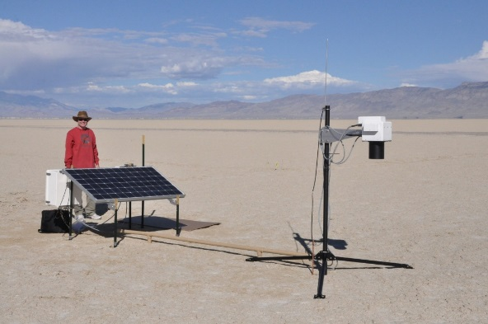
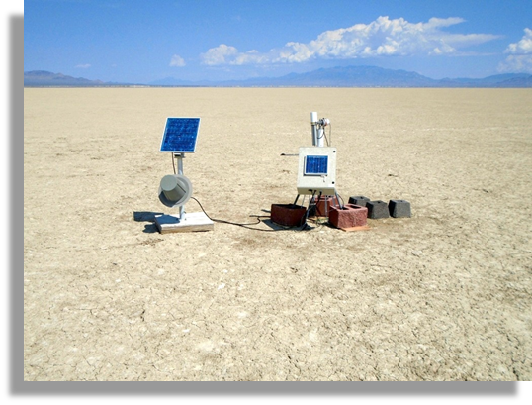
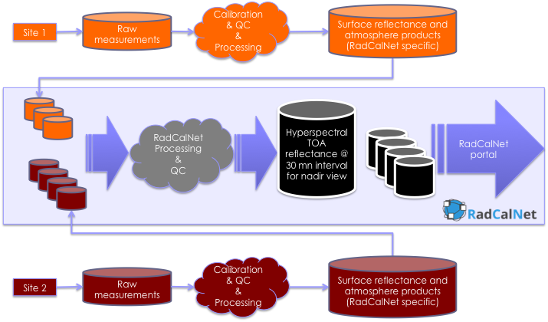
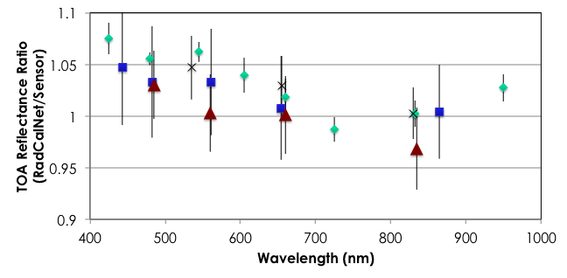
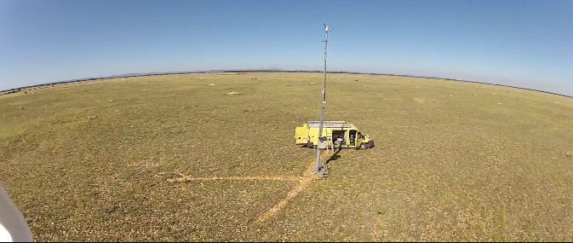
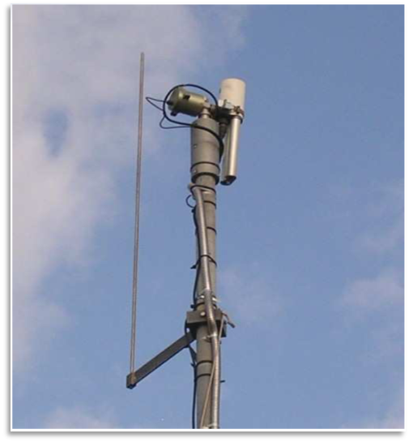
RadCalNet is a network of automated radiometric calibration sites
Committee on Earth Observation Satellites Working Group on Calibration and Validation is working to network automated radiometric calibration sites to provide predicted top-of-atmosphere reflectance
RadCalNet - Radiometric Calibration Network

Slide 9
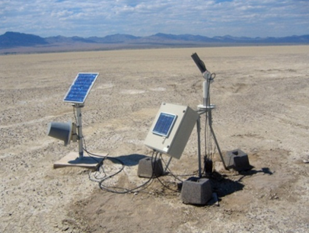
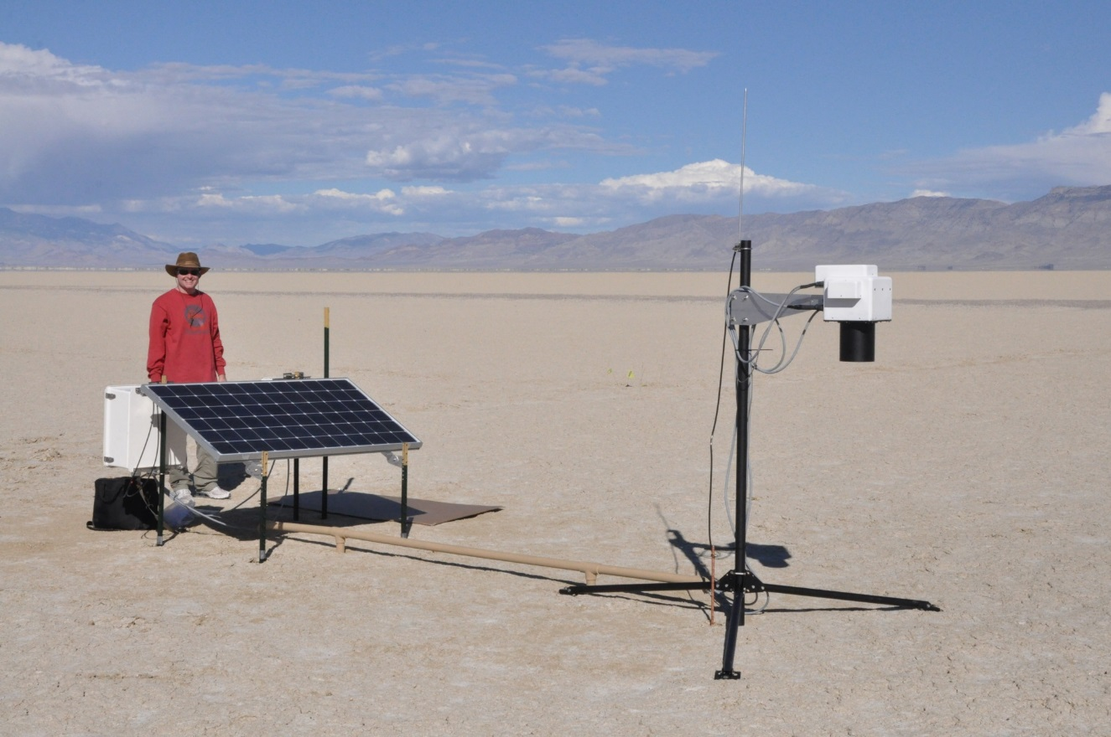
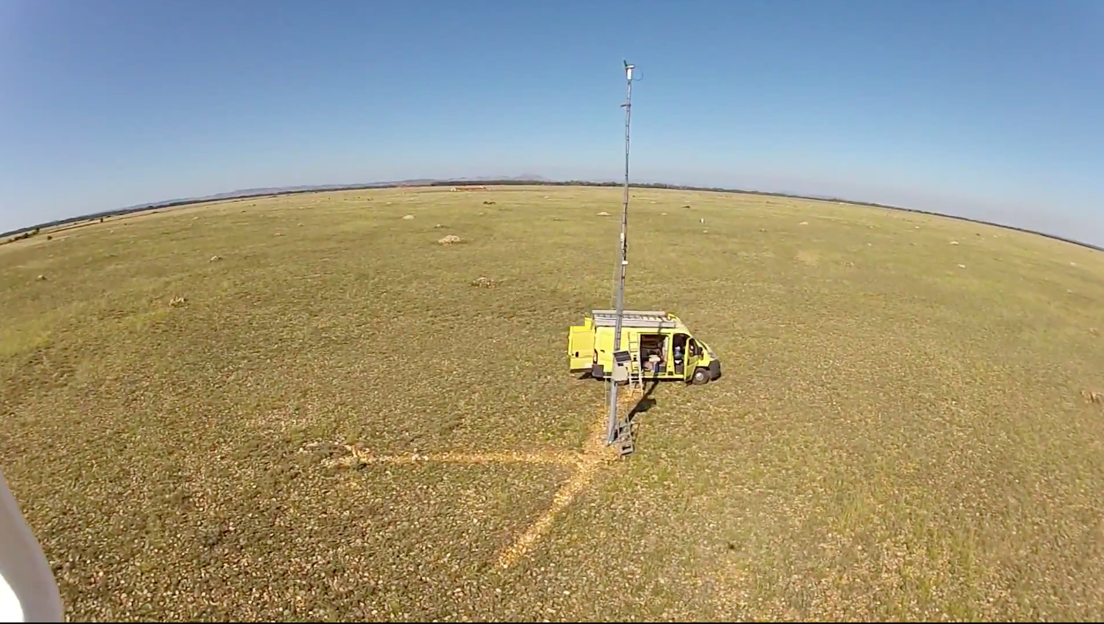
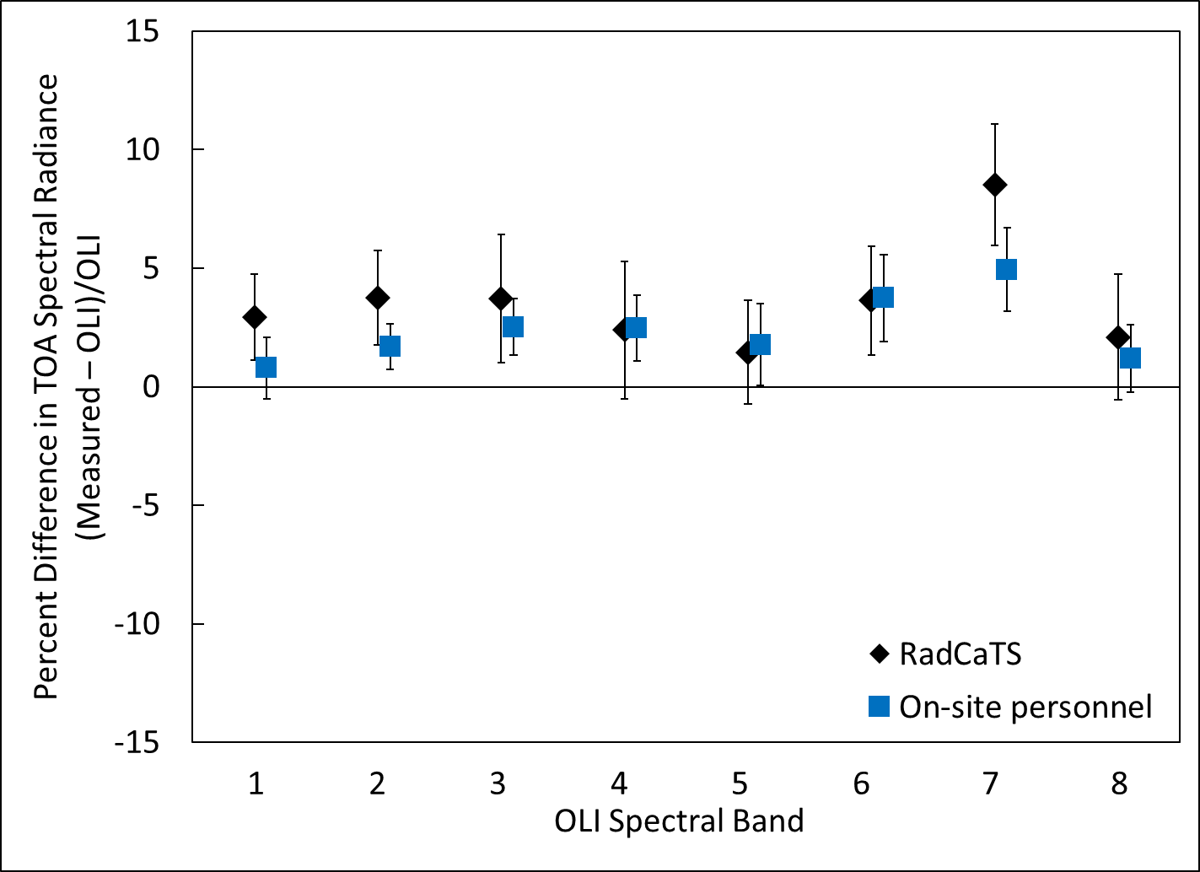
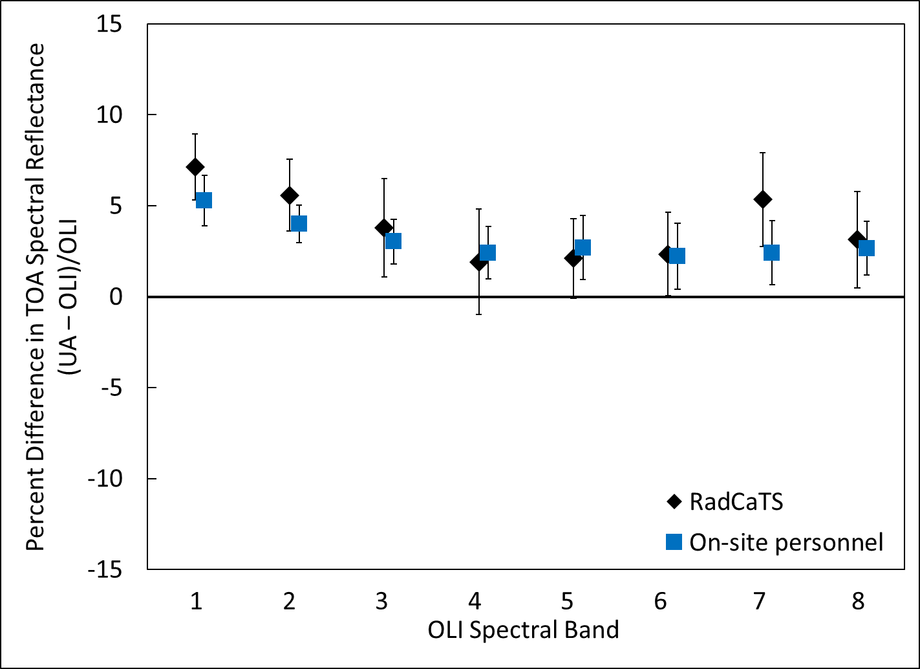
On-site measurements with people are hard
Automated field collections have been shown to provide results of similar accuracy as on-site personnel
RadCaTS at Railroad Valley Playa, USA
ROSAS at La Crau, France
Landsat 8 OLI example
TOA Spectral Radiance
TOA Reflectance

Slide 10
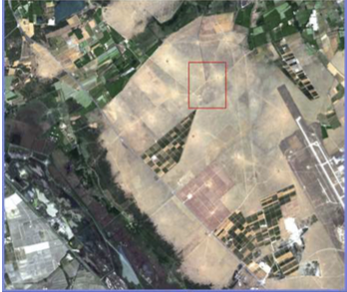
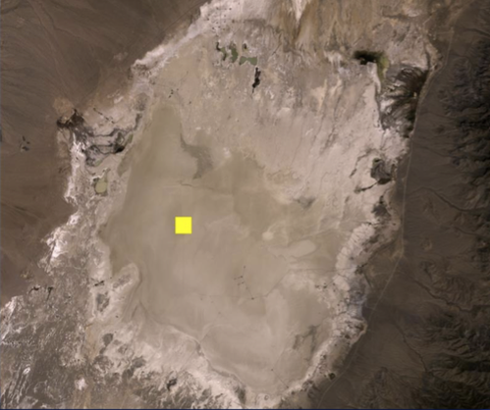
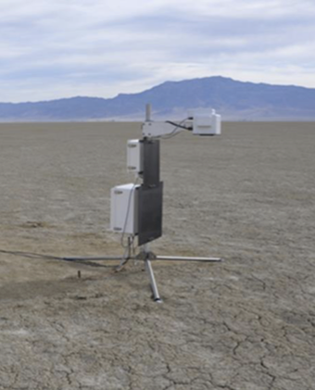
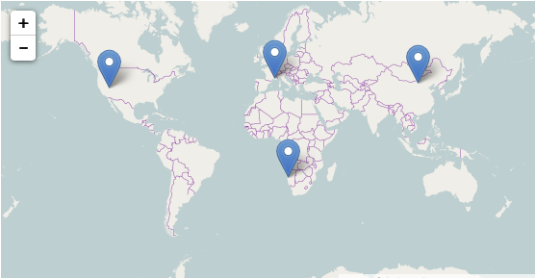
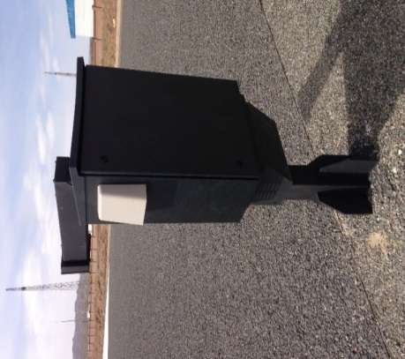
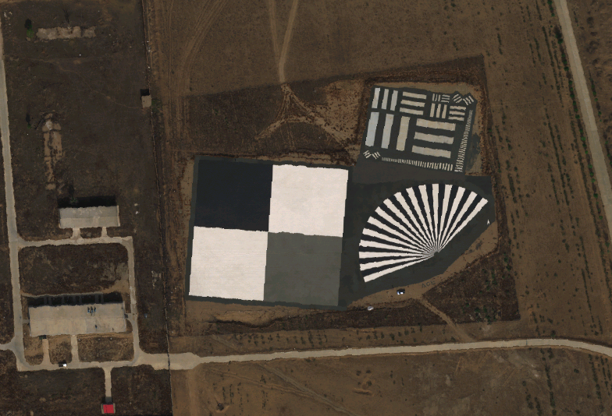
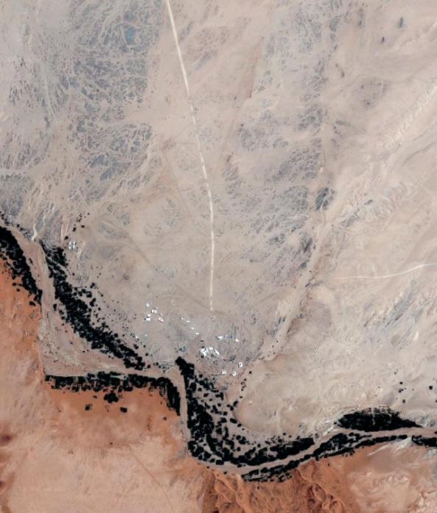
RadCalNet Sites so far
La Crau, France
CIMEL photometer (12 bands)
Pebbles and low vegetation
Site used since 1987 for calibration and instrumented since 1997
Railroad Valley Playa, USA
>20 years working experience on site
4 radiometers, sun photometer, met station
Dry lakebed
Gobabeb, Namibia
Sun photometer similar to La Crau) and met station
Sparse dry grass and gravel/sand
Installation in process
Baotou, China
Three automated spectrometers + sun photometer
Artificial target (white, black, and gray)
Operational since 2015
Baotou, China

Slide 11
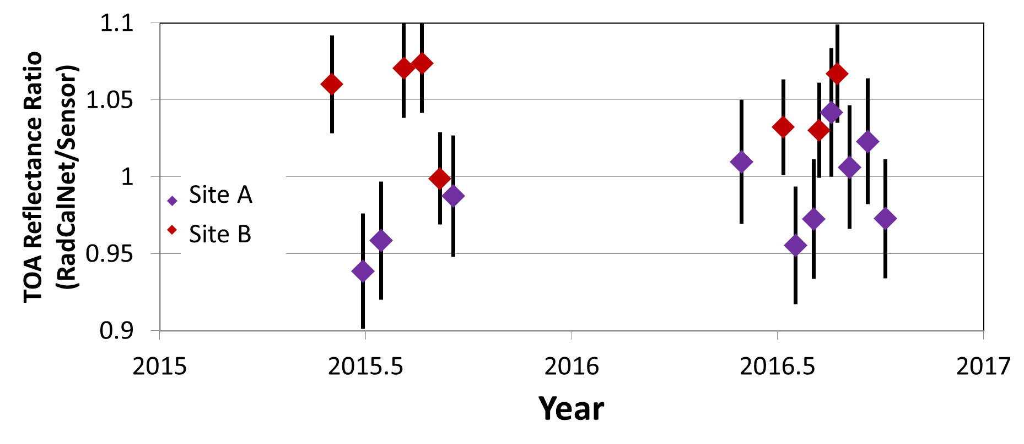
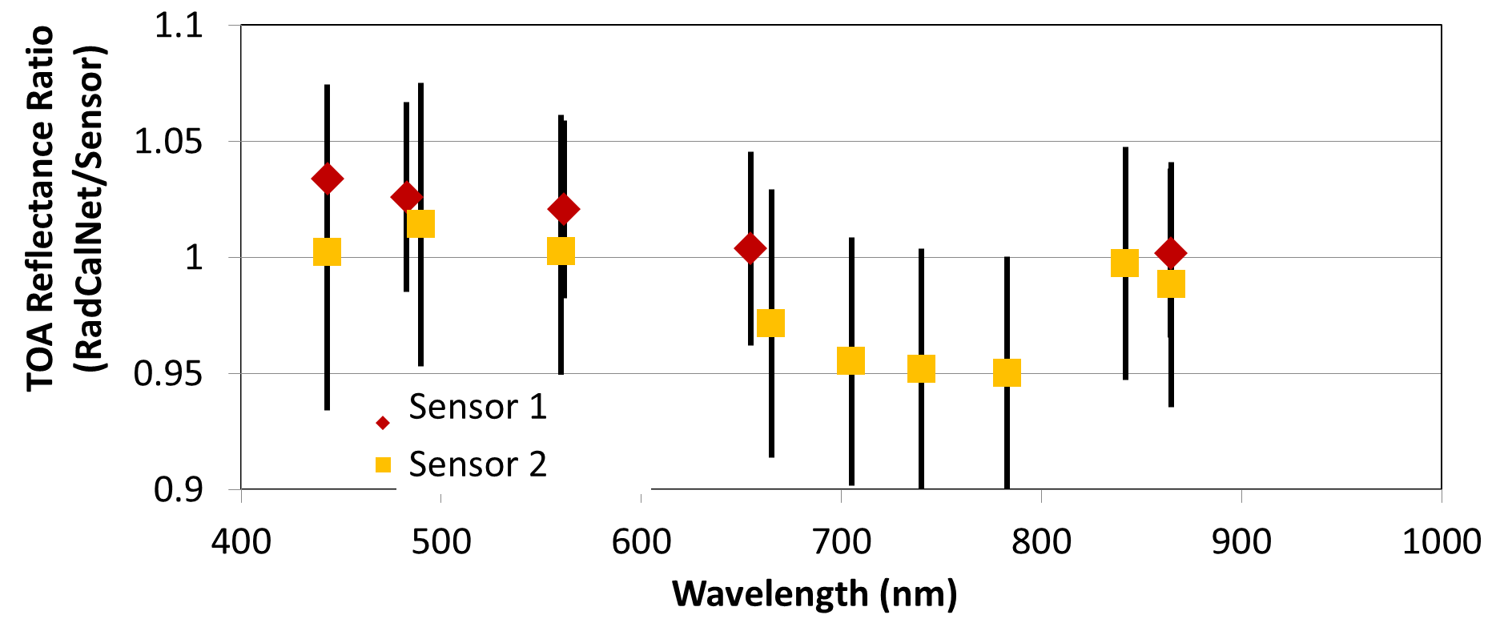
RadCalNet recently completed Beta Testing Phase
Multiple groups given access to RadCalNet data from Railroad Valley, La Crau, and Baotou
Feedback extremely positive and productive
Improvements to RadCalNet portal are being implemented
Beta testing demonstrated utility of the RadCalNet data sets
Results for two sensors from two of the sites shown here
Other results showed areas of study to understand the site uncertainties better

Slide 12
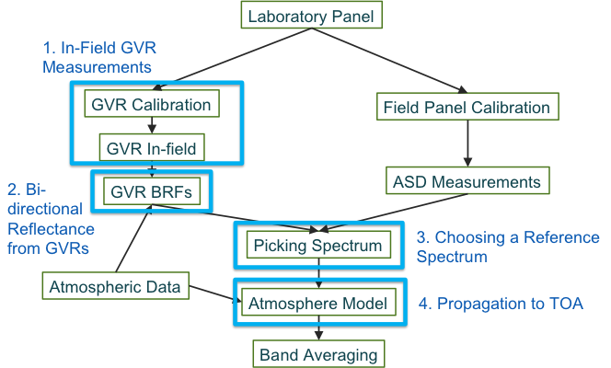
CPF can help assess the site uncertainties
RadCalNet is relying on process outlined in NPL Uncertainty Analysis for Earth Observation course (www.meteoc.org/training.html)
Uncertainty budget includes:
Instrumentation accuracy and repeatability
Data sources
Spatial homogeneity of site
Radiative transfer code
Sampling
Processing assumptions
Analysis performed using a combination of literature, laboratory results, Monte Carlo analysis, image analyses

Slide 13
Recommend Railroad Valley and Gobabeb
Overall site areas are on the order of 10 km by 10 km and both sites are suitable at the 500 m CPF resolution
Railroad Valley should offer many opportunities because of its higher latitude but suffers greater cloud contamination than Gobabeb
Gobabeb has limited history but has excellent spatial and climatological characteristics
Recommend collection of these two sites whenever possible and pointing should be used to obtain multi-angle views
Along-track acquisitions of 10 km will be sufficient
Pointing accuracy not important so long as knowledge meets current requirements

Slide 14
Conclusions
Recommended three sites for CPF planning purposes – Libya4 PICS; Railroad Valley RadCalNet; Gobabeb RadCalNet
PICS will need square scenes with repeatable centers at the km scale
RadCalNet sites will need 10-km along track samples with geometric knowledge of current CPF requirements
Site characterization does not provide the same accuracy as direct interconsistency approaches
Fortunately, some sensors do not require full accuracy of CLARREO
Currently-used test sites would be understood to a level that should allow absolute calibrations rather than only trend analysis
Clearer understanding of Instrumented test sites and uncertainties caused by atmospheric and surface bi-directional effects
Nadir views by CPF will help with sites beyond the three listed

