Slide 1
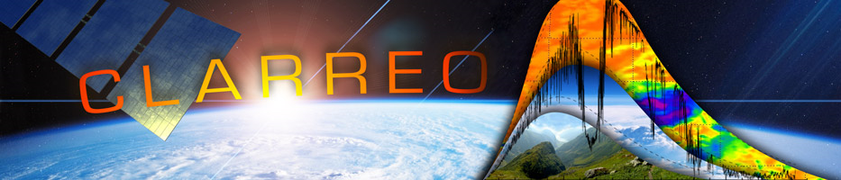
Developing spectral polarization distribution models (PDMs) for CLARREO inter-calibration applications
The CLARREO Pathfinder Inter-calibration Workshop November 14-16, 2017 in Hampton, VA.
Wenbo Sun, Bruce Wielicki, and Constantine Lukashin
Introduction
Radiation polarization fundamentals
Correction of measurement errors caused by polarization of light
The adding-doubling radiative transfer model (ADRTM)
Modeling polarized radiation for various scene types
Procedure for correction of satellite data with PDMs
Summary

Slide 2
Introduction
Climatology requires highly accurate solar radiation data for climate trend.
Solar radiation from the Earth is polarized by Earth-atmosphere system during reflection and scattering.
Many satellite sensors have some polarization dependence. To ensure the accuracy of data, Polarization Distribution Models (PDMs) are needed to correct the polarization-induced error in measurements.
Empirical PDMs based on PARASOL data only have 3 channels, cannot be applied to all solar/viewing angles and other wavelengths.
PDMs, based on RT models checked by measurements, over whole solar spectra and all incidence and viewing geometries are needed for correction of polarization-induced measurement errors.

Slide 3
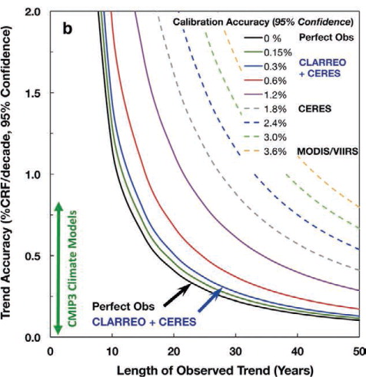
Climate trend detection needs highly accurate measurements
Effect of measurement accuracy for reflected solar radiance on both climate trend accuracy (vertical axis) as well as the time to detect trends (horizontal axis).
(Wielicki et al. BAMS 2013).
The green vertical line for reflected solar shows the range of CMIP3 climate model simulations.

Slide 4
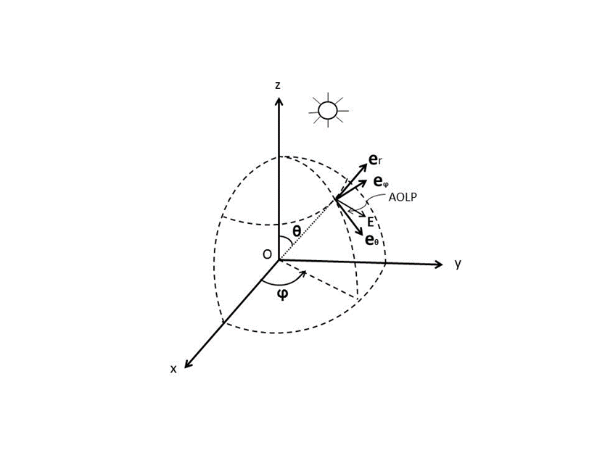
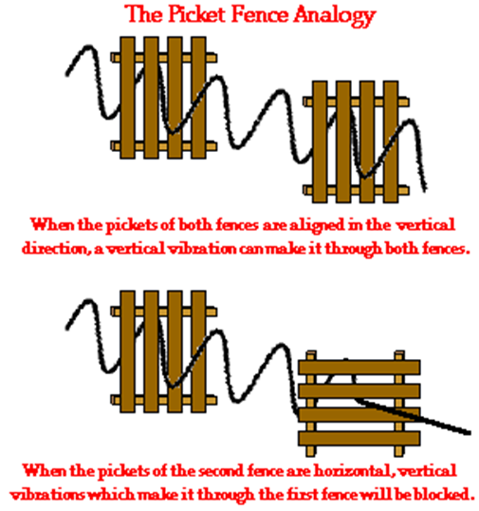
Sensors with polarization dependence have errors in their measurements due to the polarization of incidence.

Slide 5
Radiation polarization fundamentals
Any arbitrarily polarized incoherent radiation can be represented by the linear sum of an unpolarized part and a 100% polarized part as

Slide 6
Correction of measurement errors caused by polarization
Correction of polarization error in intensity is done as
Relative error of measured intensity due to polarization
Instruments with 3% of polarization dependence have ~1% uncertainty solely due to a 30% DOP of light!

Slide 7
Status of the adding-doubling radiative transfer model (ADRTM)
1. ADRTM:
This can calculate full Stokes parameters (I, Q, U, V).
2. Atmospheric profiles:
Any atmosphere profile.
3. Spectral gas absorption:
Line-by-Line and k-distribution plus ozone cross-section table.
4. Molecular scattering:
Rayleigh with depolarization factor.
5. Particulate absorption and scattering:
Mie for water clouds (Gamma size distribution);
FDTD/DDA for aerosols;
FDTD and GOM for ice clouds (dataset from Baum).
6. Surface reflection model:
Cox & Munk with Gram-Charlier expansion plus foam for ocean;
Wave shadowing effect is integrated in the ocean surface model;
Lambert model for water-leaving radiance from ocean water volume;
Rough-surface model for desert/bare land;
Rough-surface model for evergreen broad-leaf trees and grassland;
Models for other vegetation land and snow surface are under development.

Slide 8
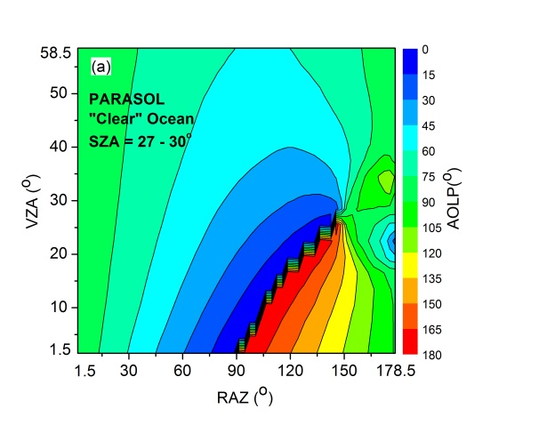
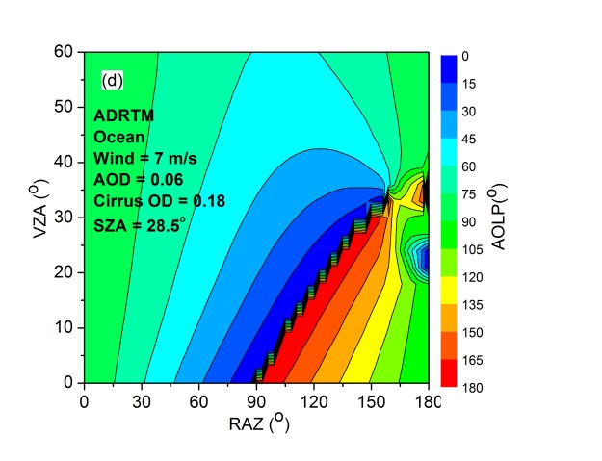
Modeling polarized radiation for various scene types
Comparing ADRTM results with PARASOL data at a wavelength of 670 nm and a SZA of 28 deg for clear oceans.
A layer of super-thin cirrus is added in ADRTM to approach to the PARASOL data for “clear” sky

Slide 9
Comparing ADRTM results with PARASOL data at a wavelength of 490 nm and a SZA of 56.94 deg for clear desert.

Slide 10
Comparing model results with satellite data at a wavelength of 490 nm and a SZA of 27.57 deg for evergreen broad-leaf trees

Slide 11
Comparing model results with satellite data at a wavelength of 670 nm and a SZA of 43.61 deg for grassland

Slide 12
Comparing ADRTM results with PARASOL data at a wavelength of 865 nm and a SZA of 54 deg for water clouds

Slide 13
Spectral reflectance and degree of polarization of solar radiation from
oceans

Slide 14
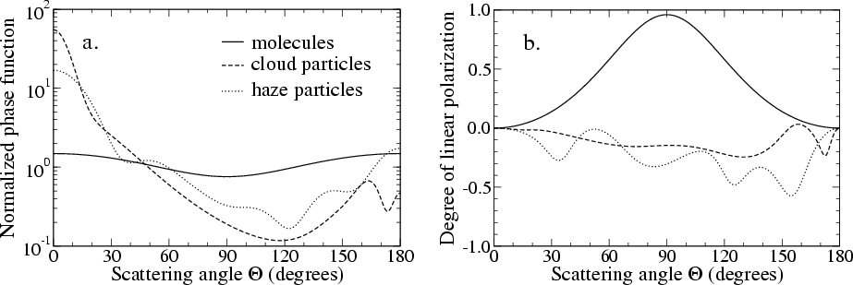
Why upper layer molecules have strong polarization?
Phase function and degree of linear polarization of different natural particles
(Stam et al. 2004)

Slide 15
Spectral reflectance and degree of polarization of solar radiation from
desert

Slide 16
Spectral reflectance and degree of polarization of solar radiation from
summer evergreen broad-leaf forest

Slide 17
Spectral reflectance and degree of polarization of solar radiation from
summer grassland

Slide 18
Spectral reflectance and degree of polarization of solar radiation from
thick water clouds

Slide 19
Procedure for correction of satellite data with PDMs
Reflectance
SceneID
SZA
Wavelength
(VZA, VAZ)
Data/File Structure of the PDMs
VAZ ……….
VZA DOP/AOLP
…… ………………
Band 1
SZA 1
Interface Program for PolCorrect
Scenetype 1
Band 2
VAZ ……….
VZA DOP/AOLP
…… ………………
SZA 2
Scene type 2
Band 3
VAZ ……….
VZA DOP/AOLP
…… ………………
Corrected Reflectance
SceneID
SZA
Wavelength
(VZA, VAZ)

Slide 20
Conclusion
The polarization states of reflected solar spectra for major Earth scenes are modeled for CLARREO PDMs.
Ocean, as a special scene type, strongly polarizes light. However, all other scene types under CPF orbits only strongly polarize light at wavelengths shorter than approximately 0.9 microns.
PDM programs are ready for CPF. Polarization correction program is also completed.
The spectral PDMs reduce the risk of the CPF mission by correcting measurement errors due to the polarization of spectrally-resolved reflected solar radiation.
References
Wenbo Sun, Rosemary R. Baize, Gorden Videen, Yongxiang Hu, and Qiang Fu, “A method to retrieve super-thin cloud optical depth over ocean background with polarized sunlight”, Atmos. Chem. Phys., 15, 11909-11918, doi: 10.5194/acp-15-11909-2015 (2015).
Wenbo Sun, Rosemary R. Baize, Constantine Lukashin, and Yongxiang Hu, “Deriving polarization properties of desert-reflected solar spectra with PARASOL data”, Atmos. Chem. Phys.15, 7725-7734, doi: 10.5194/acp-15-7725-2015 (2015).
Wenbo Sun, Constantine Lukashin, Rosemary R. Baize, and Daniel Goldin, “Modeling polarized solar radiation for CLARREO inter-calibration applications: Validation with PARASOL data,” J. Quant. Spectrosc. Radiat. Transfer 150, 121-133 (2015).
Wenbo Sun, Gorden Videen, and Michael I. Mishchenko, “Detecting super-thin clouds with polarized sunlight,” Geophy. Res. Lett. 41, 688-693, doi: 10.1002/2013GL058840 (2014).
Wenbo Sun and Constantine Lukashin, “Modeling polarized solar radiation from ocean-atmosphere system for CLARREO inter-calibration applications,” Atmos. Chem. Phys. 13, 10303-10324, doi: 10.5194/acp-13-10303-2013 (2013).

