Slide 1
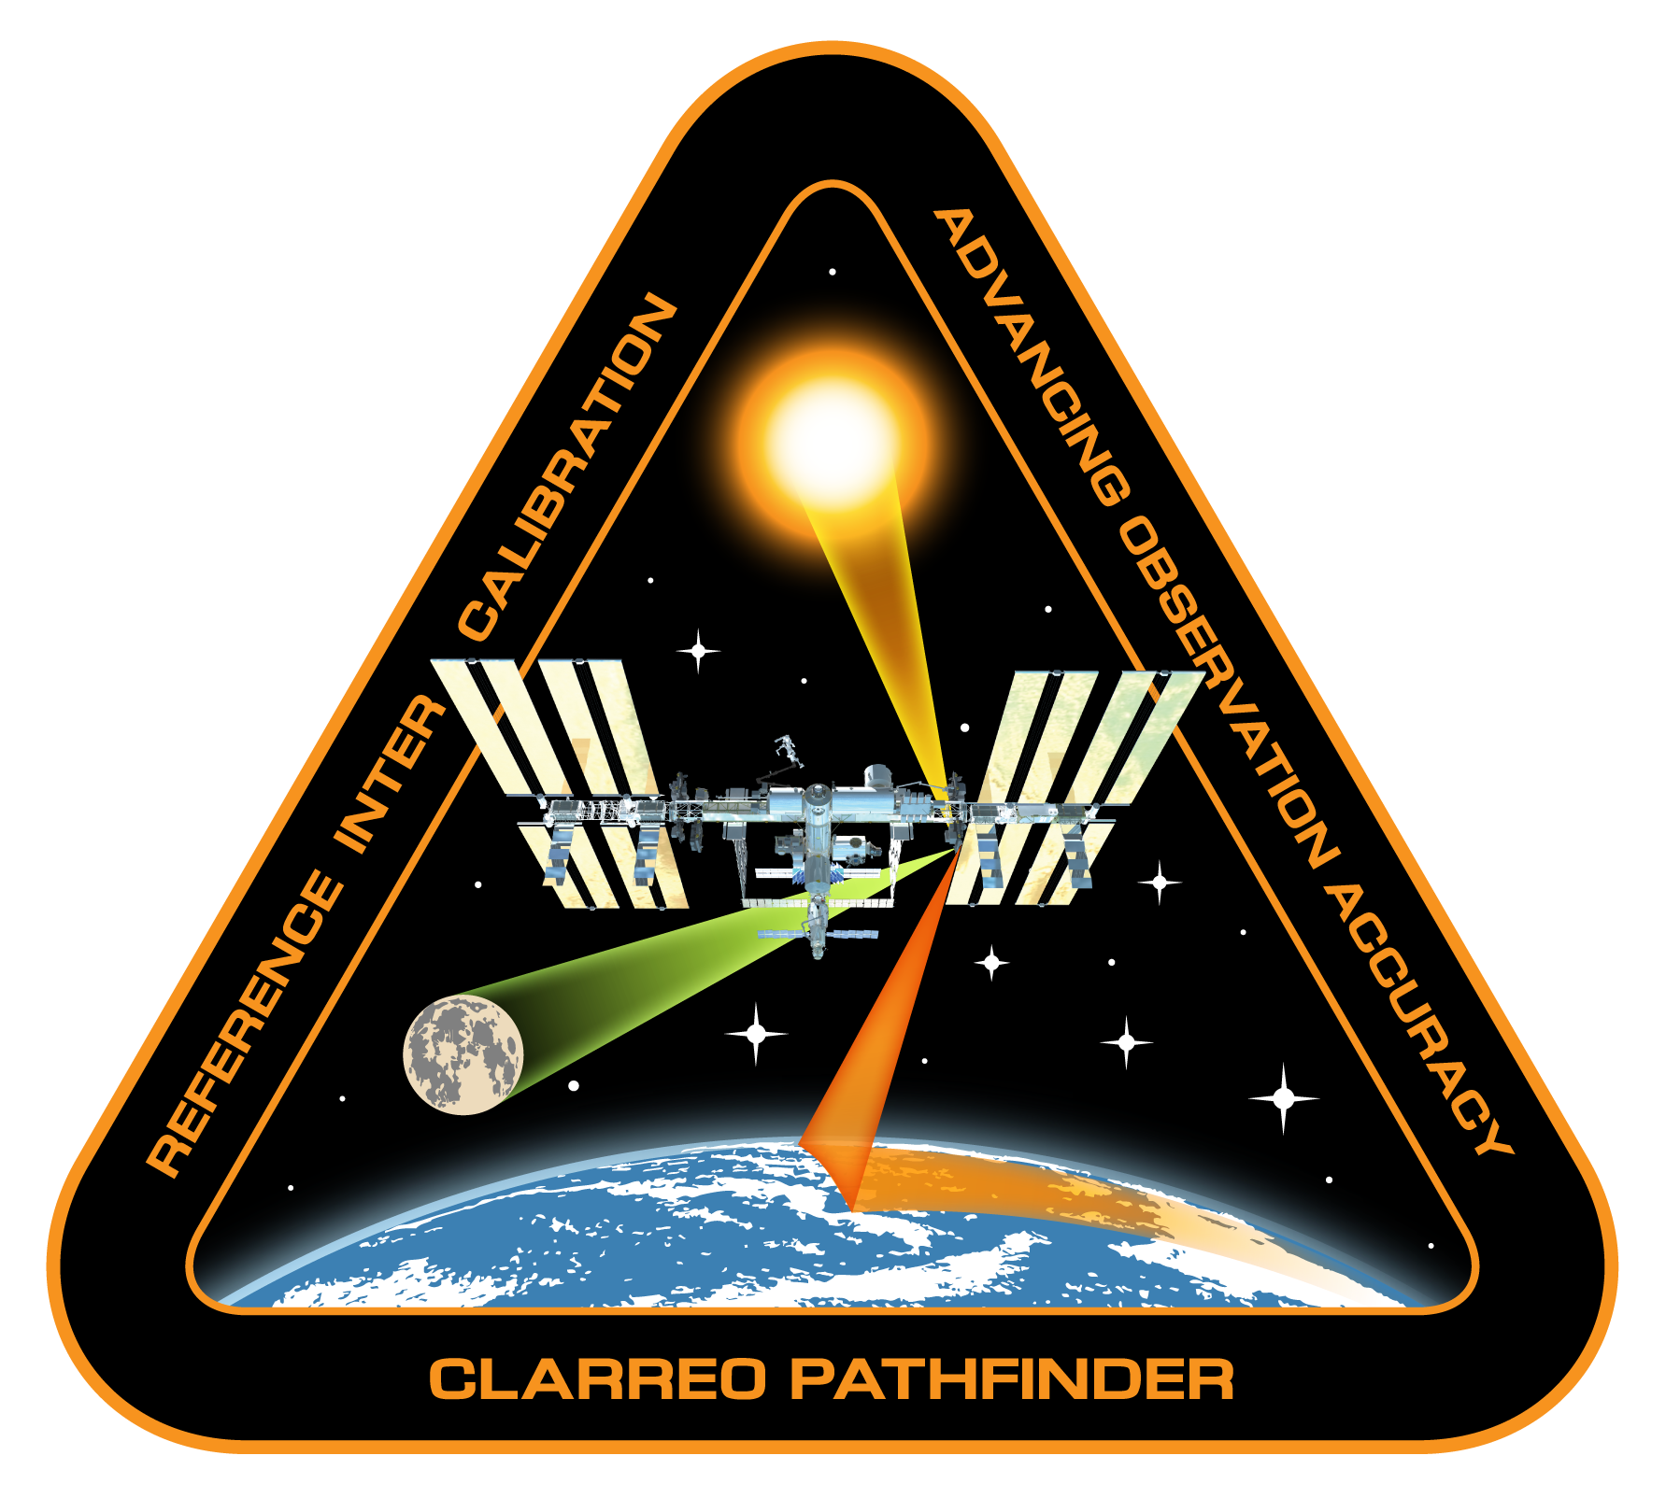
CLARREO Pathfinder Inter-Calibration
STATUS
Constantine Lukashin
Inter-calibration and Data Management Teams

Slide 2
Milestones in Q3 and Q4 of FY18
Assessment of CERES PSF code portability: N. Smith, coordinate with CERES and PCF DMTs
Date: April 30, 2018
Prototype Level-1B data product for DMT tests: Lukashin, coordinate with LASP and DMT
Date: June 30, 2018
SER for mitigation of potential instrument sensitivity to polarization: Lukashin, W. Sun, D. Goldin, LASP
Date: June 30, 2018
VIIRS Support – RSR and assessment of VIIRS data products (NASA): A. Wu
Date: July 31, 2018
Theoretical PDMs for clear-ocean, thin clouds/clear ocean, clouds over ocean: W. Sun
Date: August 1, 2018
Prototype PCRTM-based correction for CPF broadband: X. Liu, Q. Yang
Date: August 15, 2017
Estimate angular corrections for CERES inter-calibration: X. Liu, W. Wu, N. Smith, coordinate with DMT
Date: August 30, 2018
Empirical PDMs and Application clear-ocean, thin clouds/clear ocean, clouds over ocean: D. Goldin
Date: September 15, 2018
Advance draft of of ATBD for CPF Level-4 data product: Lukashin and All
Date: September 31, 2018
Lunar Inter-calibration SER: Tom Stone
Date: September 31, 2018

Slide 3
Current Focus on the CPF/CERES Algorithms
Implementation
Development
Need to be done
By proxy (MODIS)
No VIIRS Level-2
data products
available yet

Slide 4
Focus on the CPF/CERES Algorithms
CERES Point Spread Function
CERES PSF uncertainties, study by scene type
CERES PSF at > 99% ?
CPF uncertainty propagation into measured SW broadband
CERES SSF subset parameters for every FOV (radiance, ADM,
clouds, aerosols, geometry, etc.)
PCRTM modeling for missing energy < 350 nm and > 2300 nm,
including uncertainty
Definition of the CPF/CERES Level-4 data product

Slide 5
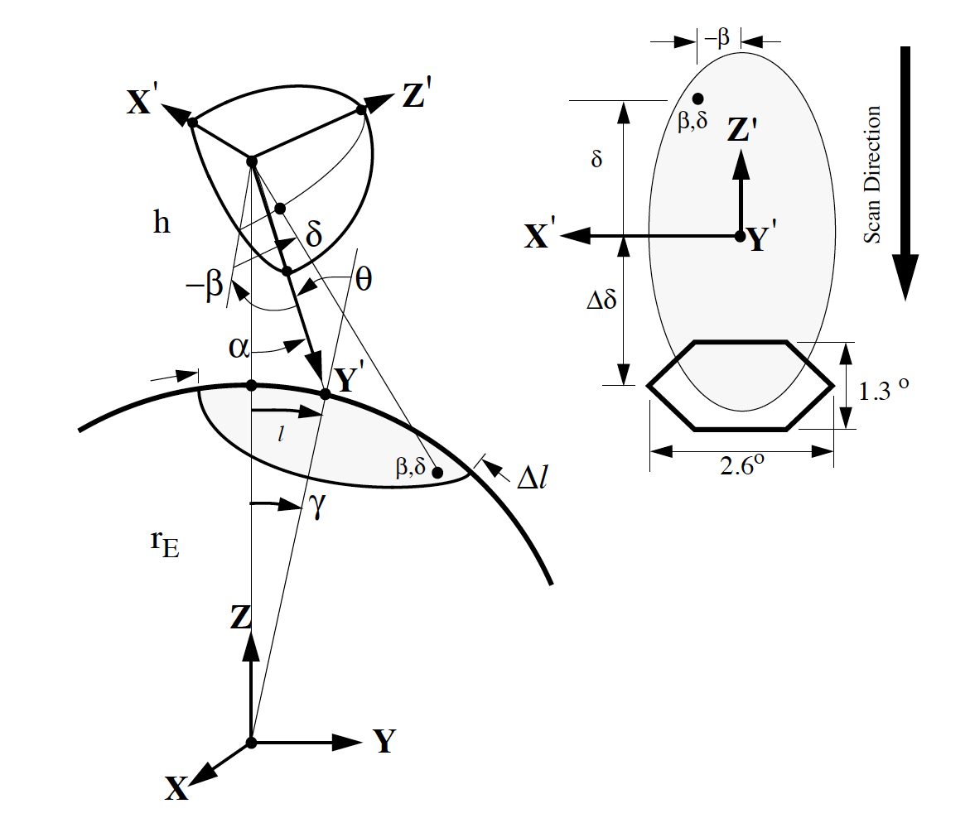
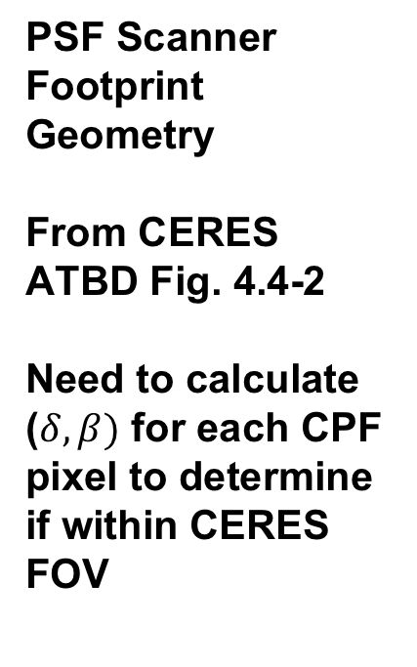
PSF Scanner Footprint Geometry
From CERES ATBD Fig. 4.4-2
Need to calculate ($δ, β)$ for each CPF pixel to determine if within CERES FOV

Slide 6
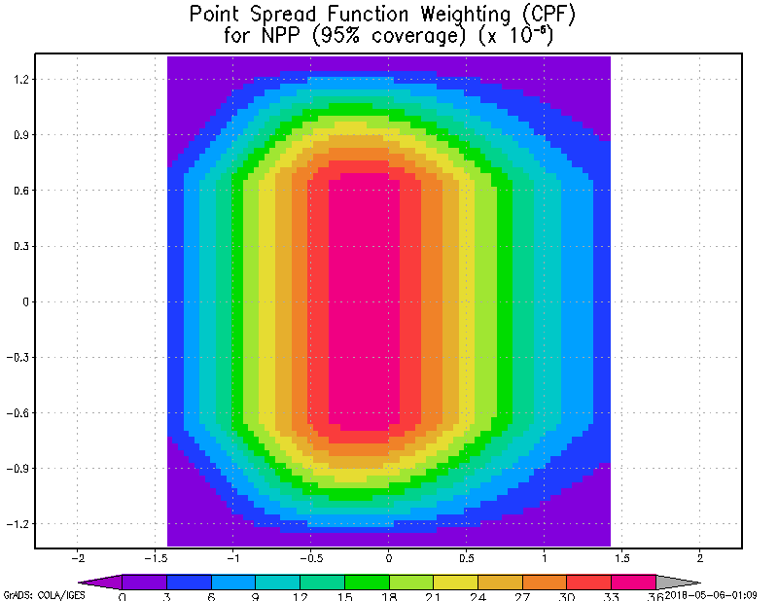
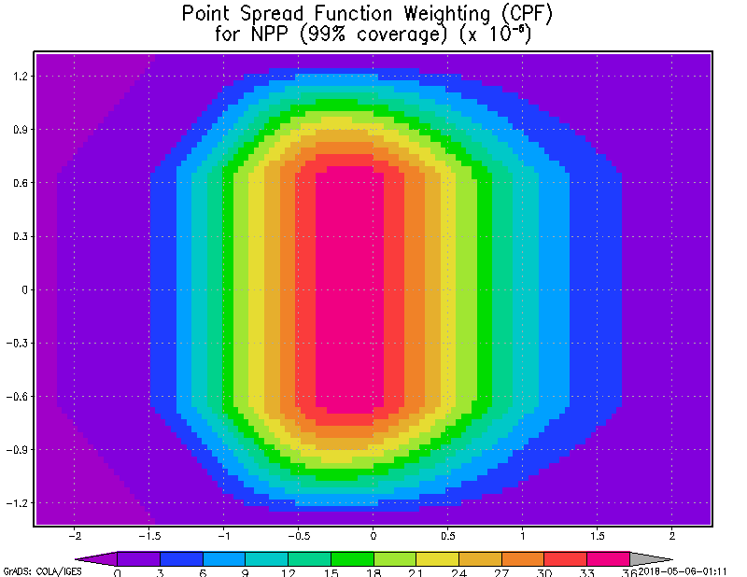
Comparison of CERES PSF with 95% and 99%
Energy Coverage (N. Smith)
Extending the energy cut-off to 99% does not significantly increase the amount of information captured as the PSF with 95% coverage appears adequate. From a computational standpoint, processing time might double with CERES/VIIRS data where a large amount of data is processed. For CLARREO (with a smaller dataset and less parameters to convolve), computational time may not be a factor even if the PSF 99% coverage is applied.
2.6º from 824 km altitude = 37.4 km
The CERES FOV of “23 km diameter” is reported as a surface equivalent for optical not-moving FOV

Slide 7
CERES Point Spread Function
Uncertainty Validation Plan
REGRESSION OF CERES BROADBAND and VIIRS IMAGER DATA (Using current CERES NPP PSF ~97% coverage)
- CERES unfiltered radiance measurements and Imager data (convolved)
correlation is an indicator of pre-launch PSF validity
- Data: SW unfiltered radiance with VIIRS 0.645 μm radiance and LW unfiltered
radiance with VIIRS 10.763 μm and 11.45 μm radiance (from CERES SSF Product)
  - Constraints
  Scenes: Clear (Ocean, Desert), All-sky , Partly Cloudy, DCC
  Homogeneous vs heterogeneous scenes
  SW: SZA 0-45, 45-60, > 60, Full VZA Swath, Imager Coverage > 90%
  - Preliminary Results (All-sky Ocean for 201202 – 201212)
  SW vs 0.645 μm channel : Regression ~ 0.9967
    LW vs 11.45 μm channel : Regression ~ 0.984 (Day) 0.982 (Night)
- Adjust PSF centroid, process through convolution software and perform
regression on new unfiltered radiance measurements with imager data.
USE OF LUNAR OBSERVATIONS TO EVALUATE PSF STABILITY (Daniels, et al.z)
USE ground PSF measurements for different Flight Models to assess consistency.

Slide 8
Training PCRTM to match the CPF/HySICS
Spectral Response Function & Spectral Sampling (X. Liu)
HYSCIS Spectral Response Function (SRF) is generated by convolving a of 3.94 nm boxcar function with a 0.48 nm FWHM SINC square function, followed by convolving with a 3.1 nm boxcar function.
Spectral sampling space is 3.1 nm
  FWHM = 4.017 nm
  Calibrated CPF wavelength will be provided with L1 data
  In the process of handling of variable wavelength spacing
PCRTM is retrained with the HYSCIS RSF
  Both balloon observation geometry and satellite observation geometries are considered in the training
  Added newly developed hyperspectral surface BRDF to the training data

Slide 9
Validate PCRTM using HySICS Data
HYSCIS Spectral Response Function (SRF) is generated by convolving a of 3.94 nm boxcar function with a 0.48 nm FWHM SINC square function, followed by convolving with a 3.1 nm boxcar function
  FWHM = 4.017 nm
Spectral sampling space is 3.1 nm
  Calibrated CPF wavelength will be provided with L1 data
  In the process of handling of variable wavelength spacing
PCRTM is retrained with the HySICS RSF
  Both balloon observation geometry and satellite observation geometries are considered in the training
  Added newly developed hyperspectral surface BRDF to the training data
Example of high spectral resolution RS spectra using MODTRAN and PCRTM
HYSICS observed (blue curves)
PCRTM modeled (green curves)

Slide 10
Algorithm Development of the Broadband Radiance Based on CPF Level-1B Data (Q. Yang)
A novel hyperspectral land surface BRDF model has been developed and new high resolution monochromatic radiances from 200 nm to 5,000 nm were simulated using new land surface BRDFs
The new land surface data together with the ocean surface data were used for the CLARREO-CERES inter calibration
New strategy was used to predict the CERES missing spectral coverage using CLARREO hyperspectral information
  Previously, we predicted the UV (200 nm to 350 nm) and IR (2300 nm to 5000 nm) hyperspectral radiances using CLARREO available radiances, then convolved the radiances from 200 nm to 5000 nm to get the CERES signals.
  Currently, we predict the broadband CERES signals in both UV and IR regions directly using the CLARREO available TOA radiances (350 nm to 2300 nm)
  In the wavelength range of 350 nm to 2300 nm, the CERES signals are obtained by convolving the CLARREO radiances with the corresponding spectral response function (???)
  The major contribution (350 nm to 2300 nm) to the CERES signal is thus directly obtained from the CLARREO measurement, which is not related to the training result. The relatively small UV and IR parts are derived from the CLARREO data and the training coefficients.

Slide 11
Algorithm Development of the Broadband
Radiance Based on CPF Level-1B Data
There were 8392 samples used for training and 8391 samples used for validation.
The UV part of the CERES signal was obtained by convolving the blue part of the radiance with its corresponding spectral response function. The same procedure was used for the CLARREO available part and the IR part of the CERES signals.
Using the training data, the relationship between the UV or IR parts of the CERES signals and the CLARREO available radiances were found. This gave out the coefficient matrices.
Using the obtained coefficient matrices, the UV and IR parts of the CERES signal could be obtained directly from the CLARREO available radiances (not from the blue or red part any more). This was demonstrated using the validation data.
The percentage RMS errors due to this methodology were smaller than 0.3% for both training and validation data (0.025% FWHM)

Slide 12

Summary on the Simulator Angular
Cor. Algorithm Development (W. Wu)
The need for a CPF L1 simulator
  Generate proxy data for algorithm development
    Spectral gap filling – needed for CPF-CERES inter-cal
    Angle mis-match correction – need for CPF-VIIRS inter-cal
  Provide realistic tools for OSSE studies
  Generate realistic proxy data for information content analysis
Key components of the CPF simulator
  Fast and accurate radiative transfer model
  CPF orbital simulator
  Geophysical atmospheric and surface parameters
    VIIRS/MODIS L2 data
    CERES SSF data
    GCM or reanalysis data
Current status
  The PCRTM simulator has been developed
  with MODIS data
  The PCRTM simulator has been extensively
  validated using MODIS data
Global Reflectance (10km$×$10km spatial resolution)
of July 1st, 2006
PCRTM simulated
(@1638 nm)
MODIS band 6
Level-1

Slide 13
    The angular correction algorithm can be used to relax angle matching criteria to get more matching events. The approach can potentially Increase inter-cal accuracy CPF-VIIRS (CERES) using the same number of matching events
    Simulation study for CPF-VIIRS angular correction has been carried out.
    The algorithm provides angular correction for each individual inter-cal event. The CPF-CERES correction can be validated using CERES ADMs on the climatological scale
Orbital Events Prediction
CPF level1 data
(SZA, VZA, AZA), (Δ VZA, Δ AZA )
PCRTM-SOLAR
R
A
Calculate ΔR (ΔVZA, ΔAZA)
Generate regression coefficients for angle mismatch correction using CPF hyperspectral data, ΔR = A R
CPF Observation that matches VIIRS spectral bands and view geometries
R_{corrected} = (1+A) R

Slide 14
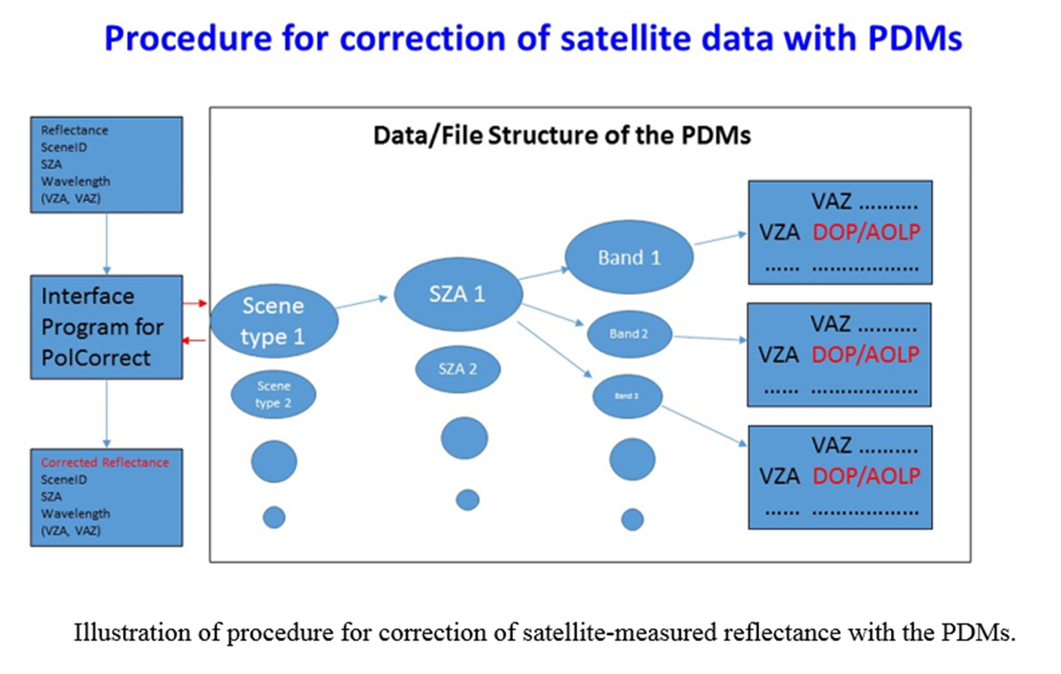
The 2nd Version of CPF PDMs for Clear Oceans
(W. Sun)
The 2nd version of CPF PDMs for clear oceans with only non-spherical sea-salt aerosols are generated for MODIS, VIIRS, and PARASOL polarization wavelengths. Modeling for CPF PDMs of super-thin-cirrus oceans and thick-cloud oceans is under preparation.
In the PDMs, the ADRTM outputs for I, Q, U, DOP and AOP are stored under each SZA directory with a file-name extension denoting band number.
A Fortran program (PolCorrect) has been made
for the radiance polarization correction procedure.
This program requires the polarization dependence
function of the instruments.
PolCorrect reads in PDM LUTs as a function
of scene type, solar zenith angle (SZA),
wavelength (Band), viewing zenith angle (VZA)
and viewing azimuth angle (VAZ).
Modeling for CPF PDMs is conducted for SZA and VZA up to 85º. Due to 1D model issue, PDM values for SZA or VZA > 75º should have larger errors and be used with caution !
This is the topic of the SER on polarization corrections.

Slide 15
Examples of DOP LUTs in CPF PDMs for clear oceans (AOD = 0.06 only)
at SZA = 60º for different wavelengths.
Different curves denote VAZ changes from 0 to 180 deg with an increment of 3 deg.

Slide 16
PDM Application Module
(D. Goldin)
Implemented first iteration of the PDM Module for the 02/15/2018 milestone.
Tested it using the clear-sky ocean scene.
PDM Module’s empirical and theoretical data stored in the form of lookup tables
and are based on:
  POLDER/PARASOL data (empirical)
  ADRTM simulation (theoretical)
PDM Module inputs (clear-sky ocean, so far):
  Wavelength
  SZA
  VZA
  RAZ
  AOD (empirical). Theoretical value set to 0 (for now)
  Wind Speed
PDM Module outputs:
  mean degree of polarization P (empirical and theoretical) and corresponding uncertainty s_{P} (empirical)
  mean angle of polarization c (empirical and theoretical) and corresponding uncertainty s_{c} (empirical)
Interpolation:
  Empirical PDMs:
    Input lookup tables based on 3 available wavelengths, 490, 670 and 865 nm. For all intermediate wavelengths P and χ are linearly interpolated. Corresponding σ_{P} and σ_{χ} are error-propagated.
  Theoretical PDMs:
    Input lookup tables based on 27 wavelengths (412 nm – 2250 nm) and 29 preset values of SZA. For all intermediate values of SZA and wavelengths P and χ are interpolated using multilinear algorithm

Slide 17
PDM Application Module (cont.)
Validation:
  Interpolated PDMs (empirical and theoretical) for P and χ means and uncertainties were checked against LUT values and were found to be self-consistent
  Empirical and theoretical P and χ were cross-validated. Empirical and theoretical PDMs were found to broadly agree, though some differences greater than 1σ_{P} and 1σ_{χ} were observed
Development:
Done: Clear-sky ocean scene PDMs now ready. Stratified by SZA, VZA, RAZ, AOD and Wind Speed
Work in progress: stratifying overcast scenes by Cloud Optical Depth and cloud types (water/ice/mixed).
Future Work:
  Stratification based on Cloud Fraction
  Stratification (possibly by season) for clear-sky land surfaces

Slide 18
CPF Level-1B Simulation
(C. Roithmayr, C. Lukashin, DMT)
Simulation of the CPF and CERES/VIIRS or CERES/MODIS inter-calibration events at the Level-1B data product sampling:
Matlab code development by Carlos
Code translation by DMT
Spectral and uncertainty data (LaRC and LASP)
Algorithms with accounting to Earth rotation (LEO intercal0
Data rate: 15 Hz
160 pixels across 10 degree HySICS swath (about 0.5 km each)
SZA, VZA, RAZ
Longitude and latitude
Reflectance and radiance spectra
Radiometric uncertainties
Consistent with LASP description of the Level-1B data product
This is simulation for the purpose of realistic sampling estimates, algorithms testing and DMT effort !

Slide 19
DMT Status
Chris Currey and Aron Bartle
IC Data Management Objectives for FY18 Q3 and Q4:
Implement CPF-CERES IC science code prototype
Filter L2 CERES data product to keep FOVs within CPF swath
Implement CERES Point Spread Function PGE Prototype
Implement CPF L1B IC data simulator within MIIC
Integrate PCRTM PGE into workflow

Slide 20
CPF IC-SDS Architectural Design

Slide 21
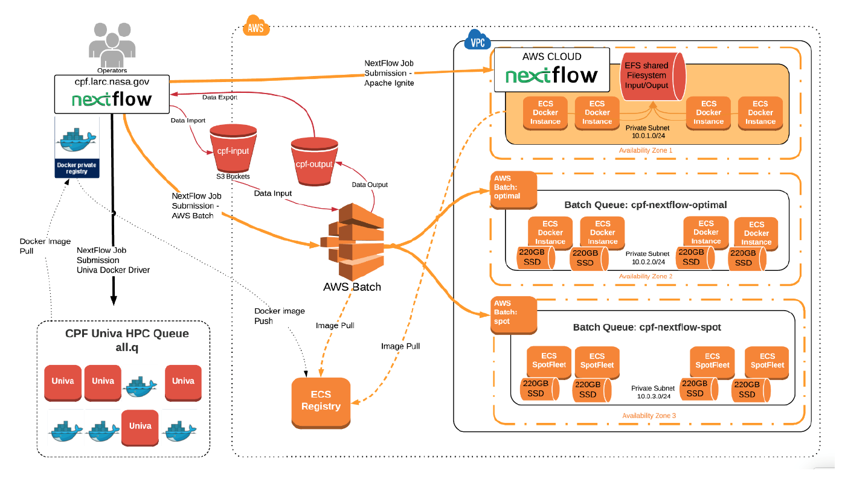
IC-SDS Nextflow Docker Architectural Design to Enable Cloud Processing
New processing & automation engine for data processing on local and cloud resources

Slide 22
Data System Configuration Performance –
AWS vs. Cluster
AWS Batch and AWS Cloud take 3.5 and 5.8 times as long as CPF Custer to execute for similarly sized configurations
I/O intensive apps. (VIIRS subsetter)
117 jobs run
Queue size limited to 96 cores
AWS Batch - maximum 96 vCPUs, 200 GB SSD per EC2 node (dynamically instantiates computer resources based on load)
AWS Cloud - pre-configured system, maximum 96 vCPUs, 20 GB SSD, 1.2 TB EFS shared filesystem

Slide 23
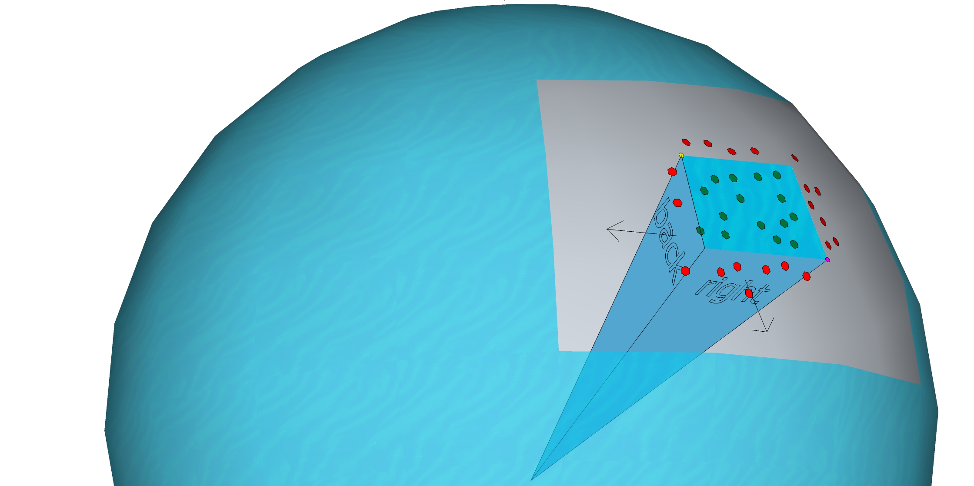
Pyramid Filter Dot Product Test
Left/back point
For points inside the pyramid…
(p - left/back) ● back_n <= 0
(p - left/back) ● left_n <= 0
(p - right/front) ● front_n <= 0
(p - right/front) ● right_n <= 0
For points outside pyramid dot product will be positive…
(p - right/front) ● right_n > 0
Right/front point

Slide 24
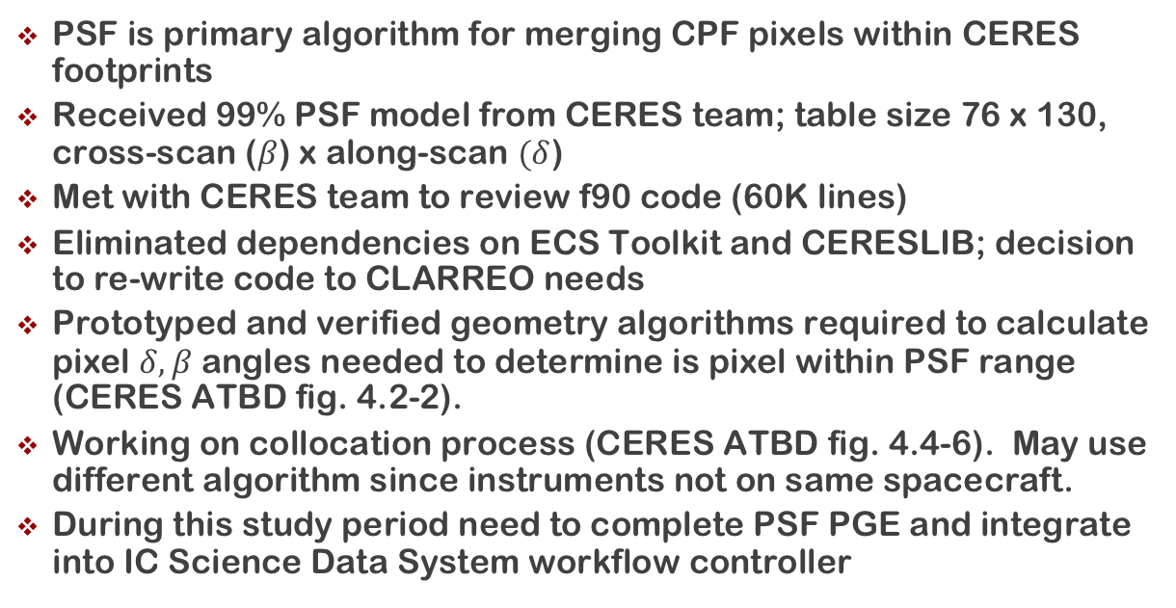
CERES Point Spread Function Status
PSF is primary algorithm for merging CPF pixels within CERES footprints
Received 99% PSF model from CERES team; table size 76 x 130, cross-scan ($β$) x along-scan $(δ$)
Met with CERES team to review f90 code (60K lines)
Eliminated dependencies on ECS Toolkit and CERESLIB; decision to re-write code to CLARREO needs
Prototyped and verified geometry algorithms required to calculate pixel $δ, β$ angles needed to determine is pixel within PSF range (CERES ATBD fig. 4.2-2).
Working on collocation process (CERES ATBD fig. 4.4-6). May use different algorithm since instruments not on same spacecraft.
During this study period need to complete PSF PGE and integrate into IC Science Data System workflow controller

Slide 25
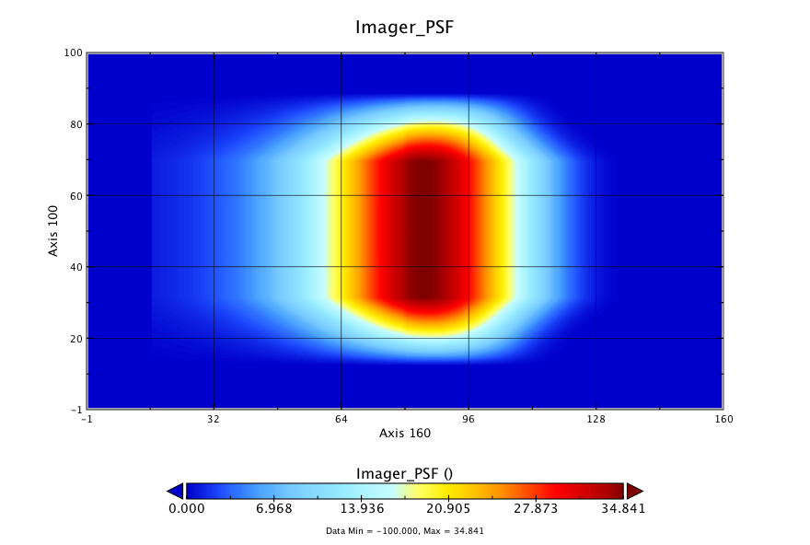
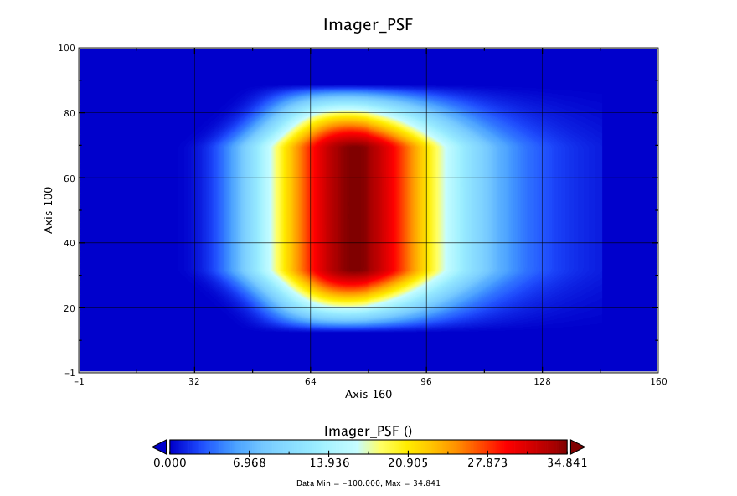

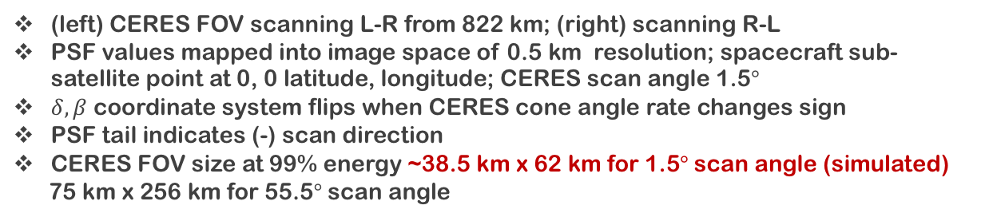
Testing/Prototyping CERES Point Spread Function
$$°$$
(left) CERES FOV scanning L-R from 822 km; (right) scanning R-L
PSF values mapped into image space of 0.5 km resolution; spacecraft sub-satellite point at 0, 0 latitude, longitude; CERES scan angle 1.5$°$
$δ, β$ coordinate system flips when CERES cone angle rate changes sign
PSF tail indicates (-) scan direction
CERES FOV size at 99% energy ~38.5 km x 62 km for 1.5$°$scan angle (simulated)
75 km x 256 km for 55.5$°$scan angle

Slide 26
Questions ?

