Slide 1
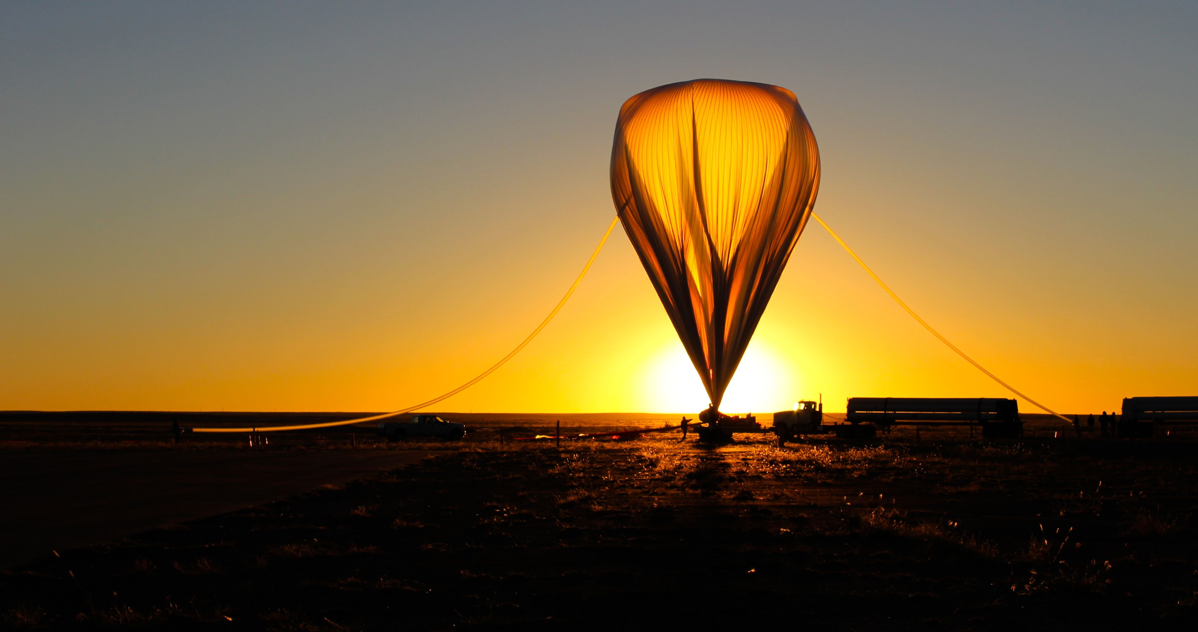
CPF/HySICS
Inter-Calibration Performance Expectations
CLARREO Pathfinder Inter-Calibration Workshop
Pat Brown, Greg Kopp, Paul Smith
Laboratory for Atmospheric and Space Physics, Univ. of Colorado, Boulder, CO

Slide 2
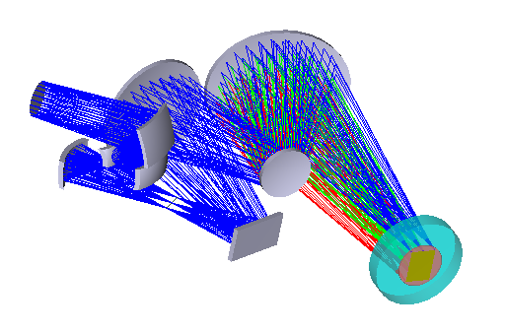
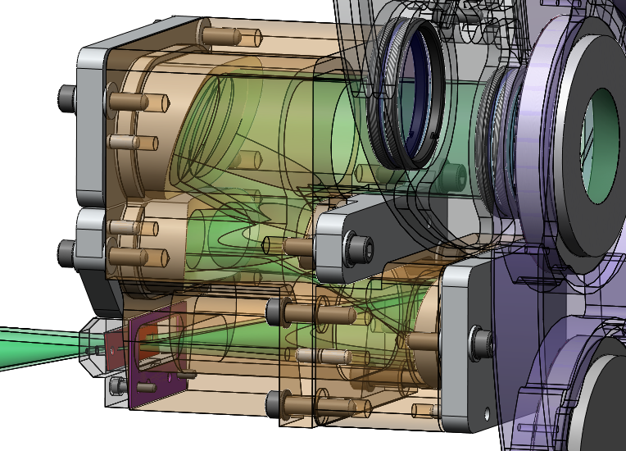
HyperSpectral Imager for Climate Science (HySICS)
Vacuum Window
and Order Sorting Filter
Aperture(s)
Instrument Summary
  Pushbroom imaging spectrometer
  Precision aperture stop in front of telescope
  Low polarization sensitivity
Grating
Fold Mirror
Slit
Parameter | Design Requirement
Spatial Resolution | 2.5 arcmin
Field of View (cross track) | 10°
IFOV | 0.02°
Wavelength Range | 350-2300 nm
Wavelength Resolution | 6 nm, constant, Nyquist
Aperture | 0.5, 10, 20 mm diameter
FPA

Slide 3
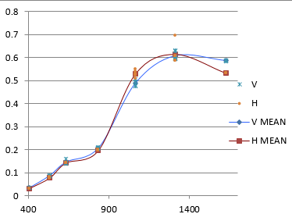
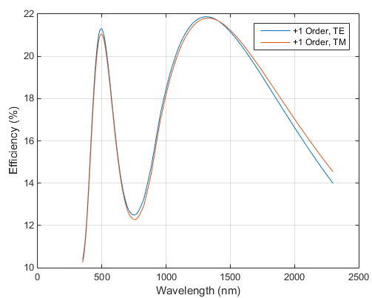
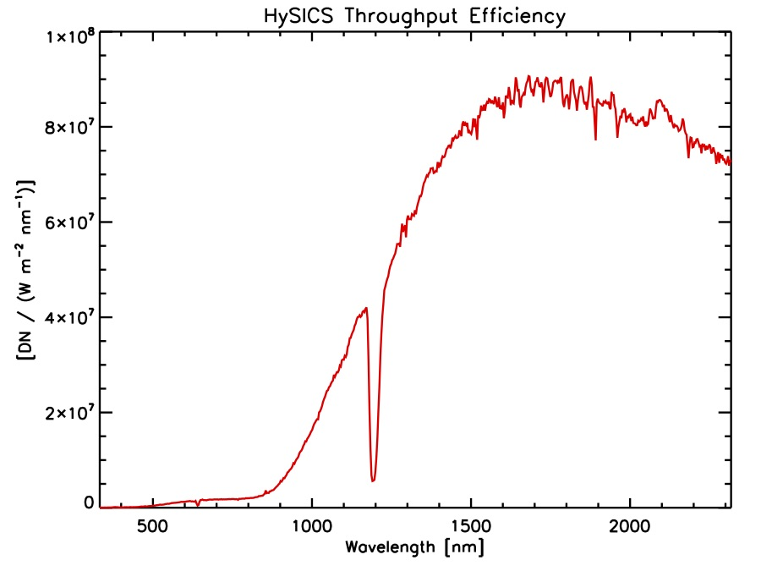
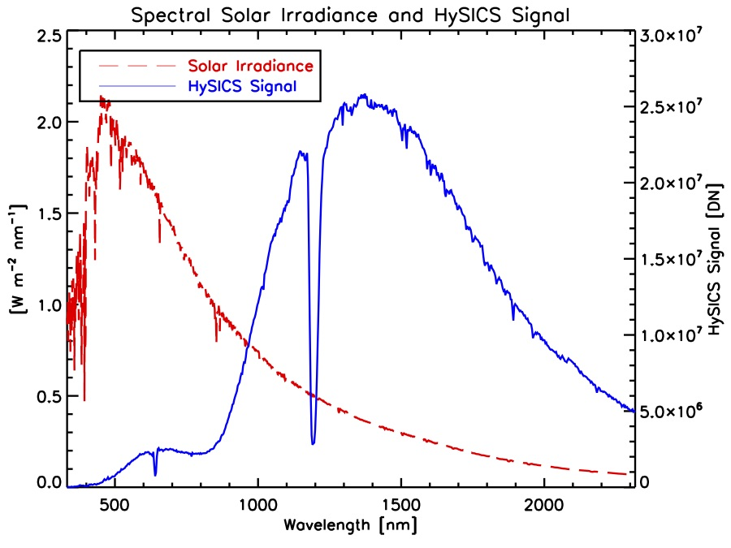
Radiometric Efficiency Is Calibrated On-Orbit Using the Sun
Balloon/HySICS Grating Efficiency
Vacuum Window
and Order Sorting Filter
Aperture(s)
CPF/HySICS Expected Grating Efficiency
Intentionally made Balloon/HySICS more sensitive in NIR where signal is weaker; will improve visible sensitivity for CPF/HySICS
Grating
Fold Mirror
Slit
FPA

Slide 4
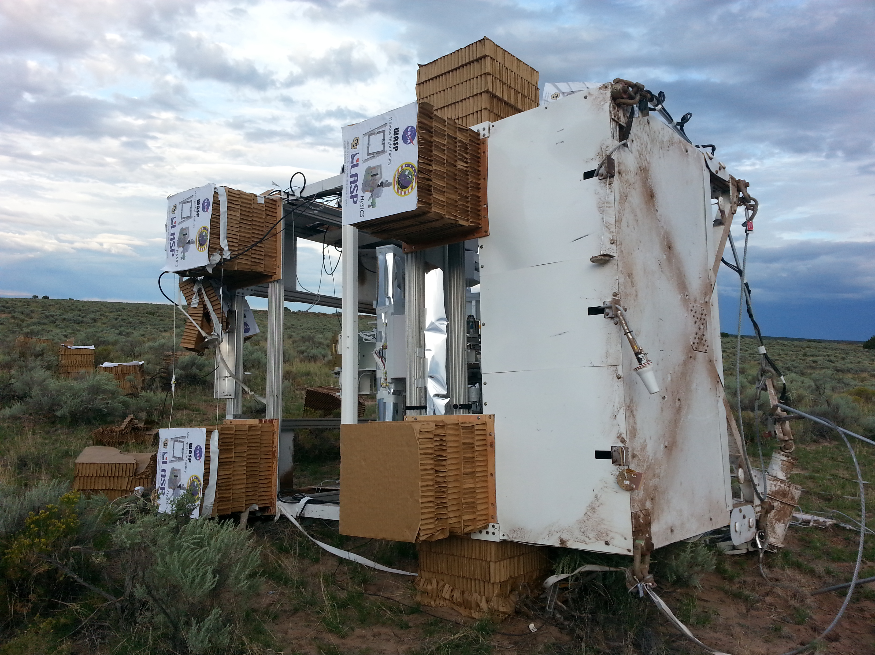
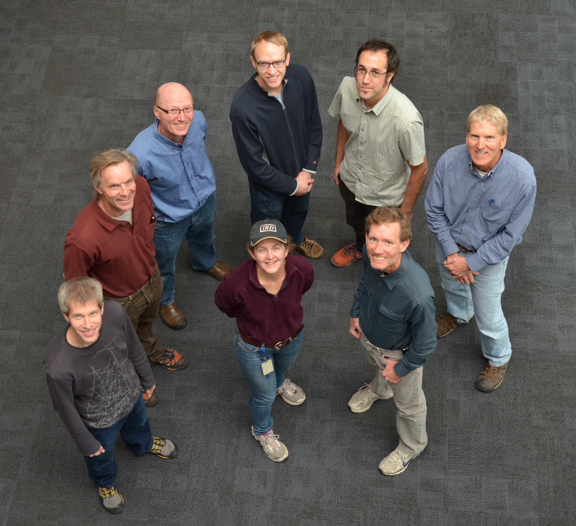
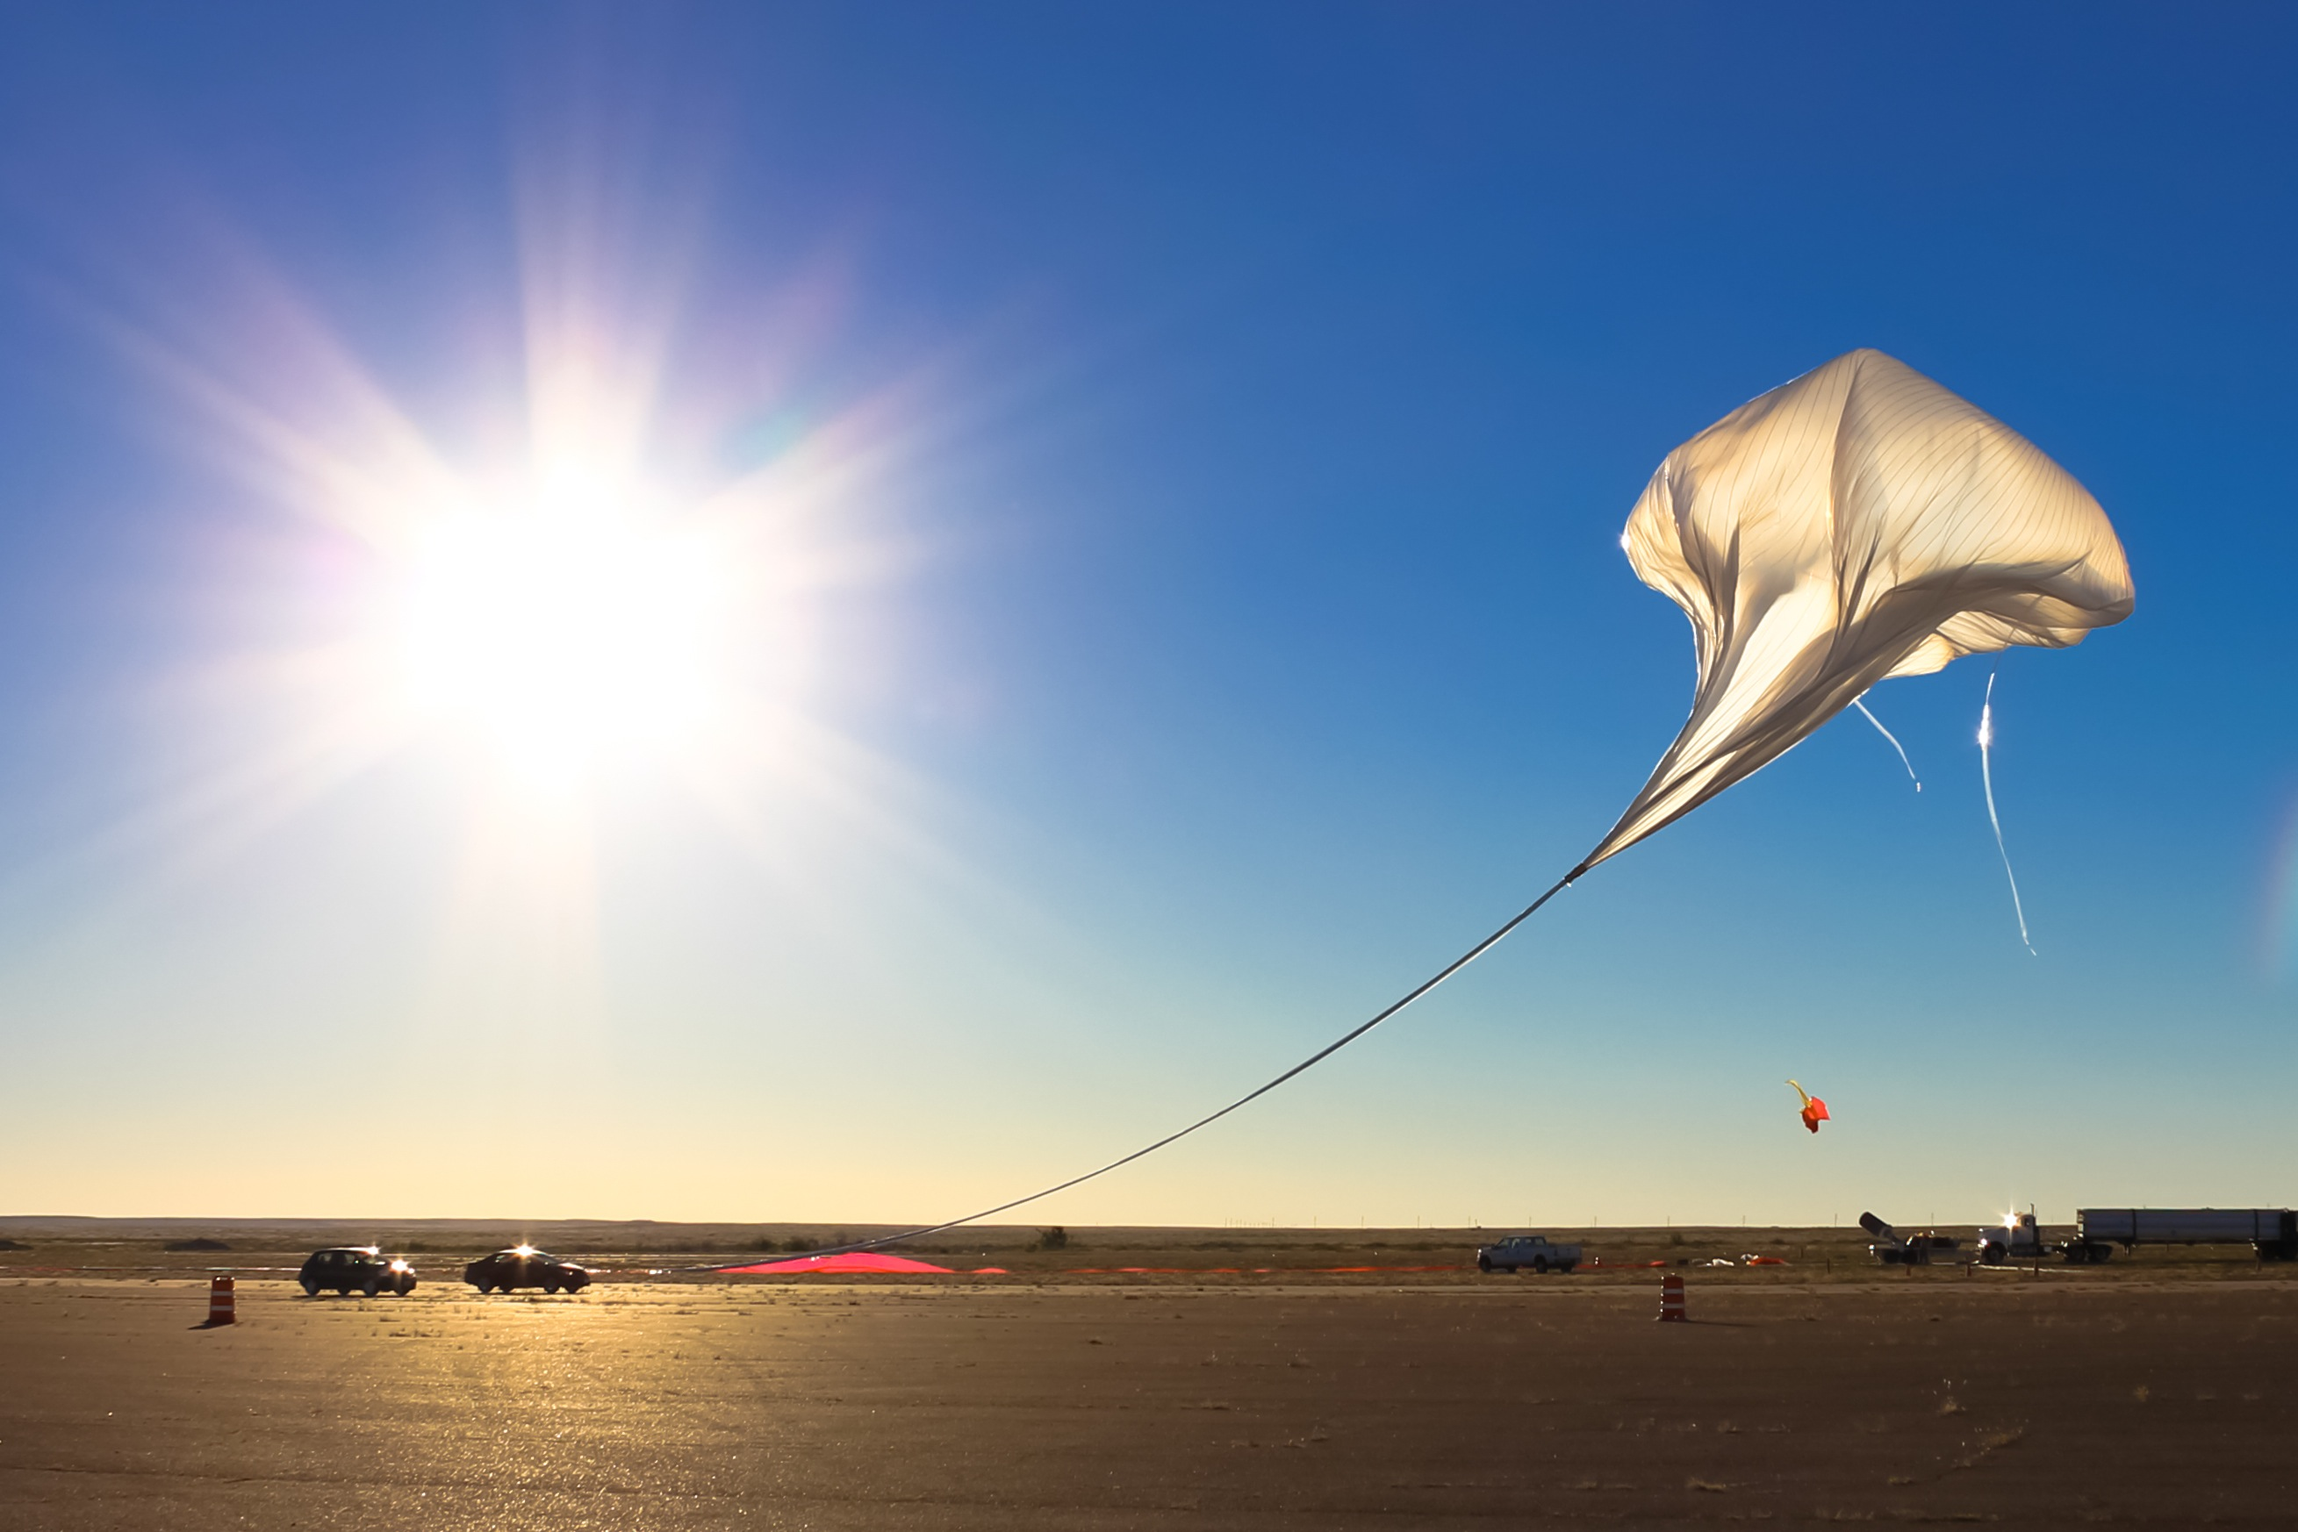
Demonstrated HySICS on Two High-Altitude Balloon Flights
Intent: Demonstrate solar cross-calibration method of Earth-radiance scenes
Altitude: 37 km (120,000’)
2013 and 2014
Balloon/HySICS Team (HySICS view)

Slide 5
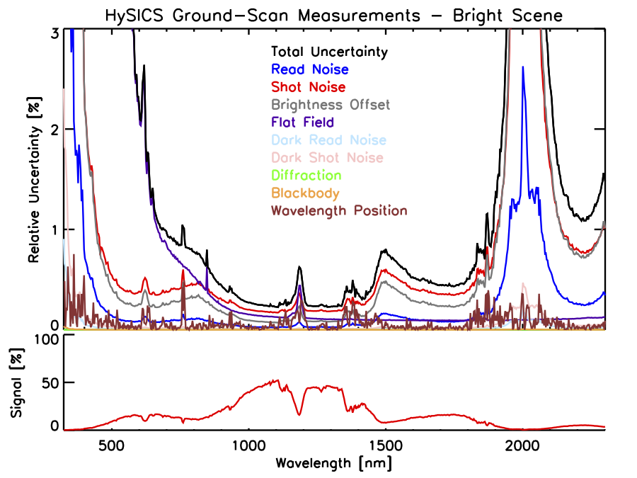
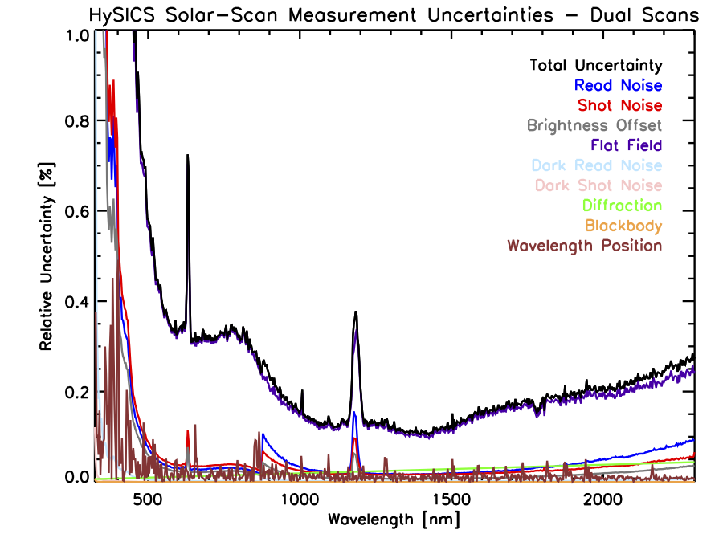
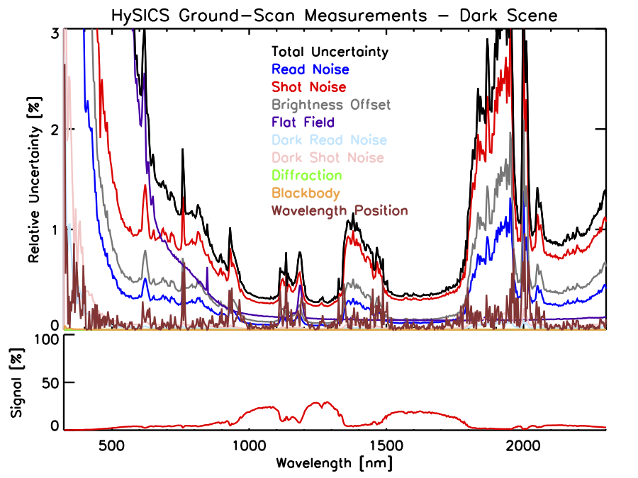
Flat-Fields and Shot Noise Dominated Balloon Uncertainties

Slide 6
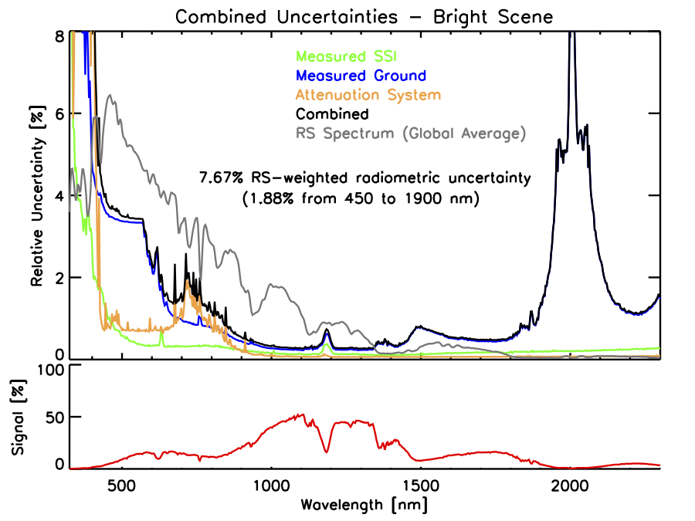
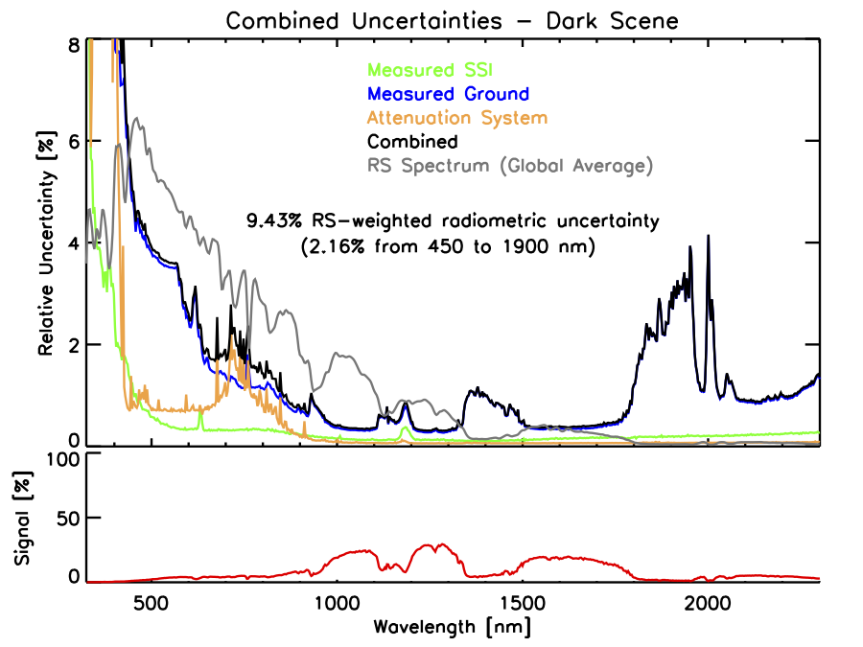
Balloon/HySICS Uncertainties Published
For details see
Kopp et al., Geosci. Instrum. Method. Data Syst., 2017, doi:10.5194/gi-6-169-2017
Uncertainties are for a single pixel

Slide 7
HySICS End Result – Radiometric Ground Images
Applying spectral solar-irradiance calibrations to the HySICS data yields radiometrically-calibrated data cubes
1233 nm

Slide 8
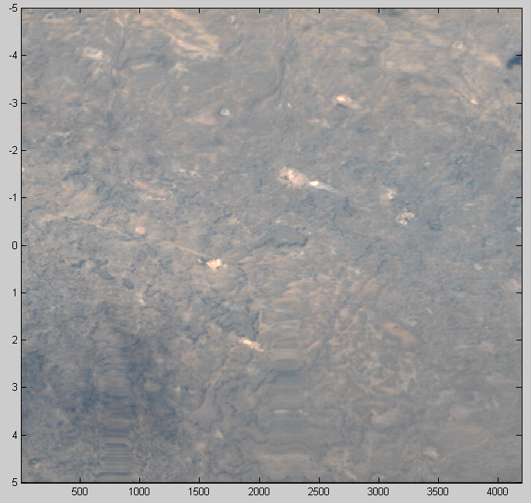
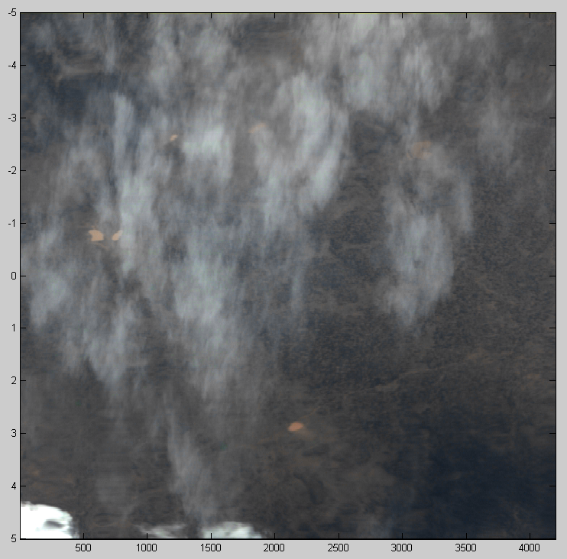
HySICS Ground Scans Acquired from Balloon Flight #2
Radiometrically-calibrated Level 1A data cubes from high-altitude balloon flight available

Slide 9
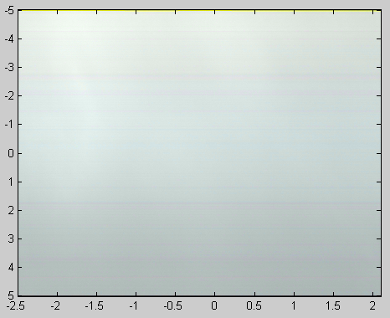
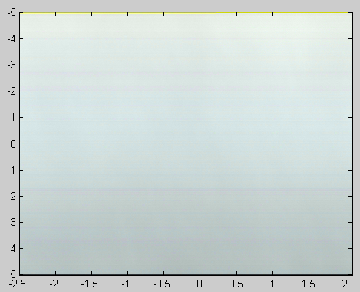
HySICS Cloud Scans Acquired from Balloon Flight #2
Radiometrically-calibrated Level 1A data cubes from high-altitude balloon flight available

Slide 10
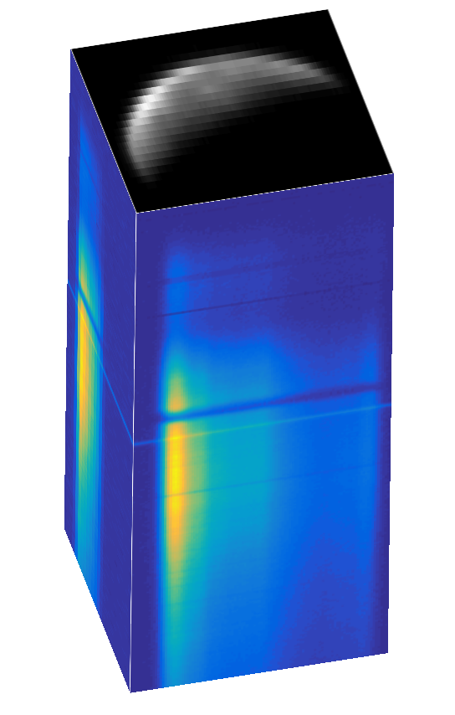
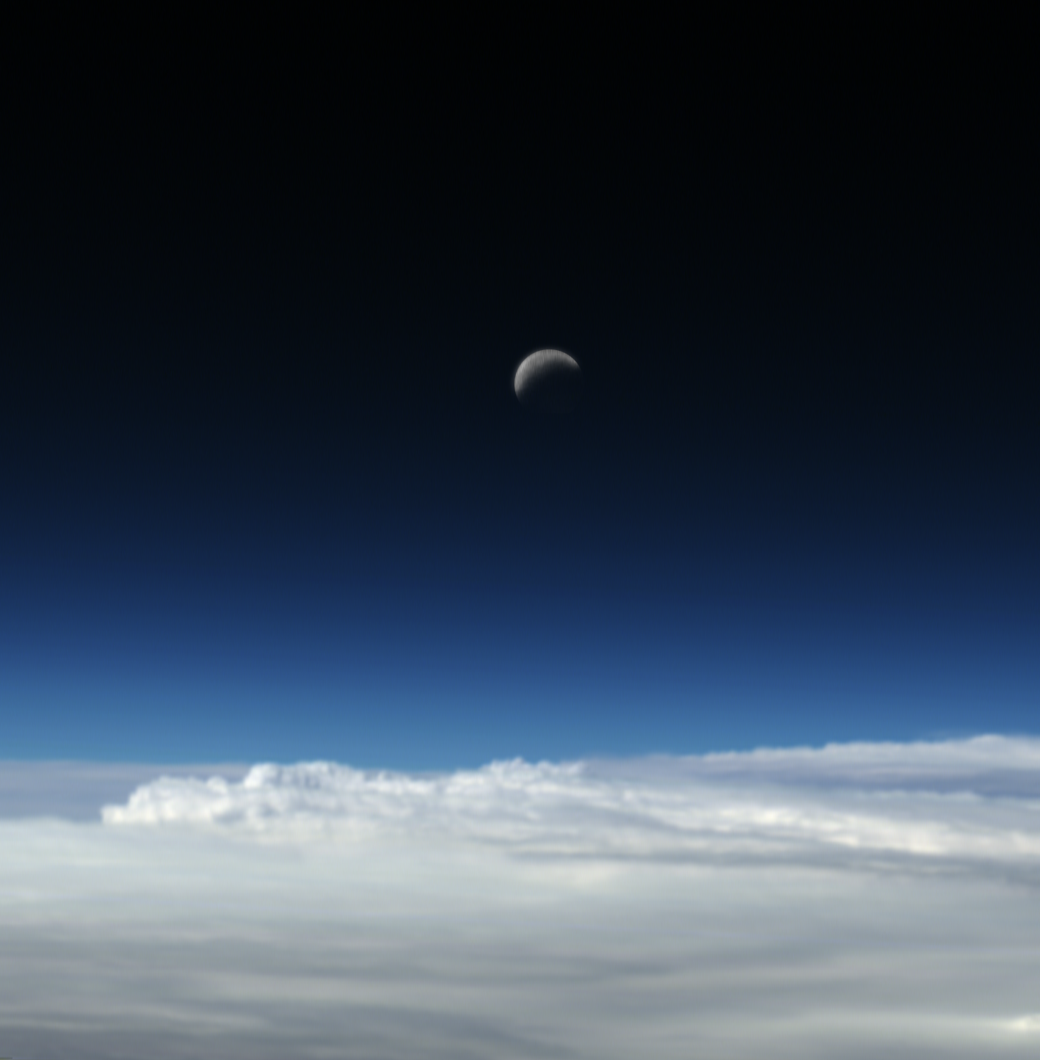
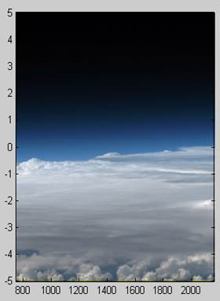
Earth Limb and Lunar Scans Acquired from HySICS Flight #2

Slide 11
Expected Improvements Due to Space-Borne Platform
Improved flat-field calibrations using Earth-viewing optics
  Lunar flat-fields at better phase angles and using multi-image dual-scan approach (see Kopp et al. 2017)
  Acquire additional flat fields using Spectralon diffuser, particularly improving temporal filling
Improved thermal stability
  Provided by second cryo-cooler and more stable thermal conditions due to true vacuum environment
  Reduces background blackbody drifts and FPA sensitivity to thermal variations
  Improves calibration durations of FPA, imaging optics, and spectral scale
Much broader spatial and temporal coverage
But there are some added un-improvements due to ISS compared to balloon platform
  Severe limitations on frequency of solar- and lunar-calibration opportunities due to ISS structure
    Will fill in with Spectralon flat-fields
  More high-frequency jitter from pointing system
    NASA’s Wallops Arc-Second Pointing (WASP) system used on balloon was incredibly good
  Occasional observing limitations due to special ISS activities

Slide 12
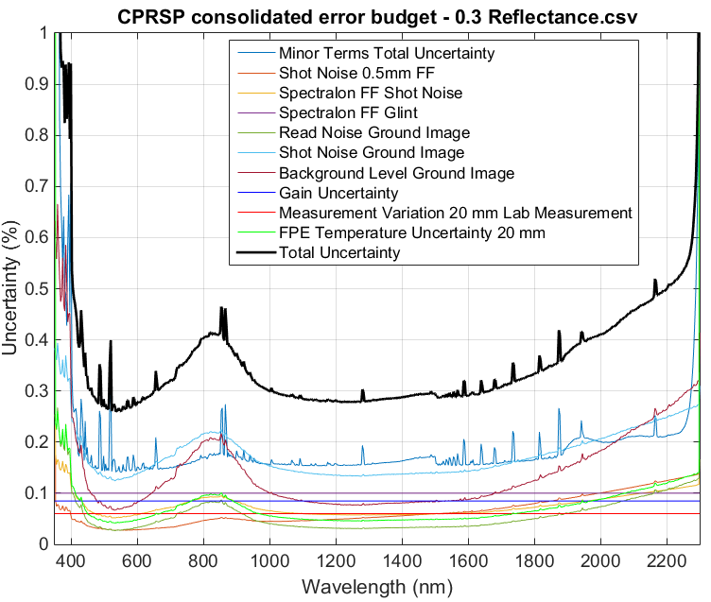
Expected Instrument-Specific Improvements
Improved grating provides lower uncertainties, higher visible signal, and less polarization
Increased intrinsic FPA gain improves ground-scene sensitivity
Improved lab calibrations reduces attenuation-method uncertainties
Uncertainty estimates for a spectrally-flat R=0.3 reflectance surface (per pixel)

Slide 13
CPF/HySICS Products for Inter-Calibration
Calibrated Earth-scene radiances and reflectances
  Acquired of overpass regions nearly simultaneously with and having nearly matching look-angles as other selected on-orbit sensors
  Acquired of several vicarious ground-calibration sites
Lunar irradiances

Slide 14
CPF/HySICS Data-Level Definitions – Level 0
Summary: All telemetered instrument and ancillary data; unprocessed; for data archive
Primary data: Contents of focal-plane-array images
  Science scans of ground, Sun, Moon
  Calibration scans of Sun, Moon (flat-fields, pointing, alignment)
  Internal calibration measurements (darks, pen-ray)
State of image data
  Each image is time-tagged
  Images are in units of DNs
  Image array columns and rows are merely counted sequentially (no useful units)
Ancillary data
  Instrument temperatures [DNs]
  Pointing information from HySICS gimbals and from ISS [DNs]
  Desired (intended and planned) pointing information

Slide 15
CPF/HySICS Data-Level Definitions – Level 1A
Summary: All ground- and lunar-scan data converted to calibrated radiance and/or reflectance units
Primary data: Calibrated scans of ground and Moon
  Set of focal-plane-array images from each contiguous ground scan
  Set of focal-plane-array images from each cross-slit lunar scan
State of image data
  Each image is time-tagged [Julian Day]
  Two image products: Images are in units of both reflectances [R/R_{Sun}] and radiances [W m⁻² sr⁻¹ nm⁻¹]
    All radiometric corrections are applied (i.e. darks, flat-fields, thermal background, spectral scale, attenuation corrections, solar-ratio, etc.)
    Uncertainties are given for each pixel for both reflectance and radiance image-products
  Image-array columns and rows are in units of relative spatial scale [m or arc-seconds] and spectral scale [nm]

Slide 16
CPF/HySICS Data-Level Definitions – Level 1A
Summary: All ground- and lunar-scan data converted to calibrated radiance and/or reflectance units
Ancillary data
  Pointing information for the look direction of each image is given (but no geo- or co-alignment corrections have been applied)
  Desired (intended and planned) pointing information
  Reference link to applicable SSI data set
  Reference to flat-field calibration data sets (and possible extrapolations due to temperature change)
  Reference to SSI calibration data set (and possible extrapolations due to temperature change)
  Reference to pen-ray calibration data set (and possible extrapolations due to temperature change)
Metadata
  Labels for type of data (to enable searching)
    Ground scan
    Lunar scan
    Calibration type (flat-field, solar scan, dark measurement, pointing or alignment data)
  Notes on look direction, data quality

Slide 17
CPF/HySICS Data-Level Definitions – Level 1B (Primary Data)
Summary: All ground- and lunar-scan data converted to radiometrically-calibrated data cubes on desired spatial and spectral scales
Primary data: Calibrated data cubes of ground and Moon with each element binned to final scales
  Data cube of each contiguous ground scan
  Data cube of each cross-slit lunar scan
State of data
  Two data-cube products: Each data cube is in units of both reflectances [R/R_{Sun}] and radiances [W m⁻² sr⁻¹ nm⁻¹] with uncertainties given for each element
  Data-cube axes are in units of absolute spatial scale [latitude/longitude for ground and RA/dec for Moon] in two axes and spectral scale [nm] in the other
  Pointing corrections have been applied to provide uniformly-spaced scans of ground (with geolocation corrections applied) and of Moon (via interpolation or similar technique)
  Each element in the data cube is time-tagged via the same interpolation technique used to create the uniformly-spaced ground scan [Julian Day]
  Spectral corrections have been applied to desired wavelength grid

Slide 18
CPF/HySICS Data-Level Definitions – Level 1B (Primary Data)
Summary: All ground- and lunar-scan data converted to radiometrically-calibrated data cubes on desired spatial and spectral scales
Metadata
  Labels for type of data cube (to enable searching)
    Ground scan
    Lunar scan
    Vicarious calibration site
    Inter-calibration observation
  Notes on look direction, data quality

Slide 19
HySICS Pointing System (HPS)
2-axis brushless DC gimbal allows for large range-of-motion, high-bandwidth, high-accuracy pointing of the HySICS instrument
HPS can point at three primary targets
  Earth target including:
    Nadir viewing
    Inter-calibration ground trajectories
    Vicarious ground targets
  Solar target
  Lunar target
ISS orbit-to-orbit attitude perturbations and base-motion jitter are compensated by HPS
See presentation by Pat Brown from splinter session on 15 Nov. 2017 for more details

Slide 20
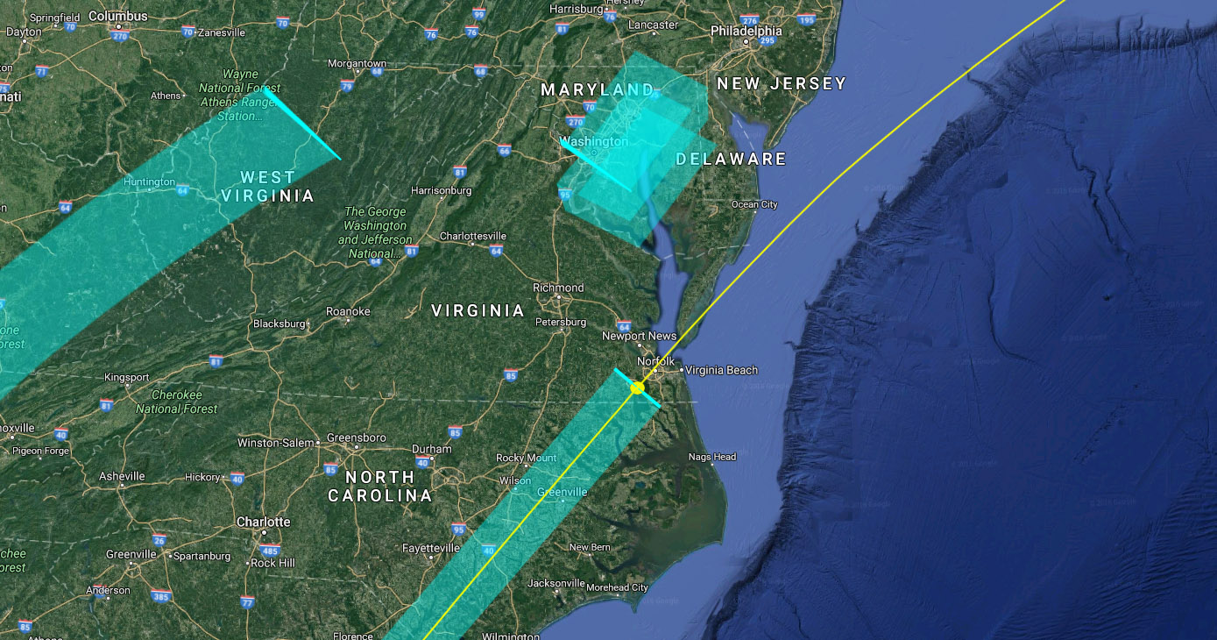
Earth Pointing Operational Modes
Surface-site tracking
Off-nadir push-broom imaging
Surface-site push-broom targeting
ISS orbit track
Nadir push-broom imaging
Sub-ISS nadir point

Slide 21
HPS Earth Pointing
Angular pointing matching <1 deg (k=1) wrt CERES/VIIRS
  Within ±10 minutes in time
  Real-time guidance calculations account for ISS position and attitude uncertainty
Geolocation knowledge <250 m (k=1) achieved with star-tracker measurements
  Star tracker provides medium-cadence (5 Hz), high-accuracy attitude knowledge (<10 arcsec) of the instrument baseplate
  Geolocation knowledge also accounts for several other error sources: ISS position, timing, resolver accuracy, misalignments (static, thermal), jitter, etc.
Jitter expected to be < 10 arcsec (k=1) due to:
  ISS base-motion disturbances
    Being minimized through both passive (direct-drive, low-coupling gimbal design) and active (star-tracker measurements to generate equal & opposite gimbal command trajectories) attenuation techniques
    SAGE III Disturbance Monitoring Package (DMP) data have been analyzed and indicate low-frequency (<1 Hz), low magnitude (<3 arcsec RMS) angular jitter that is consistent with on-orbit measurements by OPALS on ELC-1
  Cryo-cooler induced disturbances
    Initial estimates <3 arcseconds based on conservative cryo-cooler data
    Risk reduction test plan is in process to measure and characterize the cryo-cooler disturbance environment
  Actuator self-induced errors
    Heritage TSIS controller has demonstrated < 5 arcseconds residual tracking errors

Slide 22
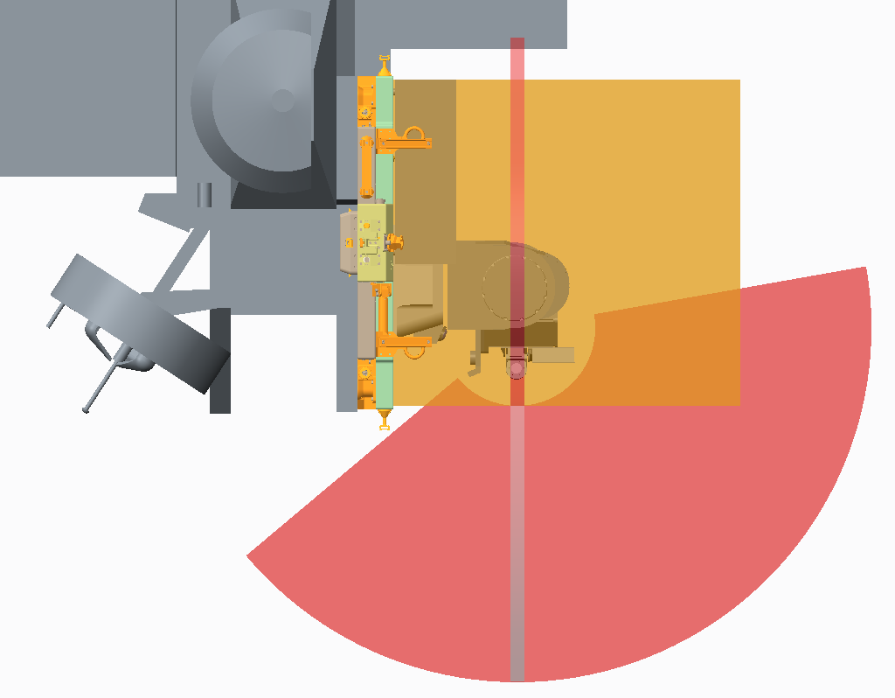
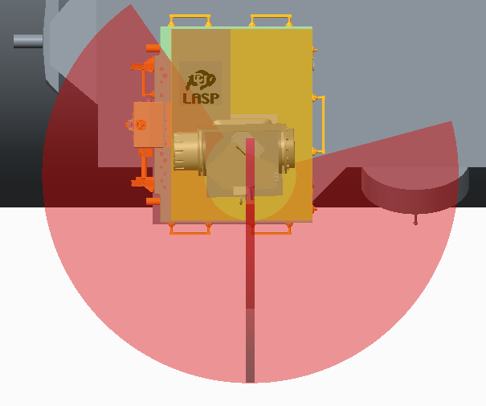
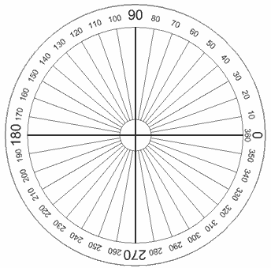


HPS Gimbal Range for Inter-Calibrations
135º
-Z Zenith
-Z Zenith
15º
+Y Starboard
-Y Port
10º
+X Ram
-X Wake
+Z Nadir
+Z Nadir
220º
HPS can point at Earth, Sun, and Moon targets often enough to meet requirements but is limited by viewing obscuration due to ISS structure

