Slide 1
TRUTHS Cross-calibration Uncertainty Tool: Status and Way Forward Javier Gorroño, Andrew C. Banks, Nigel P. Fox, Craig Underwood CLARREO Pathfinder Inter-Calibration Workshop NIA, 16th November 2017, Hampton, VA.
Welcome to the National Physical Laboratory

Slide 2
Index and objectives
TRUTHS mission
Spectral knowledge
Spatial dimension
Temporal dimension
Uncertainty budget for TRUTHS
The way forward
Research objectives:
Evaluate the “inherent” uncertainty contributions of cross-calibration with case studies
Set up a suite of tools and methodologies useful for the exploitation and design of missions like TRUTHS or CLARREO, and
define the uncertainty contributions in a cross-calibration over specific sites using rigorous metrology.
Javier Gorroño, Andrew C. Banks, Nigel P. Fox, Craig Underwood, Radiometric inter-sensor cross-calibration uncertainty using a traceable high accuracy reference hyperspectral imager, In ISPRS Journal of Photogrammetry and Remote Sensing, Volume 130, 2017, Pages 393-417

Slide 3
TRUTHS mission: Traceable Radiometry Underpinning Terrestrial and Helio- Studies
Takes terrestrial SI-traceability chain into orbit providing TOA radiance/reflectance factor (320 nm – 2400 nm) to:
Direct sampling of climate signals by TRUTHS’ sensors.
Improving performance in other observing systems through reference calibrations.
Main mission requirements:
Accuracy 320 - 2450 nm < 0.3 % (k=2)
> 200 (10 nm) channels continuously sampled globally at Nadir
Multi-angular spectrally resolved measurements of specific targets
50 m ground resolution (max.)
Notes:
This is the maximum error observed for each band after fitting all bands simultaneously (residual error for individual bands after minimising the rms error across all bands). This is sensitive to starting wavelength – i.e. do you do 400 nm – 410 nm or 401 nm – 411 nm. So the red and blue versions are for maximum and minimum residuals for all the starting wavelength options.

Slide 4
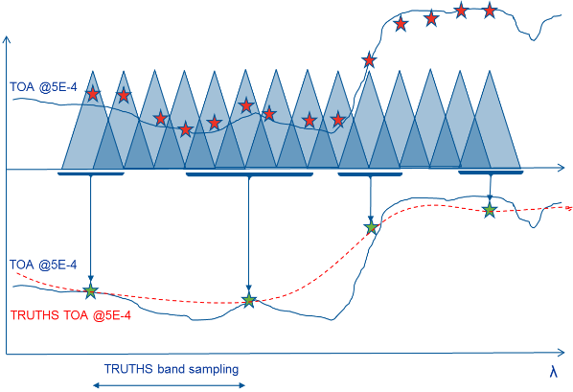
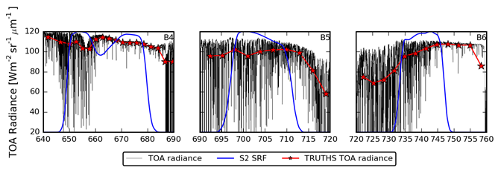
Spectral dimension: methodology
Method links the preliminary imager design of SSTL to final application results.
Sentinel 2 MSI – TRUTHS comparison
Convolution of S2 band (black line) and MODTRAN TOA radiance (black line)
Convolution of S2 band (black line) and MODTRAN TRUTHS radiance (red line)
Notes:
This is the maximum error observed for each band after fitting all bands simultaneously (residual error for individual bands after minimising the rms error across all bands). This is sensitive to starting wavelength – i.e. do you do 400 nm – 410 nm or 401 nm – 411 nm. So the red and blue versions are for maximum and minimum residuals for all the starting wavelength options.

Slide 5
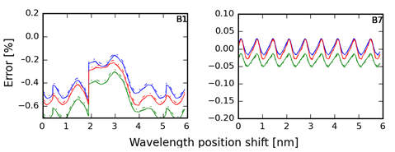
Spectral dimension: sampling/resolution
TOA radiance simulated as generic desert case with:
Results for multiple interpolation combinations
Potential positioning of array (wavelength spectral shift)
A potential criteria to select the best positioning/interpolation is an RMS of sampling error for VNIR and SWIR bands (select best and worst combination)
Results <0.3% for most bands S2 and <0.5% for S3 OLCI in no absorption bands
S2 MSI S3 OLCI
±0.5 %
0.3 %

Slide 6
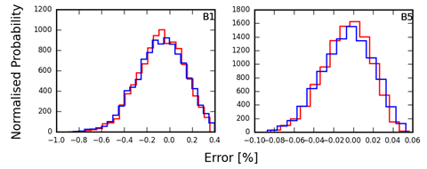
Spectral dimension: spectral knowledge
Method:
TOA radiance spectrum n times with different centre wavelength and/or bandwidth each time, before convolving it with the S2 bands
Settings:
Uncertainty→ 0.2 nm (k = 1) central wavelength and bandwidth knowledge
TOA spectral→ MODTRANv5 run at 0.1cm⁻¹ for maximum sensitivity
MCM→ 10.000 iterations.
Goal:
Simplified model to test the potential requirements in spectral knowledge

Slide 7
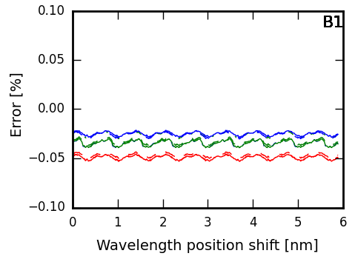
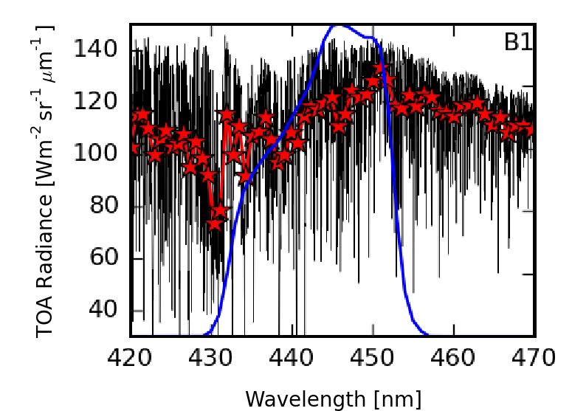
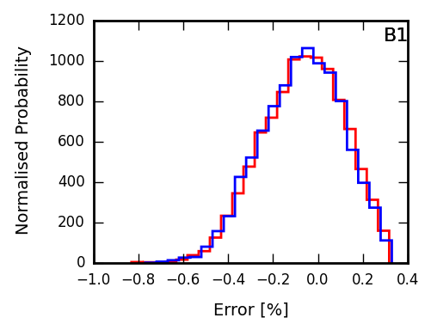
Spectral dimension: spectral binning
Issue: B1 produces error >0.3% and Spectral binning >5 to maximise SNR (>1000)
Proposed: In a cross-calibration our SNR is more relaxed (required an ROI of pixels)!!! Possibility to program the FPGA on-board for the event (minimum impact on memory/other applications).
Results: B1 simulation w/o spectral binning shows a great reduction of sampling/resolution error with same spectral knowledge uncertainty (individual native band is more sensitive but more bands are integrated)

Slide 8
Spectral dimensions: other sites
Issue: other sites from desert might show different results
Proposed: grass, ocean and snow TOA spectral radiance simulations
snow simulation→ sub-arctic summer atmospheric model at 60 ° latitude SZA of 65 °.AOT and water vapour from AERONET in Greenland.
Grassland and ocean→ mid latitude summer, June 22, same solar angles as the desert simulation but with AOT and water vapour data taken from La Crau for grassland, Ascension island for oceanic site.
Results:

Slide 9
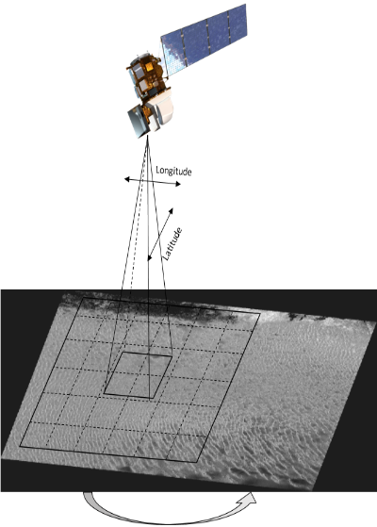
Spatial dimension: methodology
Objective:
Study the TOA radiometric uncertainty as a consequence of a geolocation uncertainty at a single overpass
Methodology
Select a ROI
Create an error image by shifting the ROI over an enlarged area
Calculate the std. growing from the centre to produce a relationship of TOA reflectance uncertainty with geoposition knowledge
Validate by comparing L8 OLI to S2 MSI
Notes:
Here we take an image pixel and we shift it relative to the centre. Each block in the colourful diagram is for a bigger or smaller shift up to 400 m. This is for La Crau (which was worse than Libya-4). Maximum shift was 400 m. The centre of the diagram corresponds to perfect overlapping (longitude/latitude scales are misleading – they are in absolute longitude/latitude when adding the arbitrary large number).
The plot on the bottom right then looks at the standard deviation of the error as you have increasing circles out from the middle of the colourful plot. With the right side being for the whole image. This is considered the uncertainty in not knowing the colocation to within 400 m. Since this increases linearly, we can make the assumption that for a 40 m colocation error it’s 10 times less.

Slide 10
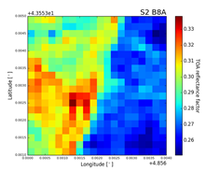
Spatial dimension: LaCrau
Step 1. La Crau 400 × 400 m² area centred at 43.556º N 4.858º E
(TOA reflectance factor)
Step 2. Error map of approximately 0.32 × 0.44 km²
~400 m
knowledge
Pseudo-linear regression
Step 3. Std growing from the centre offset vs TOA reflectance std
Step 4. Comparison for L8 OLI ans S2 MSI
~40 m
knowledge

Slide 11
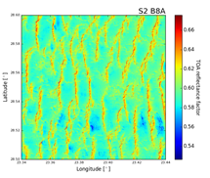
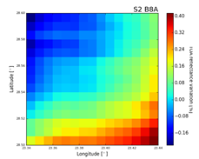
Spatial dimension: Libya-4
Step 1. 28.55º N 23.39º E with a size of 20 km x 20 km (TOA reflectance factor)
Step 2. Error map of approximately 10 × 10 km²
Pseudo-linear regression
~5km
knowledge
Step 3. Std growing from the centre offset vs TOA reflectance std
Step 4. Comparison for L8 OLI and S2 MSI
~500 m
knowledge

Slide 12
Temporal dimension: methodology
Previous work: cross-calibration matchups were set to a global scale within a 5 minutes of delay between overpass. At that time delay, the temporal noise was found to be at the 1 % level and with sufficient samples the noise reduces to <0.3% (Wielicki et al., 2008)
Complementary work: Study of the achievable residual introduced by a correction in a delay overpass of 30 minutes over PICS (example of Libya-4).
Separate study for each of the individual effects…
Notes:
Now looking at temporal effects. AT 443 nm this is dominated by the atmosphere and scattering changes. IT’s worse in winter than summer, as the sun goes through more atmosphere on the way down. It’s assumed we’d correct for this using a RTM, so we look at the difference between RTMs as the uncertainty.
At 865 nm the main effect is from inaccurately known surface BRF. Again this can be modelled to a certain extent. Here we have the results of a simulation (this time the summer is worse). The change in surface reflectance in 30 minutes was determined through MC modelling where the parameters from the Bouvet model were varied. You see an offset of about 0.6 %, with a spread of about 0.3 %.

Slide 13
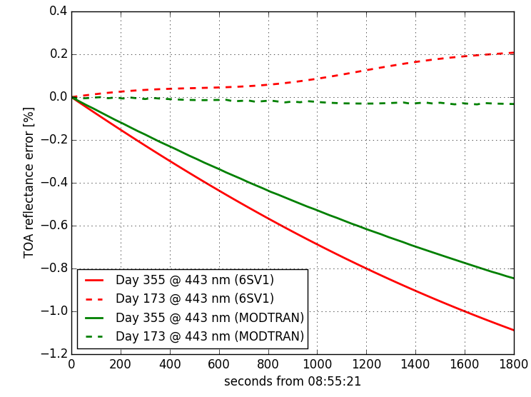
Temporal dimension: atmospheric variation and radiative transfer code impact
Similar modelling using two different RTC to find TOA reflectance factor change in 30 minutes (if uncorrected) and RTC disagreement (if uncorrected)
Summer solstice
Winter solstice
0.2 %

Slide 14
Temporal domain: atmospheric knowledge
TOA radiance difference repeated nearly 1000 times
AOT and water vapour from a normal distribution specified in Mishra et al. (2014a) as representative of Libya 4.
Results show the impact is below 0.1%
 | Day of Year 173 |  |  | Day of Year 355
 | 443 nm | 865 nm | 2201 nm | 443 nm | 865 nm | 2201 nm
Mean | -0.0303 | 0.0919 | 0.4114 | -0.8496 | 0.1169 | 0.9936
Std. dev. | 0.01 % | 0.03 % | 0.03 % | 0.06 % | 0.04 % | 0.06 %
Skewness | -1.2034 | 0.7712 | 0.0394 | -0.5856 | 0.4006 | -0.0853
Excess Kurtosis | 2.1070 | 0.2492 | 0.6763 | -0.4073 | -0.7570 | 0.0348

Slide 15
Temporal domain: atmospheric variation
In PICS the atmosphere will be largely stable in 30 min
Predict the worst case uncertainty as limit uncertainty in a temporal correction.
Previous AOT and water vapour variations have been used to study the
TOA radiance dispersion at a point in time (before it was the dispersion of the correction!)
 | Day of Year 173 |  |  | Day of Year 355
 | 443 nm | 865 nm | 2201 nm | 443 nm | 865 nm | 2201 nm
Mean | 12.4844 | 8.4809 | 0.5721 | 8.4381 | 5.4657 | 0.3482
Std. dev. | 0.57 % | 0.30 % | 1.53 % | 0.86 % | 0.67 % | 1.91 %
Skewness | 0.5784 | -1.0744 | 0.2772 | 0.7023 | -0.7512 | 0.2995
Excess Kurtosis | -0.3525 | 0.6615 | 0.1832 | -0.0903 | -0.0482 | 0.1838

Slide 16
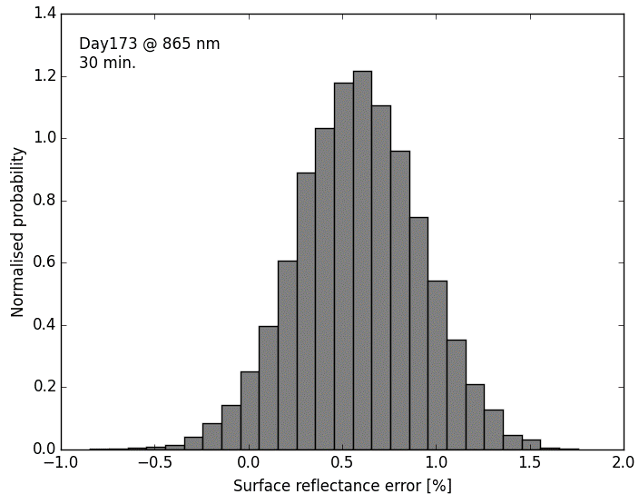
Temporal dimension: surface impact
Libya-4 RPV surface reflectance model from Bouvet (2014) taken as a reference.
The change in the surface reflectance over 30 minutes (solar illumination variation) has been repeated 10000 times.
At each iteration the RPV parameters are samples out of normal distributions 5 % std.
Uncertainty of the four parameters in the RPV model assumed as uncorrelated.
Important the method since neither uncertainty of RPV model and correlation info are available.
0.3 %
0.6 %

Slide 17
Uncertainty budget for TRUTHS – satellite comparisons (single overpass – reduces for multiple overpasses)
Uncertainty | Best S2 bands | Worst S2 bands
Spectral resolution TRUTHS | 0.1 % | 0.6 %
Spectral accuracy TRUTHS | 0.1 % | 0.2 %
Spatial co-alignment mismatch | 0.1 % (Libya) 0.12 % (La Crau) | 0.1 % (Libya) 0.5 % (La Crau)
30 minute time difference (atmospheric effects) | 0.1 % (if corrected) 0.3 % (if atmosphere not known) | 0.1 % (if corrected) 2 % (if atmosphere not known)
30 minute time difference (surface BRF) | 0.2 % | 0.4 %
Combined with reasonable corrections | 0.4 % - 0.5 % | 0.7 %
Viewing angle and polarisation error not included!

Slide 18
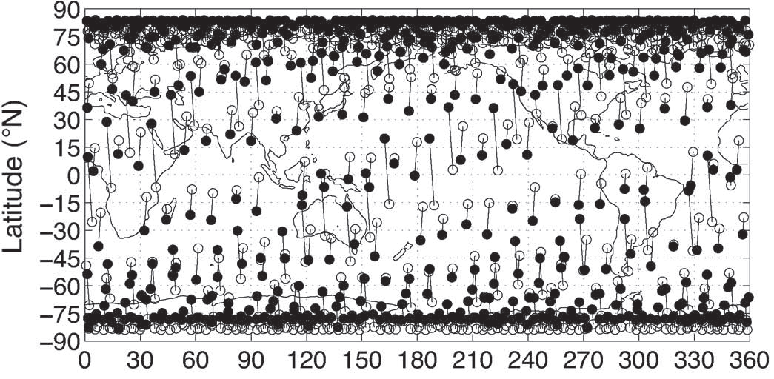
The way forward
Short-term goal: refine previous modules and expand the uncertainty analysis to include polarisation and viewing angle effects.
Long-term goal: An end-to-end cross-calibration uncertainty tool. A tool capable of predicting the radiometric error for any crossing between a reference and target sensor and estimate the achievable uncertainty over the accumulated crossings also to evaluate potential spectral band shifts of sensors under test.
Fundamental questions for the long-term studies:
Are errors independent? Up to what limit?
Is it better asynchronous or synchronous orbit in terms of uncertainty?
Which are the impacts in uncertainty convergence for different scenarios: corrections, constraints…?
For each single event obtain SZA, VZA, SAA, VAA,lat/lon, time…
Associate site to a land class (e.g. IGBP) and atmospheric conditions (e.g. ECMWF data)
Calculate the error of the simulated event: spectral, temporal, spatial, viewing, polarisation…
Repeat the process to obtain an error distribution (i.e. uncertainty)
ROITHMAYR et al.: CLARREO APPROACH FOR REFERENCE INTERCALIBRATION OF REFLECTED SOLAR SENSORS

Slide 19
Thank you. Questions?

