Slide 1
CLARREO Pathfinder
Project Status
Gary Fleming, Project Manager
NASA Langley Research Center
November 16, 2017
(757).864.6664
Gary.A.Fleming@NASA.gov
http://fpd.larc.nasa.gov/index.html

Slide 2
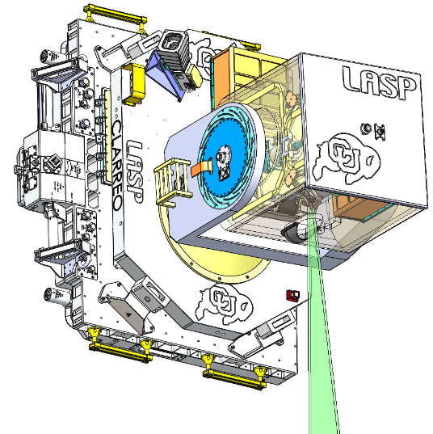
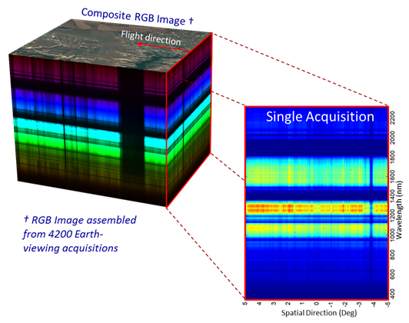
CLARREO Pathfinder Project Overview and Scope
CLARREO Pathfinder will demonstrate essential measurement technologies for the Reflected Solar portions of the CLARREO Tier 1 Decadal Survey Mission
Demonstrate on orbit, high accuracy, SI-Traceable calibration
Demonstrate ability to transfer this calibration to other on-orbit assets
Formulation, implementation, launch, operation, and analysis of measurements from a Reflected Solar (RS) Spectrometer, launched to the International Space Station (ISS)
Category 3 / Class D Mission, nominal 1-year mission life + 1 year science data analysis
Targeted for launch in early CY2022
Project execution authority assigned to NASA LaRC
Authority to Proceed received April 11, 2016
Instrument Payload
Spectrally-Resolved Earth Reflectance
CLARREO Pathfinder is not the end, it is a critical step along the way to a full CLARREO Mission.

Slide 3
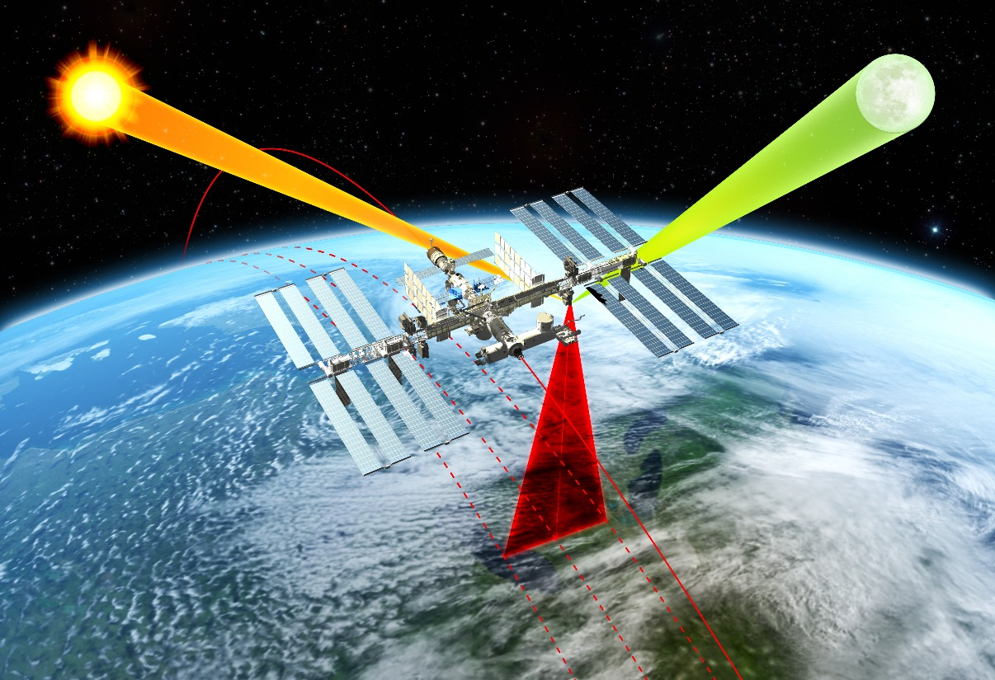
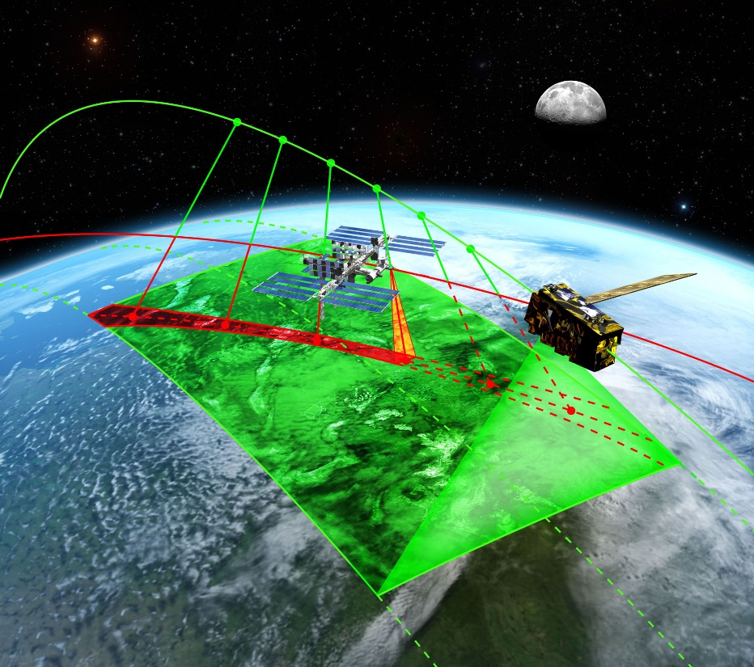
CLARREO Pathfinder: Baseline Mission Objectives
Demonstrate high accuracy SI-Traceable Calibration
Demonstrate Inter-Calibration Capabilities
Objective #1: Demonstrate the ability to conduct, on orbit, SI-Traceable calibration of measured scene spectral reflectance with an advanced accuracy over current on-orbit sensors using a reflected solar spectrometer flying on the International Space Station.
Objective #2: Demonstrate the ability to use that improved accuracy to serve as an in orbit reference spectrometer for advanced intercalibration of other key satellite sensors across the reflected solar spectrum (350-2300 nm).

Slide 4
Science Observations
Requirements
Solar and Lunar Views | Demonstrate On-Orbit SI-Traceable calibration accuracy
Nadir Data Collection | High accuracy, spectrally-resolved, geolocated data of Earth solar reflectance
Earth-views matched in time, space, viewing angle, and spectrum (visible) with CERES/RBI and VIIRS | Demonstrate inter-calibration with CERES/RBI and VIIRS Possibilities: SNPP, JPSS-1, JPSS-2
Additional Mission Opportunities
Inter-Calibration of Geosynchronous Imagers | Examples: ABI on GOES-16, EUMETSAT’s SEVIRI/GERB
Inter-Calibration of Low Earth Orbit Imagers | Example: Landsat imagers
Measurements of Surface Sites (i.e. Deserts) (instrumented and non-instrumented) | Spectrally-resolved reflectance that can be used as calibration references for current/future Earth Science instruments
Calibration of lunar irradiance | Potential ~10x improvement of current lunar irradiance standard, enabling the moon to be used as on-orbit calibration source for current / future Earth Science instruments
Instrument payload will have the capabilities to achieve the additional mission opportunities
Priorities will be determined by a future CLARREO Pathfinder Science Team (anticipated FY19-20 start)

Slide 5
Level 1 Requirements Summary
 | Measurement Uncertainty
Demonstration Parameter | Baseline Requirement* | Threshold Requirement**
Spectrally-Resolved Earth Reflectance (350 – 2300 nm): SI-Traceable, referenced to spectral solar irradiance | ≤ 0.3% (k = 1) | ≤ 0.6% (k = 1)
Spectrally-Integrated Earth Reflectance (350 – 2300 nm): SI-traceable broadband (350 - 2300 nm) spectrally-integrated Earth reflectance with spectral accuracy weighted using global average Earth spectrally reflected energy | ≤ 0.3% (k = 1) | ≤ 0.6% (k = 1)
On-Orbit Inter-Calibration***: Demonstrate the ability to Inter-Calibrate with CERES/RBI short wave channel and VIIRS reflectance bands | ≤ 0.3% (k = 1) | ≤ 0.6% (k = 1)
*Baseline requirement is within a factor of 2 of full CLARREO Tier-1 Decadal Survey Mission Requirements
**Threshold requirement is a factor of 2 (CERES) to 4 (VIIRS) better than current capabilities.
***Inter-calibration uncertainty are contributions from data matching noise.

Slide 6
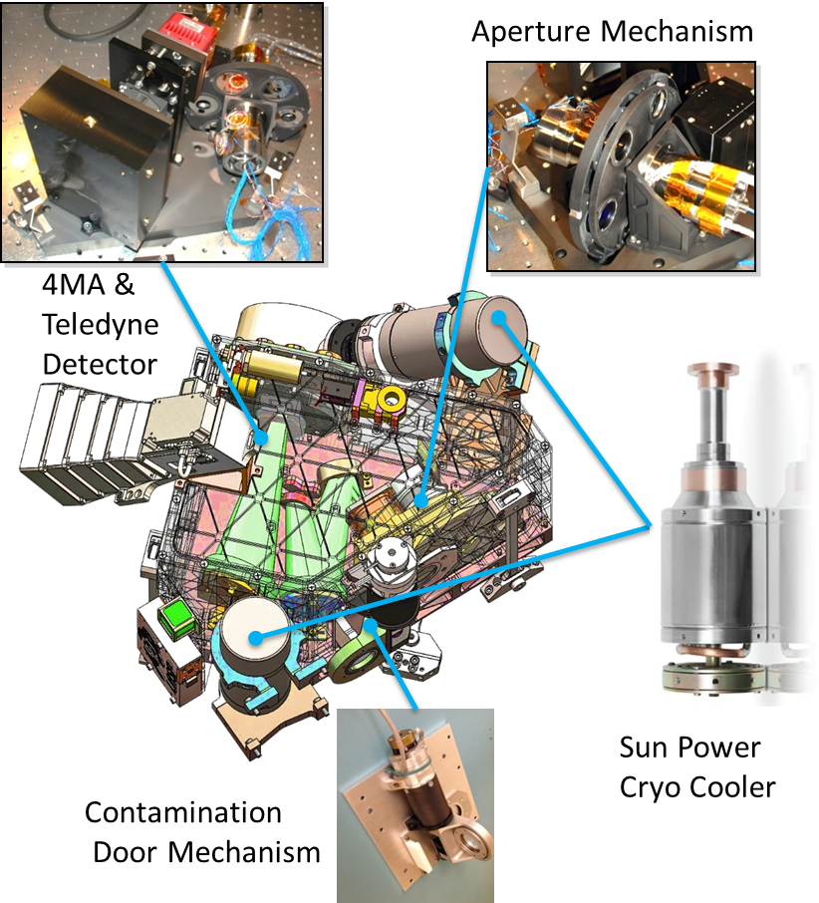
CLARREO Pathfinder Reflected Solar (RS) Spectrometer Description
Based on Hyper-Spectral Imager for Climate Science (HySICS) instrument
Developed by the University of Colorado Laboratory for Atmospheric and Space Physics (LASP) under NASA Earth Science Technology Office (ESTO) Instrument Incubator Program (IIP)
IIP Awards in 2007 and 2010
Push-broom Spectrometer
350-2300 nm spectral range
70km cross-track swath width
Previously demonstrated to achieve accuracies approaching CLARREO requirements for climate data records
Two-Axis Pointing System enables solar / lunar / Earth viewing
Pointing system will be developed by LASP
Active stabilization for use on ISS
Leverages significant design heritage from past programs – TSIS, GLORY, TIMED
HySICS instrument has been previously flown on two high altitude balloon flights: 2013 and 2014

Slide 7
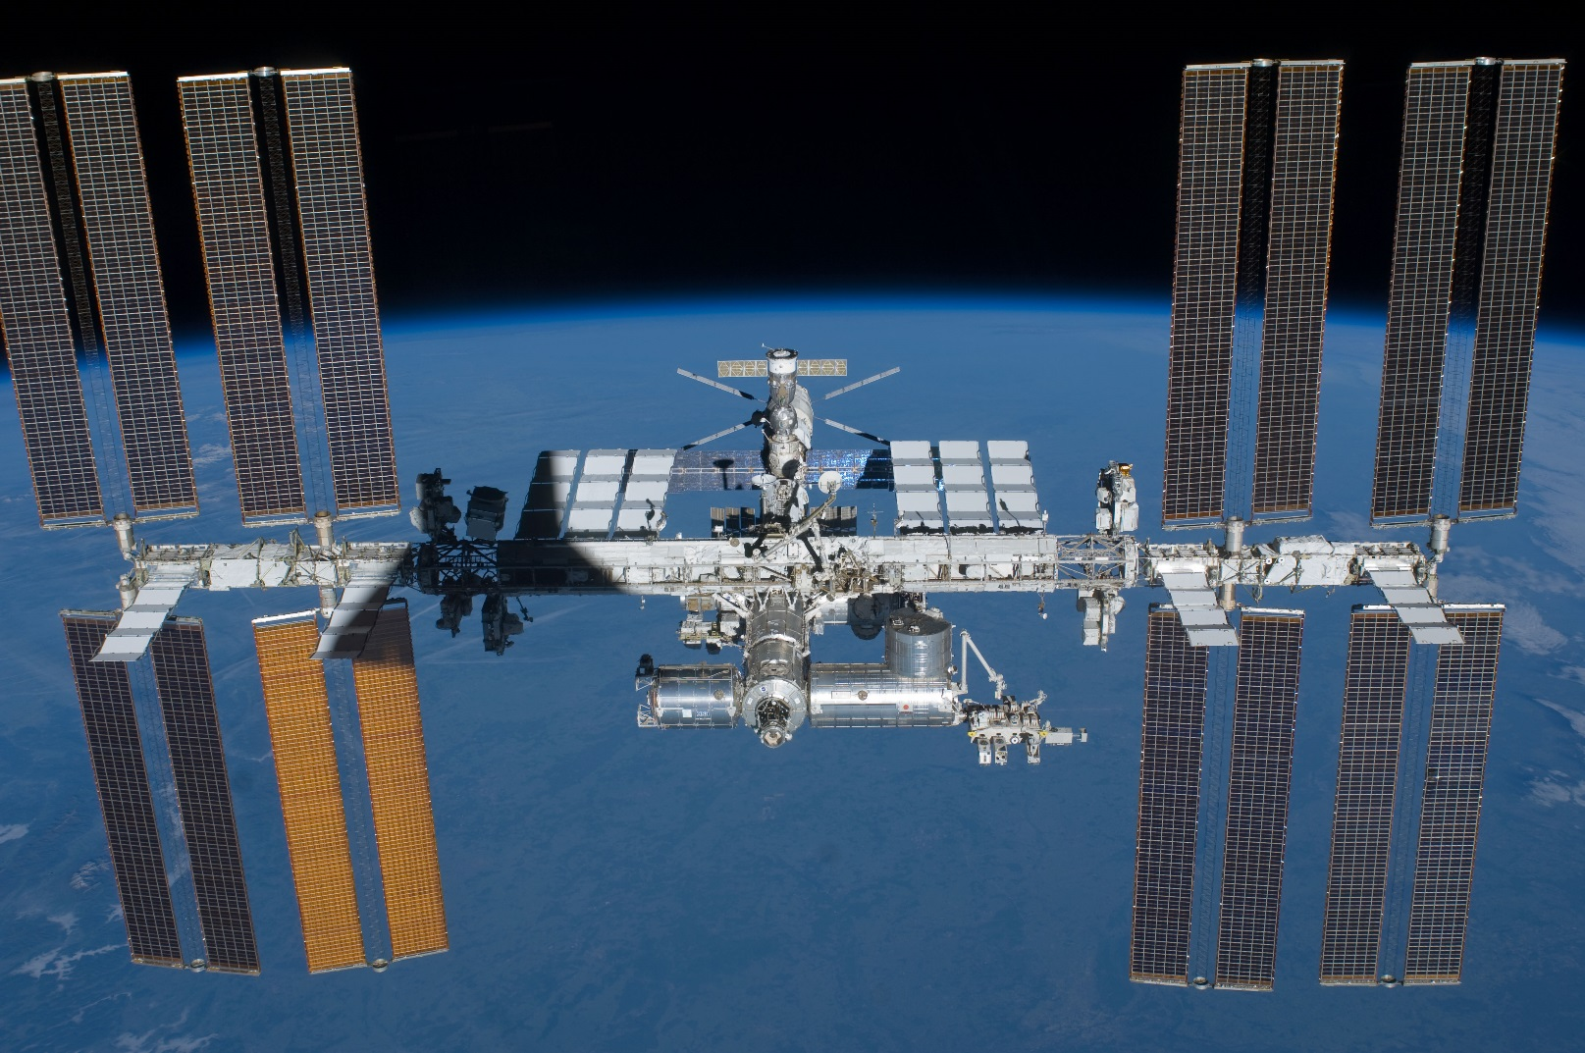
CLARREO Pathfinder: Location on ISS: ELC-1 Site #3
CLARREO Pathfinder Payload will be installed on ExPRESS Logistics Carrier #1 (ELC-1) Site #3
ELC-1
Site 3
Orientation: ISS orbiting towards the reader

Slide 8
Project Status

Slide 9
CLARREO Pathfinder Project Status as of November 16, 2017
CLARREO Pathfinder continues to operate in FY18
Currently in extended Phase A of Formulation
Project has been impacted by uncertainties resulting from the President’s FY18 Budget Request to Congress
Project received direction in late May, 2017 to suspend activities related to awarding the CLARREO Pathfinder prime contract and to develop alternative work plans for FY18 – Q1 and Q2
Impact thus far is an approximate 11-month delay in launch readiness date
Current Best Estimate of Launch Readiness Date is Q1, CY2022
Future activities are dependent upon the FY18 Congressional Appropriation
CLARREO Pathfinder passed a combined System Requirements Review / Mission Definition Review on July 25-27, 2017
Project did not proceed to KDP-B after SRR/MDR due to programmatic uncertainties
Pending new direction from NASA HQ, project anticipates conducting a delta-SRR in ~May 2018 as a precursor to KDP-B and initiation of Phase B activities
Project has retained strong support and advocacy within NASA Science Mission Directorate – Earth Science Division, and the Earth Systematic Missions Program Office

Slide 10
Prospects of a future IR Pathfinder
CLARREO Project and Langley Research Center remain very supportive and interested in a future IR Pathfinder mission
The potential for a future IR Pathfinder is dependent upon the outcome of the next Decadal Survey

Slide 12
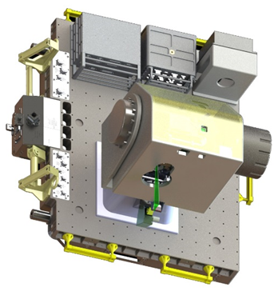
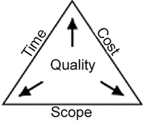
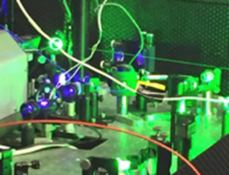
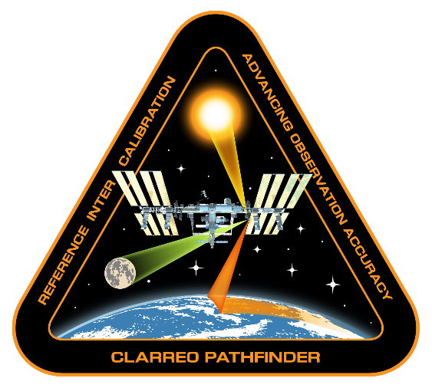
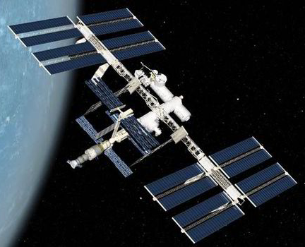
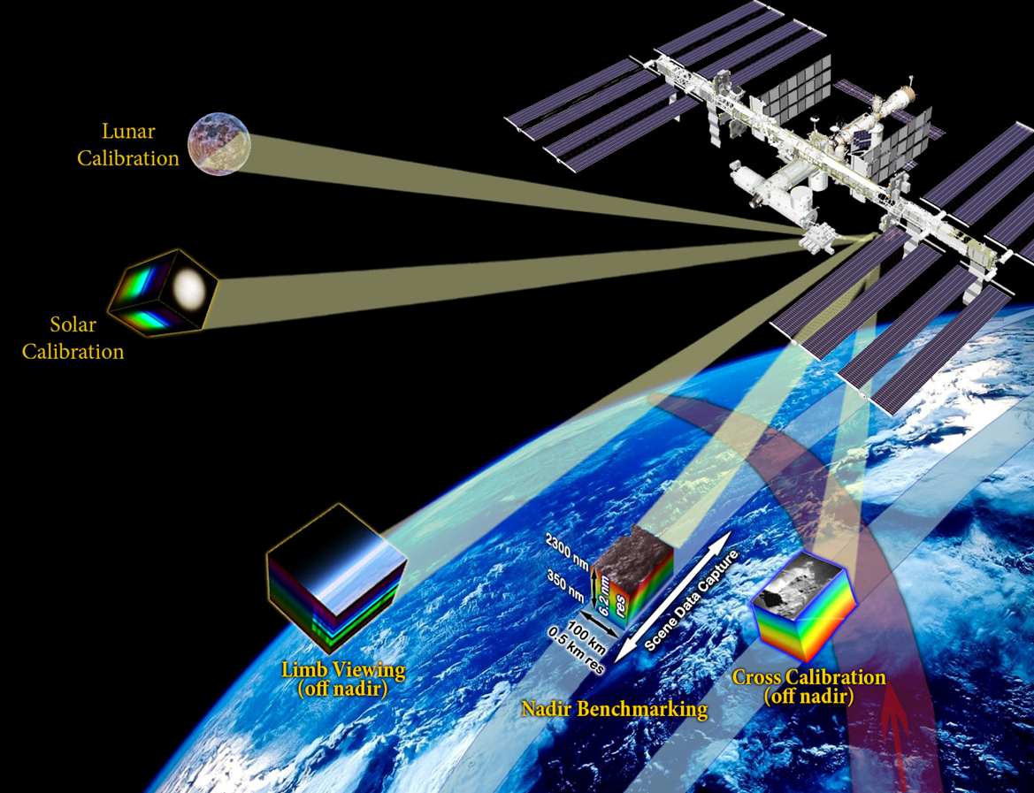
CLARREO Pathfinder Primary Work Elements
Payload
Development
Project
Management
Independent
Calibration
Science Data
Analysis
Launch and
Accommodation
on ISS
Science Data
Management
On-orbit Operations
Demonstrate
Inter-Calibration
Demonstrate High Accuracy
Calibration
GSFC LaRC
JSC / ISS LASP

Slide 13
CLARREO Pathfinder Data Products
Data Product | Description | First Data Delivery after IOC | Maximum data latency after first release
Level 0 | Reconstructed, unprocessed instrument and payload data at full resolution, with any and all communications artifacts (e.g., synchronization frames, communications headers, duplicate data) removed. | 4 months | 48 hours
Level 1b | Calibrated and geolocated observations at full resolution, annotated with ancillary information such as radiometric and geometric calibration coefficients and georeferencing parameters (e.g., platform ephemeris) | 8 months | 1 month
Level 4 | Time/angle/space matched inter-calibration data for reference (CPF) and target sensors (CERES and VIIRS), scene information from target sensors (CERES and VIIRS), modeled parameters for estimated polarization and radiometric corrections | 10 months | 6 months

