Slide 1
Inter-calibration of GEO imagers and GSICS activities
David Doelling, Rajendra Bhatt, Conor Haney, Benjamin Scarino, Arun Gopalan
CLARREO Pathfinder Inter-Calibration Workshop
NIA, November 16, Hampton, VA.
Nov 16, 2017

Slide 2
GSICS goals
An international organization aim to harmonize retrievals across sensors for climate monitoring, weather forecasting and environmental applications, by providing consistent calibration
Global Space-based Inter-Calibration System (GSICS)
http://gsics.wmo.int
Calibration strategy using best practices uniformly across sensors
Monitoring instrument performance
Operational and historical inter-calibration of satellite sensors
Anchoring measurements to an absolute references
Such as CLARREO, the moon
Provide the retrieval community calibration coefficients

Slide 3
GSICS calibration activities
The GSICS effort is divided into sub-groups
UV, visible/near IR, IR, microwave, solar spectra, GPM precipitation
GSICS processing and research centers
CMA, CNES, EUMETSAT, ISRO, IMD, JAXA, JMA, KMA, NASA, NIST, NOAA, ROSCOSMOS, ROSHYDROMET, USGS, WMO
GSICS calibration products available
Geostationary IR calibration coefficients referenced to IASI and AIRS
GSICS VIS/NIR calibration efforts
Current focus is to calibrate the geostationary sensors
Use the moon, and deep convective clouds to transfer the NPP-VIIRS reference calibration
Should be ready shortly

Slide 4
GSICS to use NPP-VIIRS as the visible calibration reference
Many of the VIIRS and 3rd generation GEOs have very similar spectral response functions
This reduces the uncertainty of SBAF to account for spectral band differences
NPP-VIIRS and the follow on VIIRS onboard JPSS-1 to JPSS-4 will allow the transfer of the reference calibration between VIIRS sensors and ultimately to CLARREO
The MODIS instruments are ageing and require more onboard calibration adjustments such as response versus scan (RVS) corrections

Slide 5
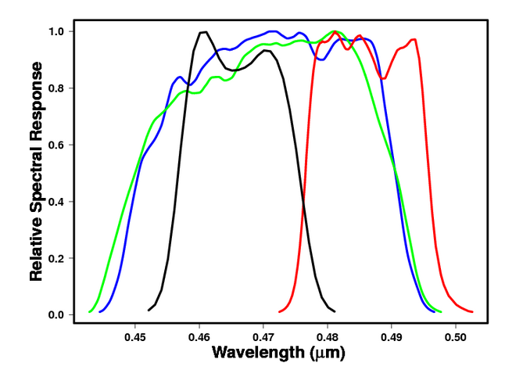
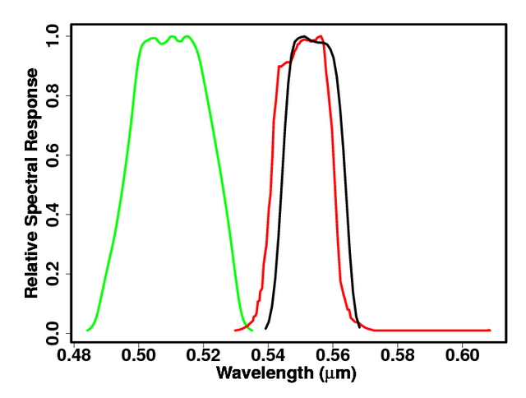
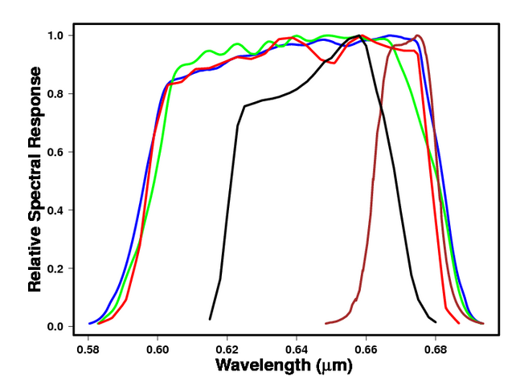
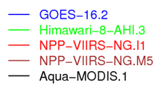
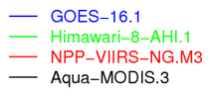
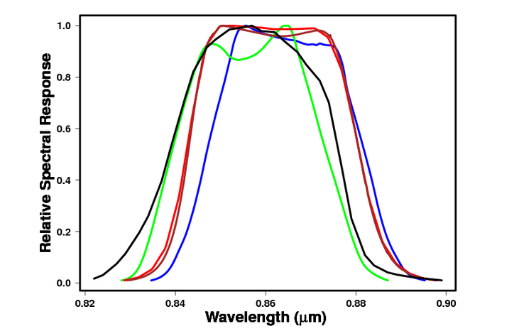
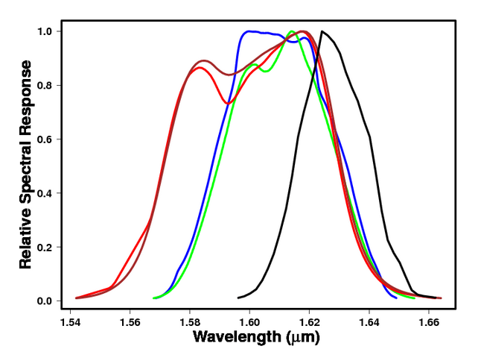
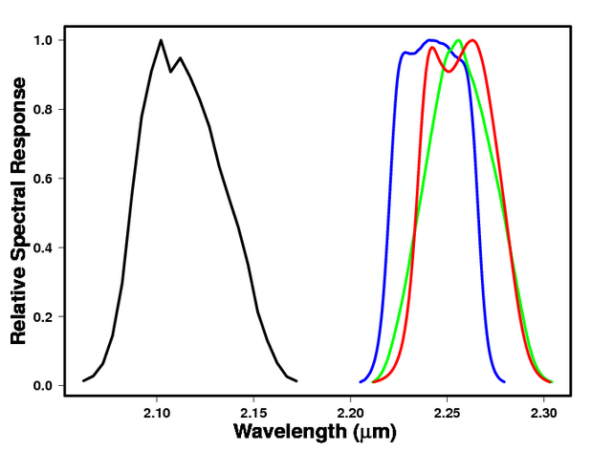
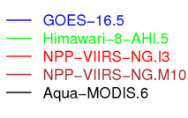
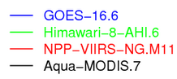
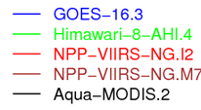
Comparison of MODIS, VIIRS and GEO imager reflected solar bands
0.48µm
0.55µm
0.65µm
0.86µm
1.6µm
2.2µm
NPP-VIIRS more closely resembles the 3rd generation GEOs than Aqua-MODIS bands, especially for SWIR bands

Slide 6
NPP-VIIRS level1B datasets
Some of the NPP-VIIRS level1B datasets/calibrations
NOAA IDPS (Interface Data Processing Segment) (Changyong Cao)
NOAA ocean color group
NASA LandPEATE (Jack Xiong), 03110, Ver1, Ver2
NASA ocean color group
NASA aerosol optical depth group
Every retrieval group and project has different requirements for VIIRS calibration
CERES requires stability for the whole processing Edition and consistent GEO calibration with MODIS
Other projects would like the most absolute accurate calibration
Ocean color requires the polarization and space count to be accurately charaterized
Does each retrieval group need an optimized calibration?

Slide 7
Can level 1A calibration modules be as traceable as level 1B datasets?
Rather than downloading every version of Level 1B VIIRS calibrated data, the level 1A is archived once and during retrieval processing the a calibration module is applied
The CERES project has 2 versions of Terra and Aqua MODIS level 1B (sub-setted) datasets that amount to 0.5 PB, amounting to large storage requirements and cost
Can all the instrument data be saved in level 1B, that is now in level 1A
Every retrieval group and project has different requirements for VIIRS calibration
Each retrieval group can then have its own calibration module, without having to distribute many versions of level-1B calibrated data
If there is a calibration anomaly, such as the Terra-MODIS water vapor anomaly, calibration modules would significantly decrease latency between versions
Retrieval groups could test/process the new calibration, without having to wait for level 1B processing

Slide 8
Calibration module advantages
Currently GSICS can only update the overall temporal calibration on level-1B datasets
GSICS can correct more instrument anomalies with the level-1A
If there are any instrument specific updates required, such as mirror side differences, response versus scan angle, this information is not located in the level-1B datasets, and cannot be updated on the level 1B
Calibration modules by definition are documention. This information is saved for future generations. This information is lost in the level 1B format.
If there are any future improvements not available today, they can be easily implemented in terms of a calibration module.
Migration of the data and the calibration knowledge to new platforms and programming languages is crucial to to keep the historical records at the same quality as todays climate quality record.

Slide 9
The ultimate research data flow
Level 1B
Level 2
Level 3
VIIRS Level 1A dataset
VIIRS Calibration Module
IDPS
LandPEATE
Ocean Color
VIIRS Cloud Retrieval Module
Hiedinger
Platnick
Minnis-CERES
Spatial and Temporal averaging Module
Gridded
daily
Verify the model physics or natural variability mechanisms with GCM
Reiterate GCM experiments
• This approach optimizes the calibration and retrieval for the process study being analyzed
• The processing would be performed on the fly from the level 1A dataset
• User would select the calibration, retrieval and averaging modules
• User would select the time and spatial domain, format, and parameters, user downloads only data needed.
• User would get the latest calibration and retrieval algorithms
• The slowest part of any processing process is I/O, the only I/O would be the reading of the level-1A and the writing the file for the user. Processing is on the fly and optimized for the user, not all codes need to be run.

Slide 10
DCC invariant target method
Use pixel-level BT(11µm)<205 threshold to detect DCC pixels over the tropics
Use pixels within 40° view and solar angles, the Lambertian part
Histogram pixel radiance or reflectances on a monthly basis
DCC reflectance in VIS and NIR bands depends mainly on optical depth.
Use Hu et al. 2004 model to remove BRDF dependencies
For SWIR wavelengths (absorbing channels), the reflectance is a function of both optical depth and ice particle size.
With an increase in ice effective diameter, the absorption increases that is wavelength dependent

Slide 11
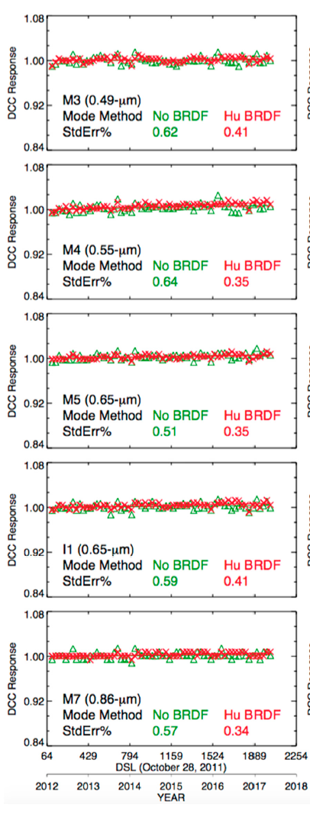
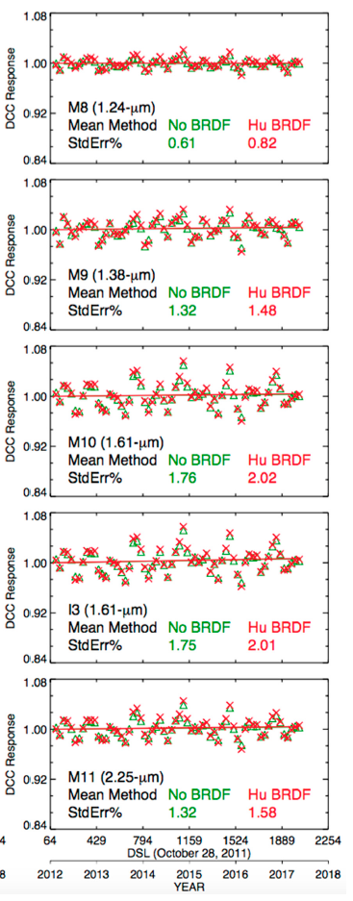
VIIRS band stability
For VIS/NIR bands the PDF mode is very stable over time and the Hu DCC BRDF model reduces the monthly noise
For SWIR bands the PDF mean is more stable than mode and there is a distinct seasonal cycle

Slide 12
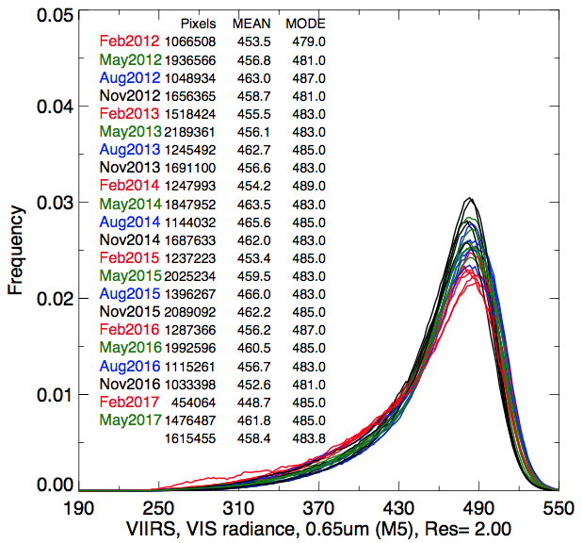
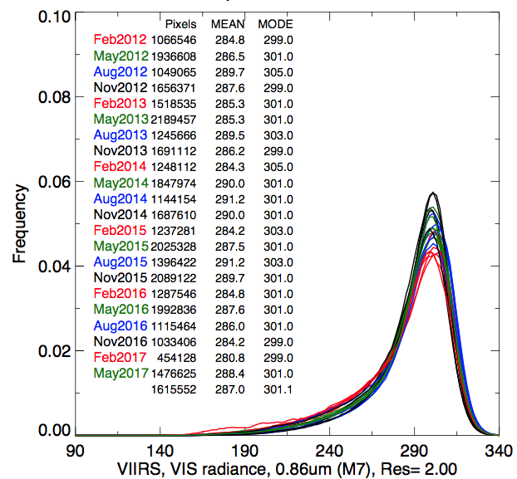
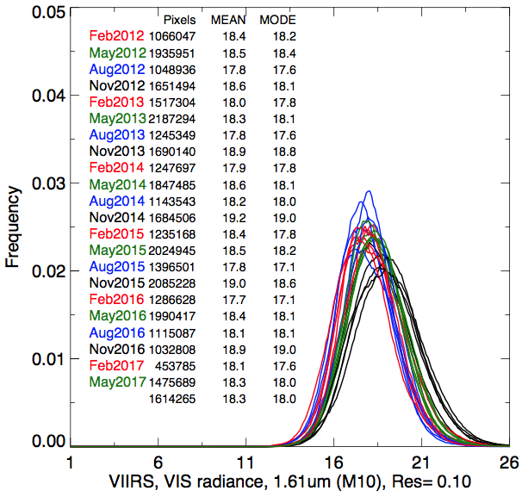
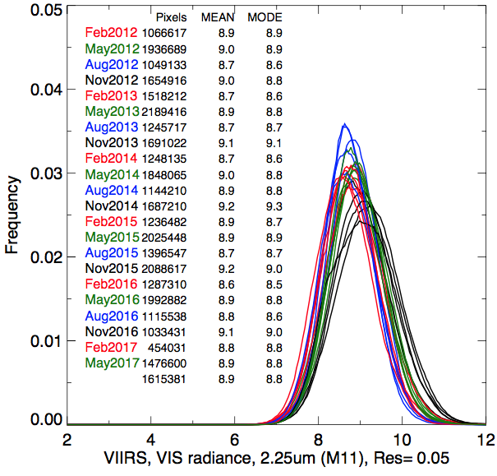
Monthly VIIRS DCC PDFs
M5 (0.65µm)
M7 (0.86µm)
For VIS/NIR bands the PDF mode is very stable over time
For SWIR bands the PDFs have a seasonal cycle
The seasonal variability in spatial and temporal distribution of DCC SWIR radiance is annually repeatable.
Build channel specific BRDFs using DCC pixel level data
M10 (1.61µm)
M11 (2.25µm)

Slide 13
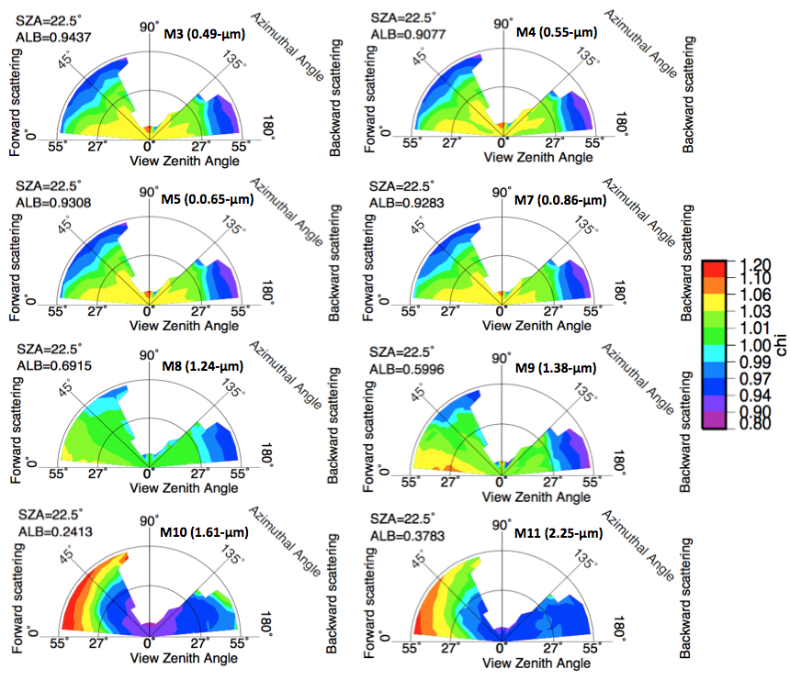
All season BRDFs
Chi = the angular bin reflectance divided by the albedo (integrate the view and azimuthal reflectance)
For VIS/NIR bands the BRDF is very similar
For SWIR bands the BRDF is unique for each band
The 1.24µm channel is the most Lambertian

Slide 14
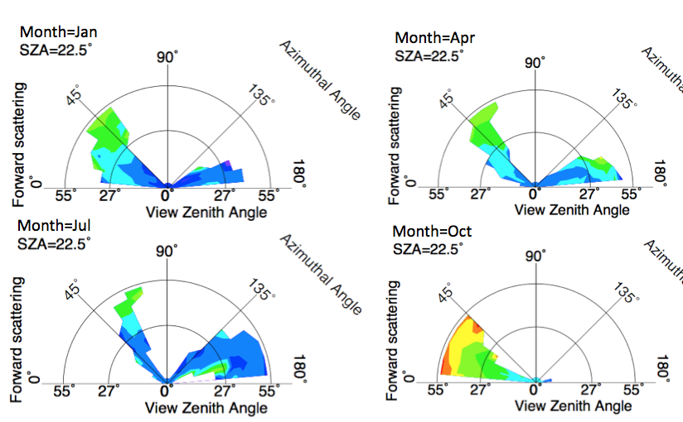
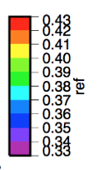
Monthly BRDFs VIIRS M11 (2.25µm)
Each month also has a unique BRDF structure for SWIR channels
For VIS/NIR band there was no monthly BRDF dependence
The DCC reflectance is a function of the spatial and temporal distribution of DCC, which has a seasonal cycle and repeats annually

Slide 15
DCC BRDF deseasonalization efficiency
Table of linear fit standard errors in % of monthly DCC PDF-mode radiances
The deasonalized linear fit standard error is in ()
The BRDF model is very efficient in removing the seasonal variation

Slide 16
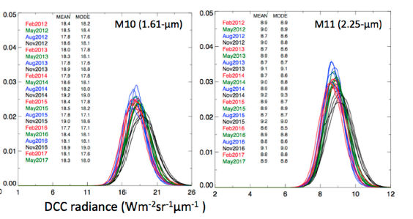
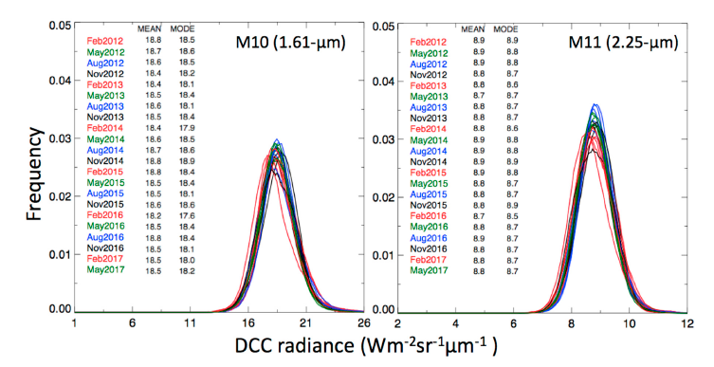
PDF comparison
No BRDF
Monthly BRDF

Slide 17
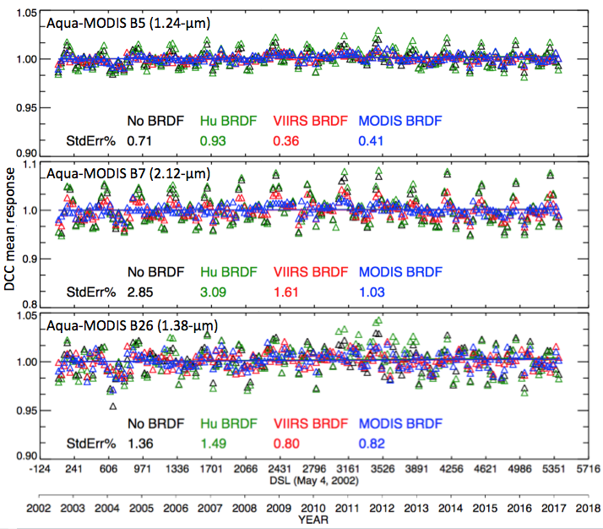
Can the monthly BRDFs be applied to MODIS?
To develop monthly BRDF models takes several years of data
Deasonalization also takes more than two years of data
Can the monthly BRDFs from NPP-VIIRS be applied Aqua-MODIS, which are in the same sun-synchronous orbit? Yes
This method can be used to assess the stability of J1-VIIRS soon after launch

Slide 18
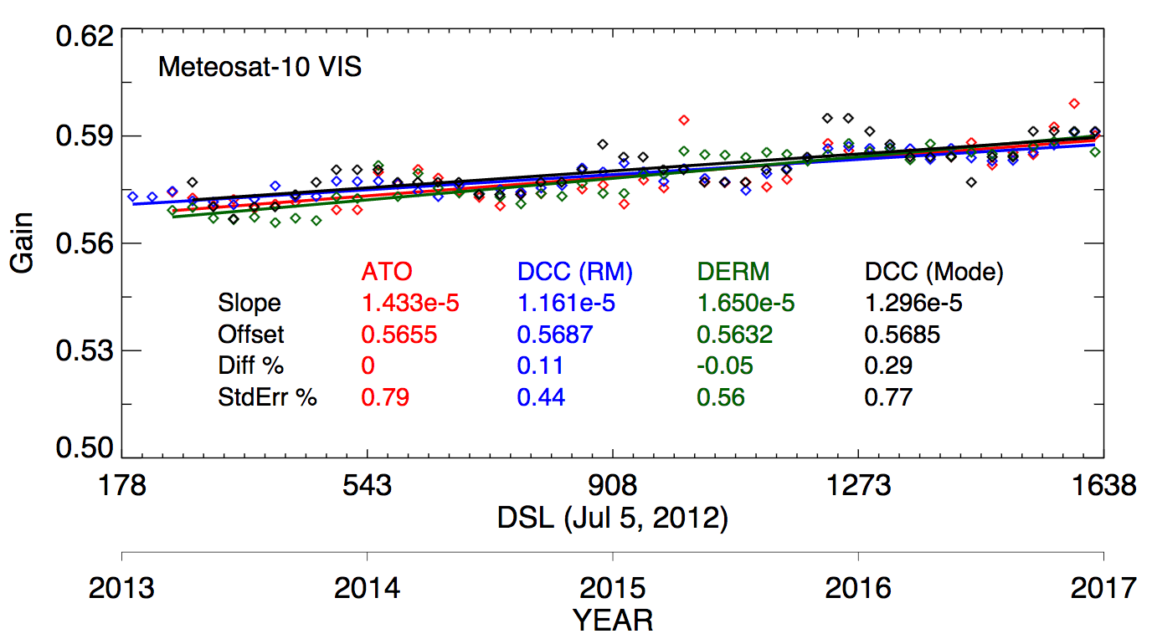
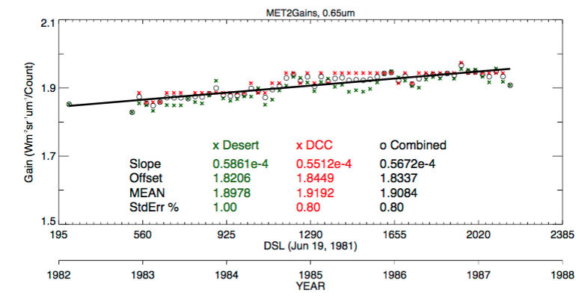
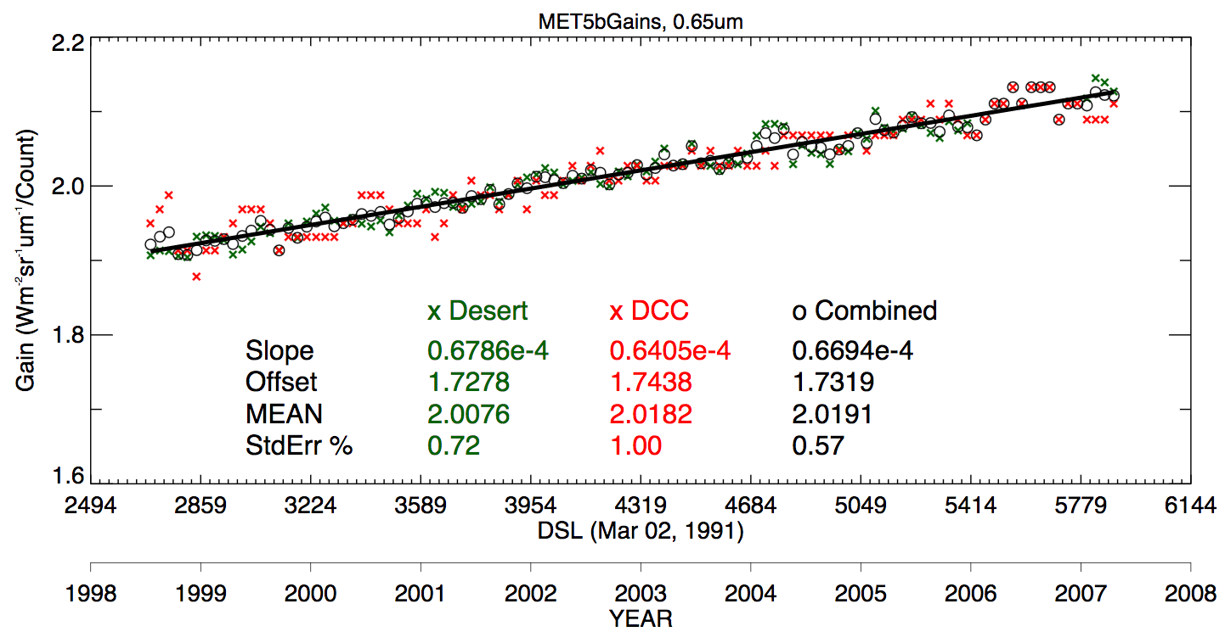
GEO invariant target methods
Met-10, within 0.3%
Desert was characterized using Met-9 referenced to Aqua-MODIS B1
DCC was characterized over the GEO-domain using Aqua-MODIS
Both all-sky ocean and DCC ray-matching transfers the Aqua-MODIS calibration directly
Once invariant target characterized, then can be applied historically and in the future if the GEO scanning schedule is similar
Met-2, within 1.1%
Met-5, within 0.5%

Slide 19
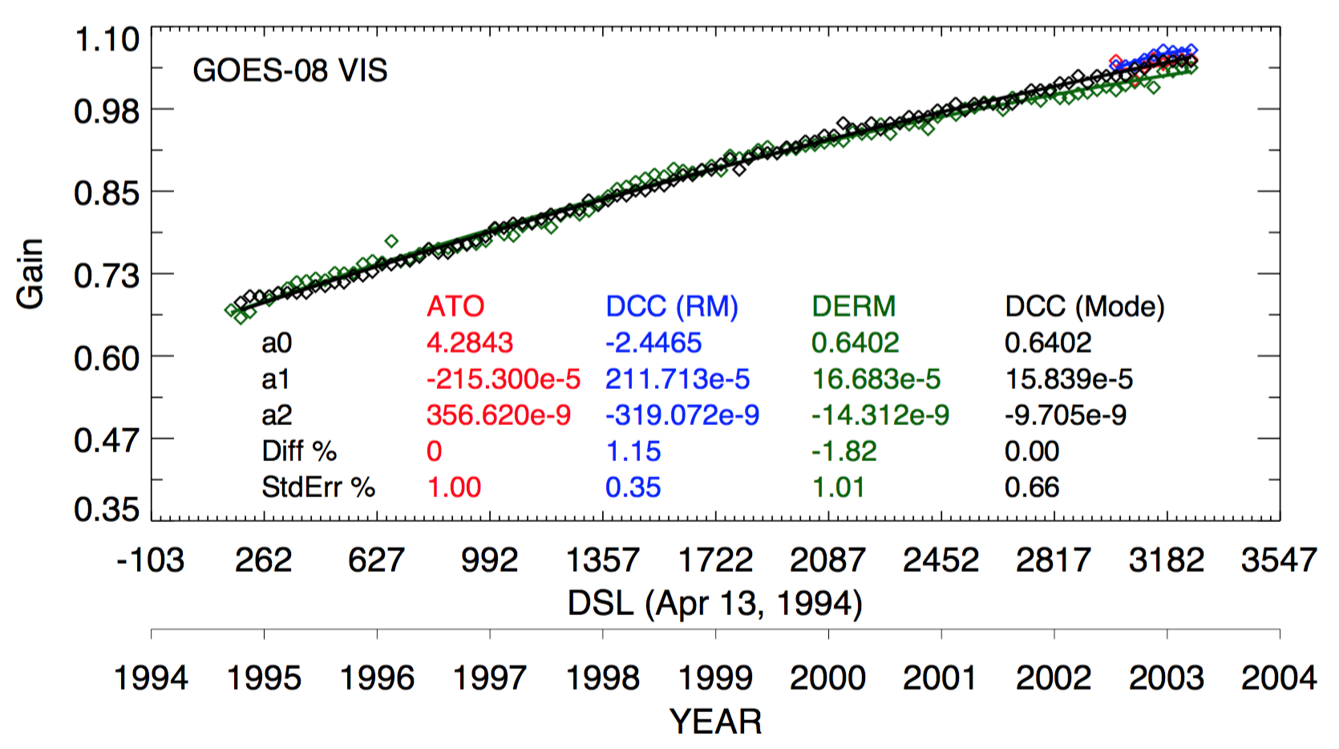
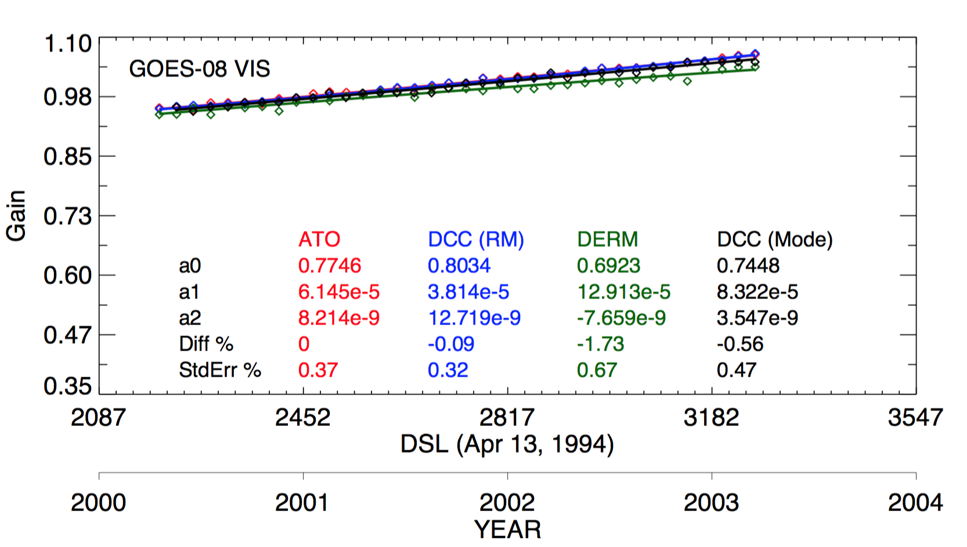
GOES-8 SRF changing
GOES-8 1994-2003
Desert is spectrally red, whereas DCC are spectrally flat over the GOES-8 SRF
It is known the SRFs degrade faster for shorter than for longer wavelengths
Therefor DCC would have a greater gain over time than deserts
Also there is only 0.3% gain difference between DCC and deserts for GOES-12 (2003-2011)
GOES-8, 2000-2004
Decoster et al. 2013, also documented spectral degradation for Met-7
Yves Govaerts working on Met-7 SRF degradation over time

Slide 20
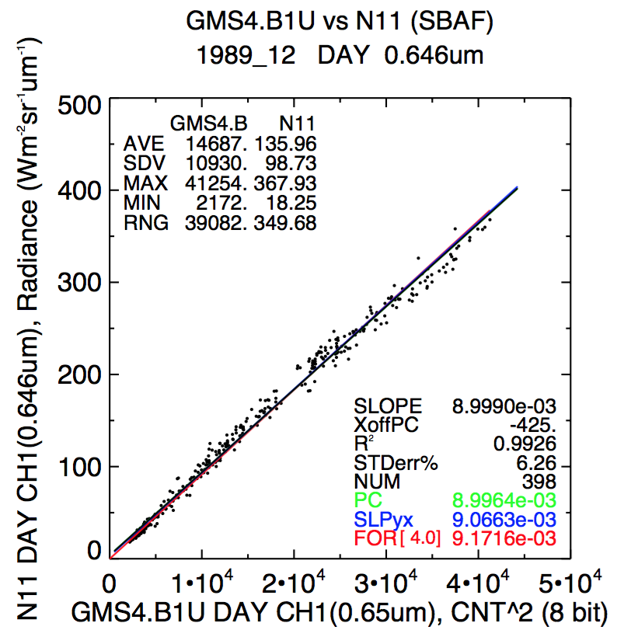
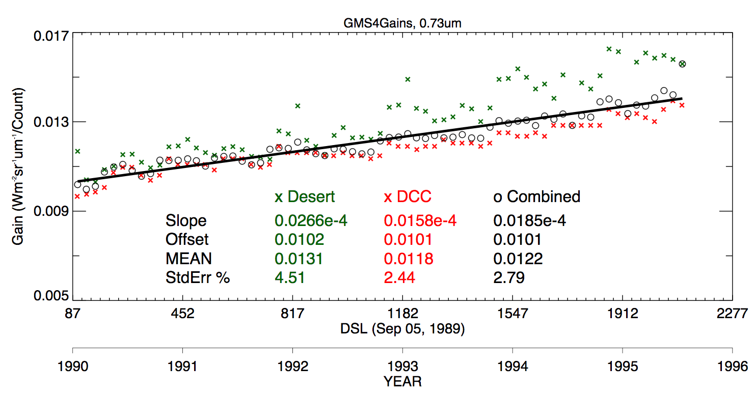
GMS-4 non-linear response
All-sky ocean ray-matching
Unlike GOES-8, for GMS-4 the desert gains are increasing more than DCC
Ray-match GMS-4 and NOAA-11 AVHRR to check sensor response for linearity

Slide 21
GEO calibration with CLARREO
Calibrate VIIRS with CLARREO to transfer the absolute calibration to VIIRS
This will be the primary method of GEO calibration
Invariant target characterization designed for each of the 5 GEO domains
Ray-match GEO and CLARREO visible radiances, GEO to VIIRS, to calibrate the GEO as a reference sensor for the GEO domain.
Once the reference GEO sensor has been absolutely calibrated, it can then be used to characterize invariant targets.
Directly characterize invariant targets with GEO viewing geometry, GEOs are always located in the same location and scanning schedule
Possibly look at other GEO onboard calibration issues
Mainly diurnal effects on GEO calibration, Pathfinder on ISS
RVS, response linearity
It does not look like that Pathfinder will be in space long enough to unravel the SRF degradation of broadband GEO visible bands

Slide 22
Conclusions
Is there a case to be made for calibration modules to reduce the latency between calibration versions and reduce data volume?
DCC invariant target method can asses the stability of VIS/NIR and SWIR bands soon after launch, for example J-1 VIIRS
The CLARREO instrument can characterize ground targets for GEOs as well as inter-calibrate NPP-VIIRS, to provide a reference calibration for GEO inter-calibration
Multiple invariant targets, characterized by CLARREO and ray-matching with CLARREO can asses sensor performance with respect to diurnal effects, spectral response changes, sensor response linearity, as well as calibrate the sensor

