Slide 1
MODIS/VIIRS Standard Cloud Products: SW Calibration and Trend Quantification Challenges
S. Platnick¹, K. Meyer¹, N. Amarasinghe, S. A. Ackerman³, R. Holz³, A. Heidinger^{3,4}, et al.
1NASA GSFC, ²SSAI, 3U. Wisconsin CIMSS/SSEC, 4NOAA NESDIS
CLARREO Path Finder Science Workshop
Nov. 2, 2021

Slide 2
Imager Cloud Products: Different Instruments, Multiple Sensors … and the list is growing
MODIS Standard Cloud Products
  Cloud mask (MOD35/MYD35) and properties (MOD06/MYD06)
  Terra (start of data record in 2000) and Aqua (2002)
MODIS/VIIRS Continuity Cloud Products
  Cloud mask (CLDMSK) and properties (CLDPROP) algorithm applied to common MODIS and VIIRS spectral channels
  VIIRS on Suomi NPP (2011), NOAA-20/JPSS-1 (2018), JPSS-2 (2022), JPSS-3 (2028), JPSS_4 (2032) [see K. Meyer & Aisheng Wu talks tomorrow]
“GEO-Ring” Cloud Products
  MODIS/VIIRS continuity cloud algorithms being ported to GEO imagers: GOES ABIx2, Himawari AHIx2, KOMPSAT AMI, Meteosat FCI (2022), FY4, …

Slide 3
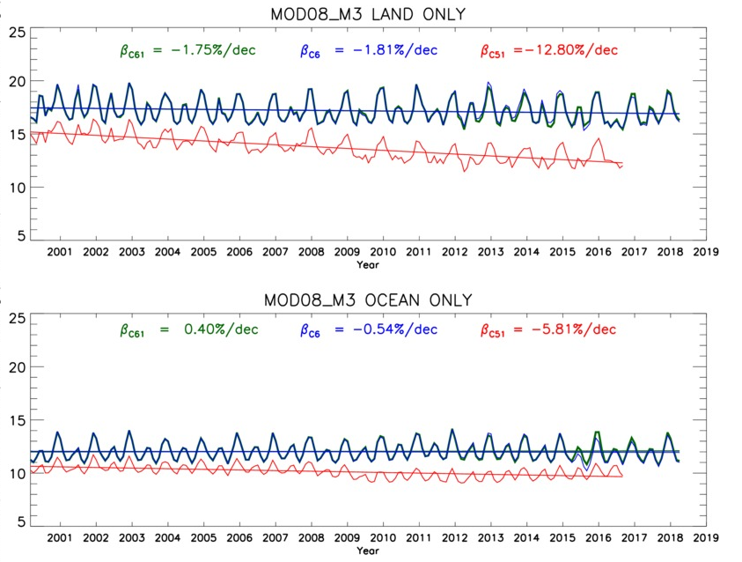
Climate Data Record Challenges: Calibration
18-yr time series, ±60° zonal mean
Terra MODIS Liquid water Cloud Optical Thickness (COT) Trends
C6: -2%/dec
influence of
0.67 µm channel
Response vs. Scan (RVS) calibration drift
COT
C5.1: -13%/dec
land
COT
C6: -0.5%/dec
ocean
C5: -6%/dec
0.86 µm RVS drift

Slide 4
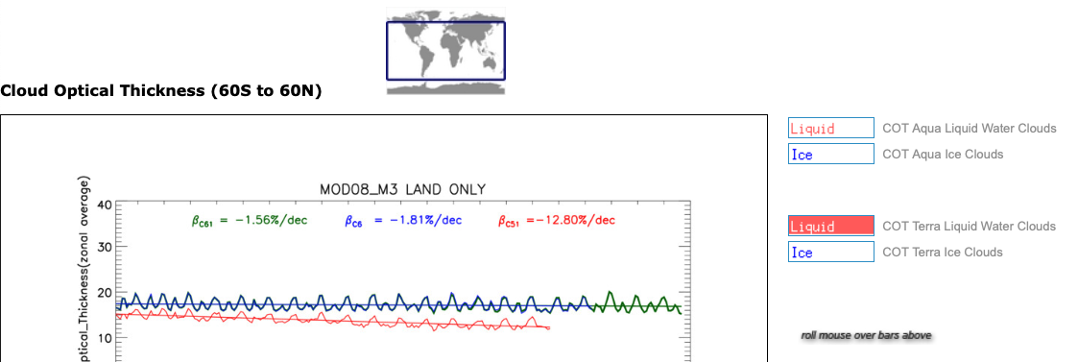
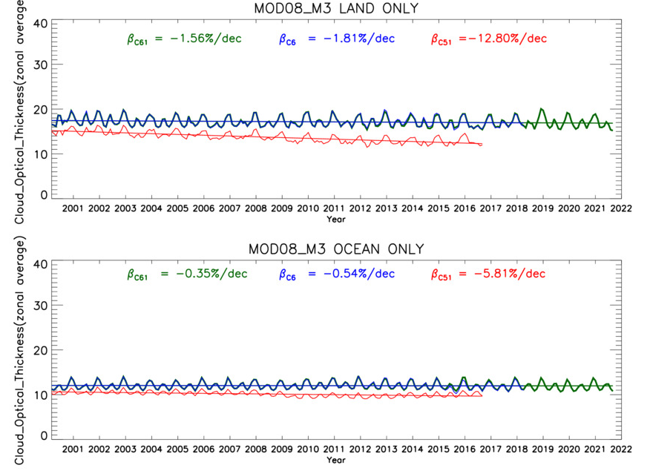
Climate Data Record Challenges: Calibration
21-yr time series, ±60° zonal mean
Terra MODIS Liquid water Cloud Optical Thickness (COT) Trends
C6.1: -1.6%/dec
C6.1: -0.4%/dec
modis-images.gsfc.nasa.gov/trend_web/Timeseries1.html

Slide 5
Climate Data Record Challenges: Natural Variability

