Slide 1
Pseudo-Invariant Land Site/Vicarious Calibration
K. Thome
CPF Science Workshop
2-3 November 2021

Slide 2
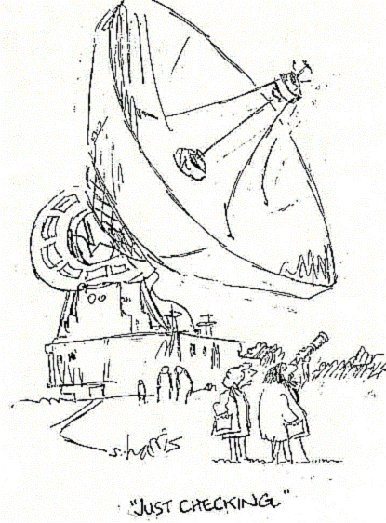
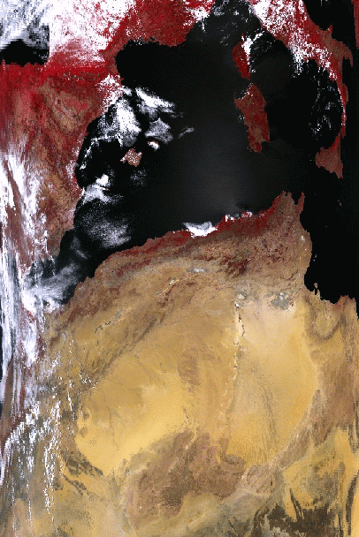
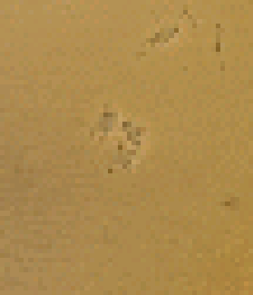
Vicarious approaches
Vicarious calibrations are methods that do not use onboard calibration
  Surface Test sites with and without in situ measurements
  Modeled atmospheric sources
  Lunar calibration
  Deep space views
Biggest advantage is that vicarious approaches do not degrade over time

Slide 3
In-situ based methods
Multiple methods but all essentially have the same key pieces
  Characterize a surface
  Characterize the atmosphere
  Radiative transfer model to predict what the sensor sees
SI-traceable, absolute radiometric approach

Slide 4
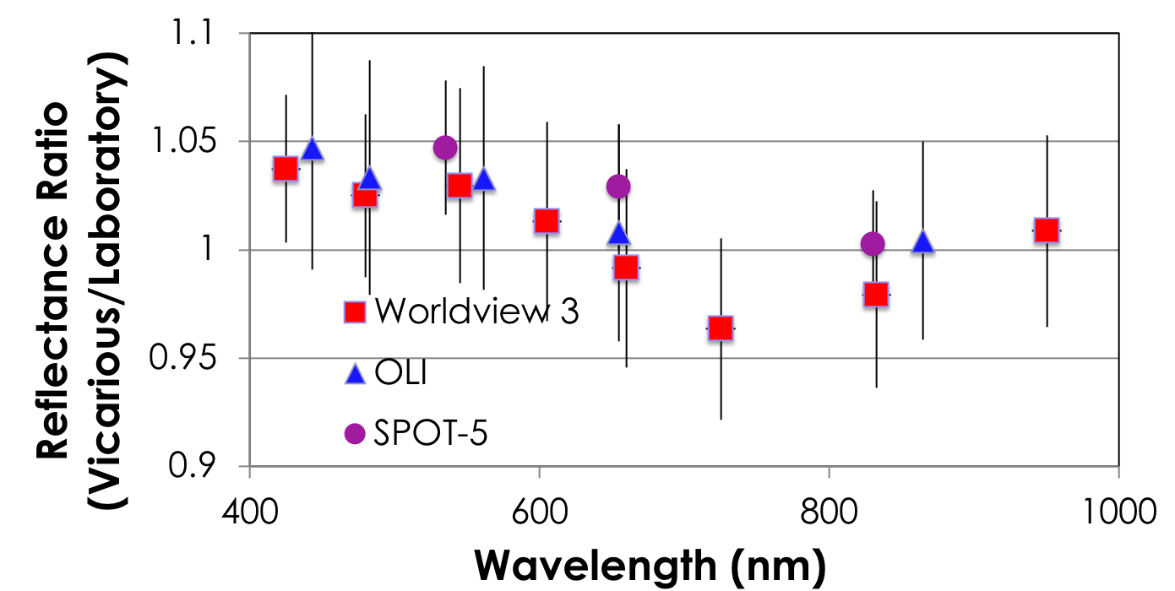
SI-traceability of in situ methods allows for intercomparisons
Results shown here are based on RadCalNet
RadCalNet (Radiometric Calibration Network) is an automated measurement network through CEOS
Show results from three sensors with no coincident views
Ratio of RadCalNet top-of-atmosphere reflectance to sensor-based value
Uncertainties are combination of systematic and random
In situ methods can show real differences between sensors due to differences in atmospheric absorption, view geometries, collection times, and spatial resolution
All three agree statistically with each other and with the RadCalNet product

Slide 5
Repeatability of in situ results are same order as absolute uncertainty
ASTER and ETM+ results in situ based data at multiple sites showing typical scatter in retrieved sensor calibration
ASTER 650-nm band all dates
Error bars are k=1 absolute uncertainty based on SI-traceable error budget
Scatter is similar for both sensors
Selected ASTER dates are those with ideal measurement conditions
ASTER 650-nm band selected dates
Landsat 7 ETM+ 650-nm band all dates

Slide 6
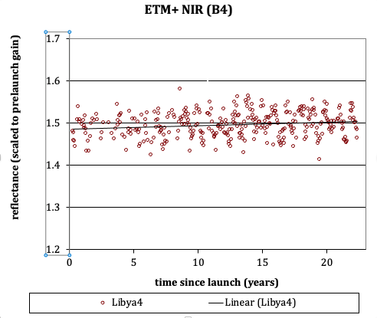
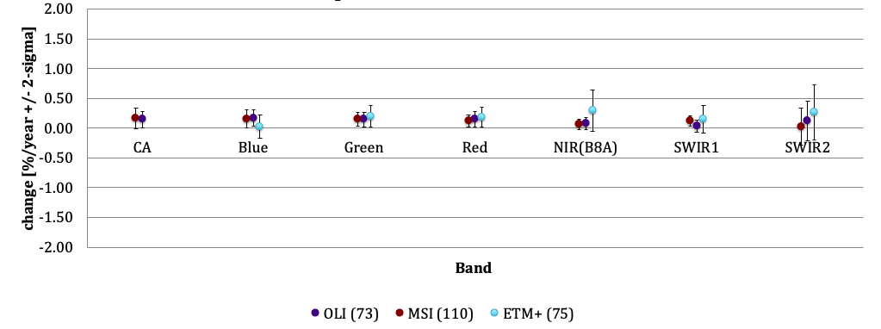
Pseudo-Invariant Calibration Sites (PICS)
Surface reflectance does not change significantly with time for PICS
Typically desert sites
PICS provide large numbers of calibration opportunities
  Excellent approach for sensor trending
  Intercomparisons can be done if sensors overlap in time
Landsat-7 ETM+ 850-nm band at Libya 4
Libya-4 PICS
Libya 4 results from Landsat and Sentinel sensors

Slide 7
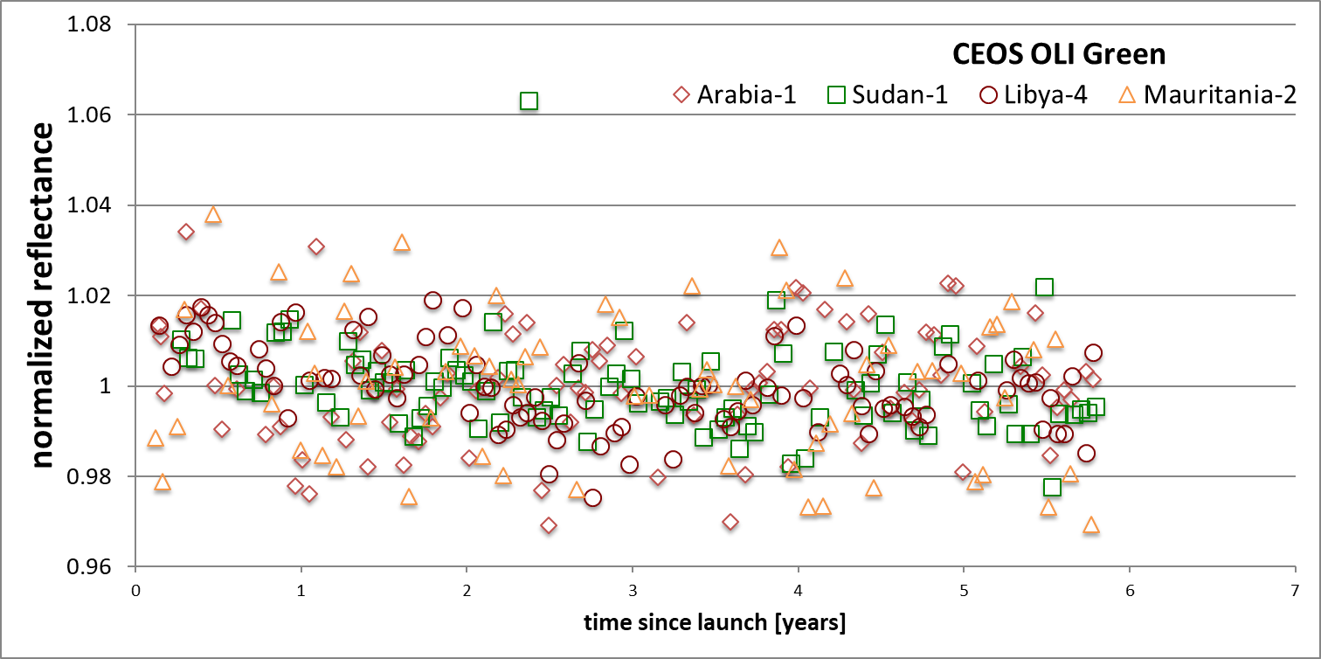
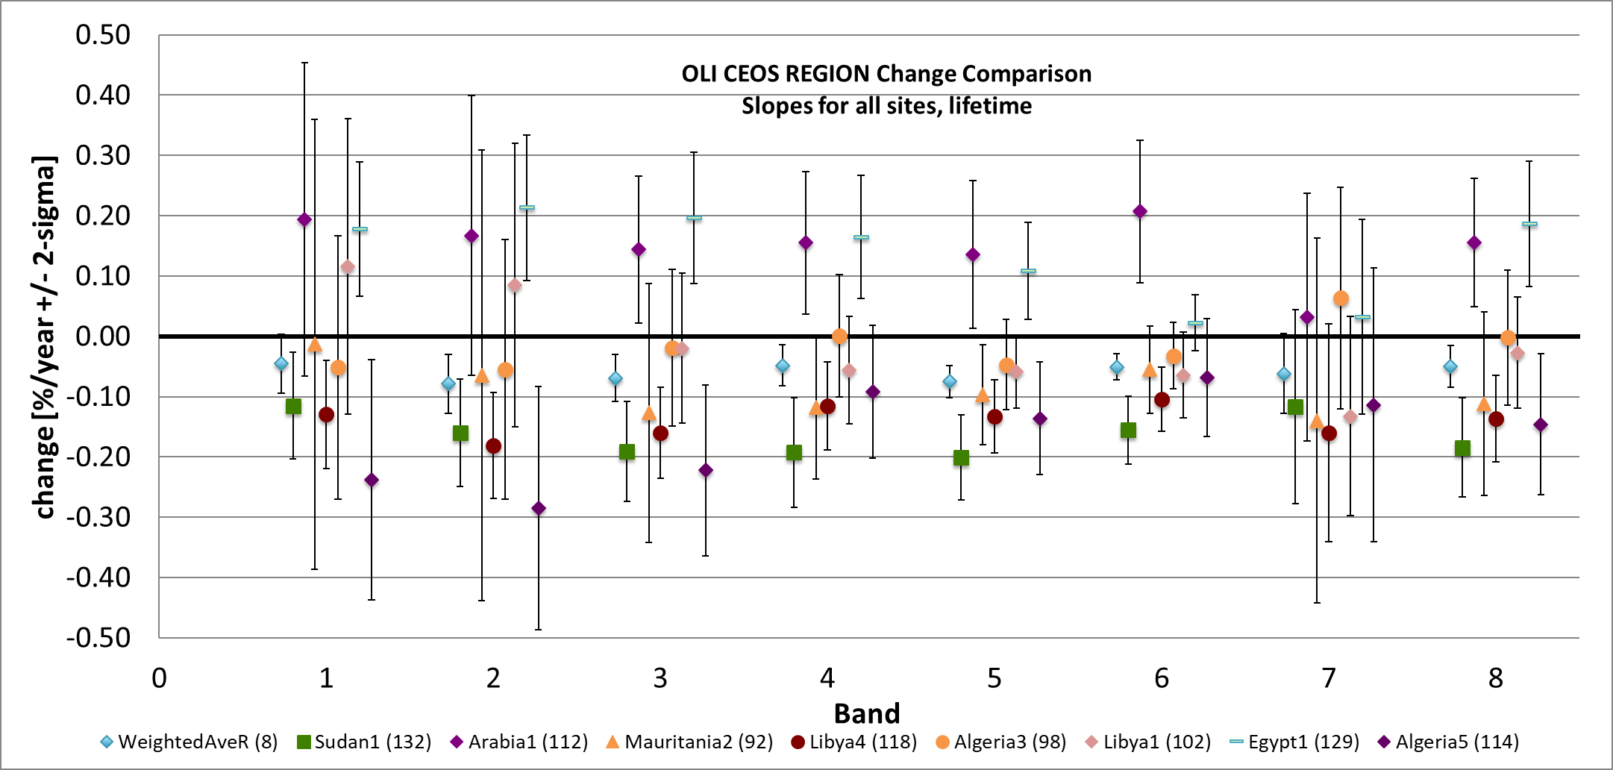
PICS results benefit from large numbers of collections
100s of data sets needed to understand uncertainties
  View-sun geometry
  Spectral
  Spatial resolution
Effects are sensor dependent
Using multiple sites helps (and hurts)
Landsat-8 OLI 550-nm results from four CEOS PICS
Landsat-8 OLI trend studies for CEOS PICS
Catalogs of PICS are maintained by international calibration groups
OLI example for CEOS sites
  Function of time for 550-nm
  Yearly trend results for each band for each site
  Noticeable site-to-site effects

Slide 8
CPF will improve understanding of vicarious uncertainties
Validating vicarious approaches requires knowledge of the truth - CPF data will provide “truthier” data
Knowing and attributing uncertainties is more important than calibration
  Systematic versus random
  Key to developing improvements
CPF’s fiducial reference measurements will allow us to decouple effects from
  Sensor under test
  Surface
  Atmosphere
  Processing approaches and traceability
CPF will help understand outliers
  No singular cause for outlier data sets has been found
  Results show variability not explained by known uncertainties

Slide 9
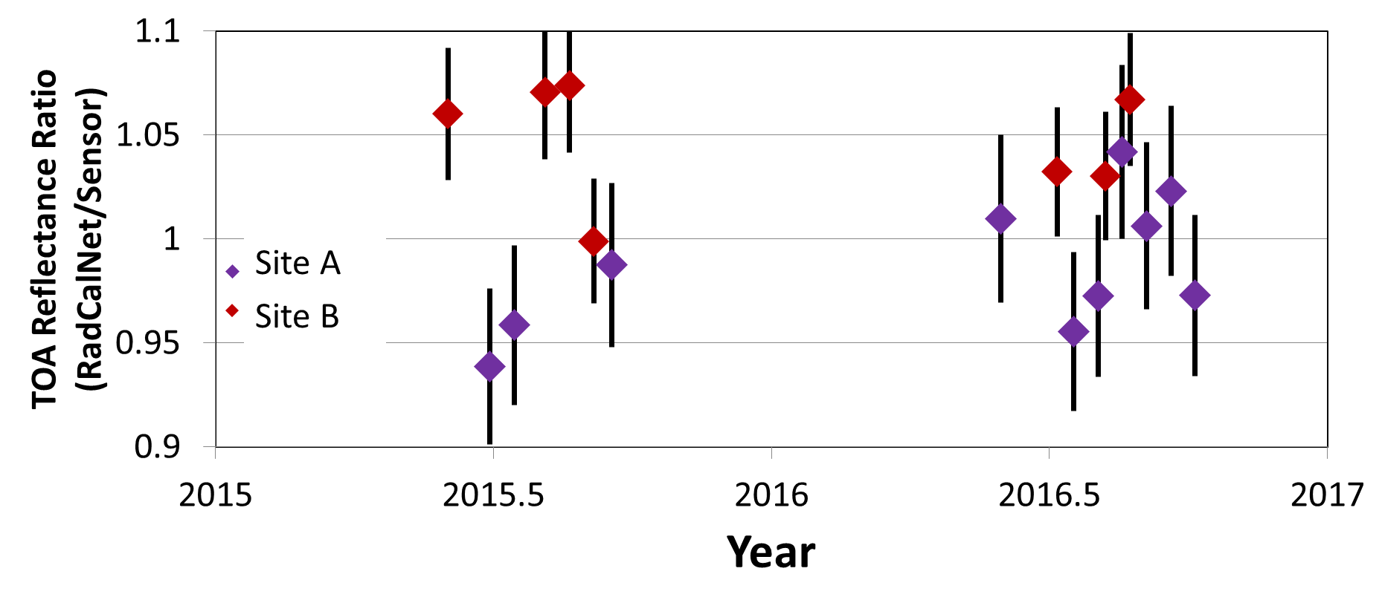
Systematic versus random differences
RadCalNet results from two sites for blue band of a single sensor
Error bars are k=1, SI-traceable, absolute accuracy of RadCalNet product
Each data point agrees with sensor’s calibration to within combined uncertainties
CPF would provide a more stringent comparison to evaluate if there are systematic differences between the two sites
No significant temporal change in sensor
No significant difference between the two sites

Slide 10
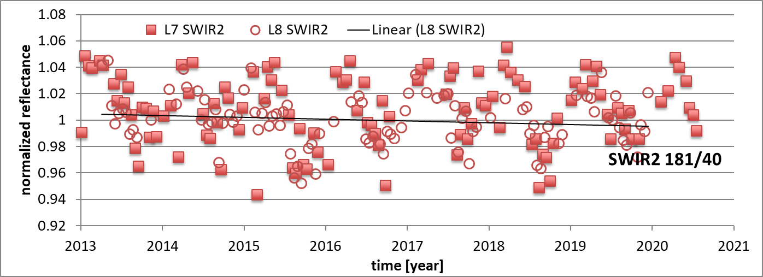
Sensor under test effects
Cloud-screened results for Landsat 7 and Landsat 8 1600 nm band
Data show greater variability for lower SNR system (Landsat 7 whiskbroom scanner) versus higher SNR (Landsat 8 pushbroom)
CPF would help understand how much is due to sensor noise

Slide 11
Surface effects
Same plot as previous chart
Data show a seasonal effect that is likely bi-directional reflectance effect caused by changing solar angle
CPF would help understand how much is due to sensor noise and how much is the surface

Slide 12
Atmospheric effects
Same plot as previous chart
Scatter in data could be due to sub-pixel clouds, thin clouds, or dust storms
CPF would help understand how much is due to sensor noise and how much is the surface and how much is the atmosphere

Slide 13
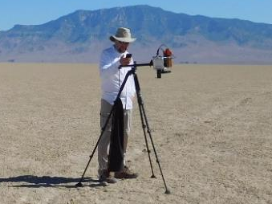
Multiple processing and traceability approaches
In situ approaches can follow a radiance-based or reflectance-based traceability
  Diffuser approach to reflectance-based
  Absolute radiometric calibration for radiance-based
CPF can provide the insight needed to assess the processing, instrumentation, ground sampling, and traceability approaches
Error budgets show that radiance-based method will have lower uncertainties
  Diffusers currently a limiting uncertainty for reflectance retrieval
  Absolute radiometric calibrations have improved dramatically
  Sampling approaches and ground instrumentation also differ between the two approaches

Slide 14
Summary
CPF will provide data needed to assess and reduce uncertainties in vicarious calibration approaches
High accuracy and hyperspectral nature of CPF are the keys to decouple the varied uncertainty contributors in vicarious results
  Provide a better understanding of test site uncertainties due to atmospheric and surface bi-directional effects
  Give insight into traceability paths and processing approaches
Validated uncertainties will give clear guidance on the difference between noticeable and significant as well as systematic and random
Lessons learned will also provide insight into similar effects in higher level data product validation
Challenge will be to determine the optimal amount of data needed at vicarious calibration sites

Slide 15
Supporting charts

Slide 16
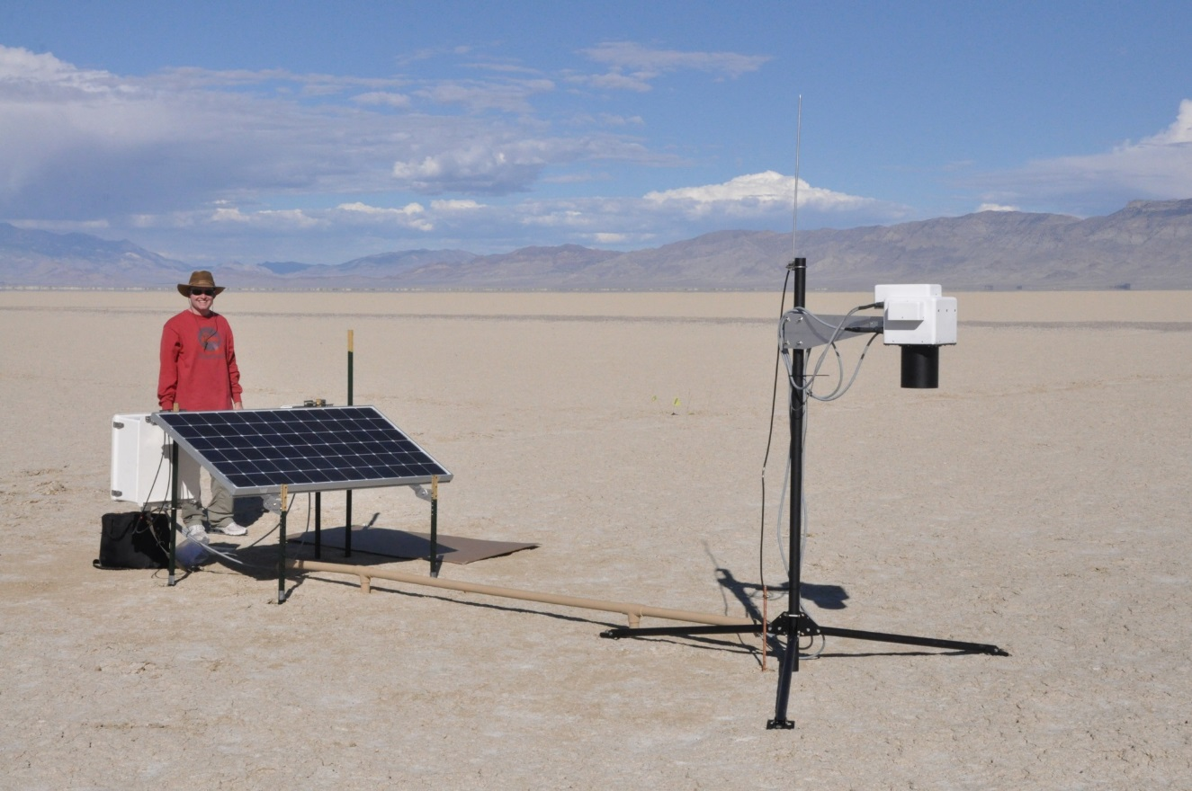
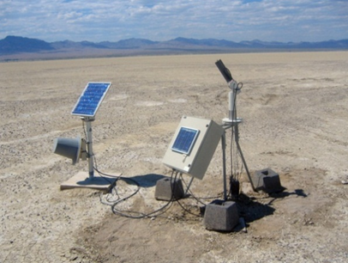
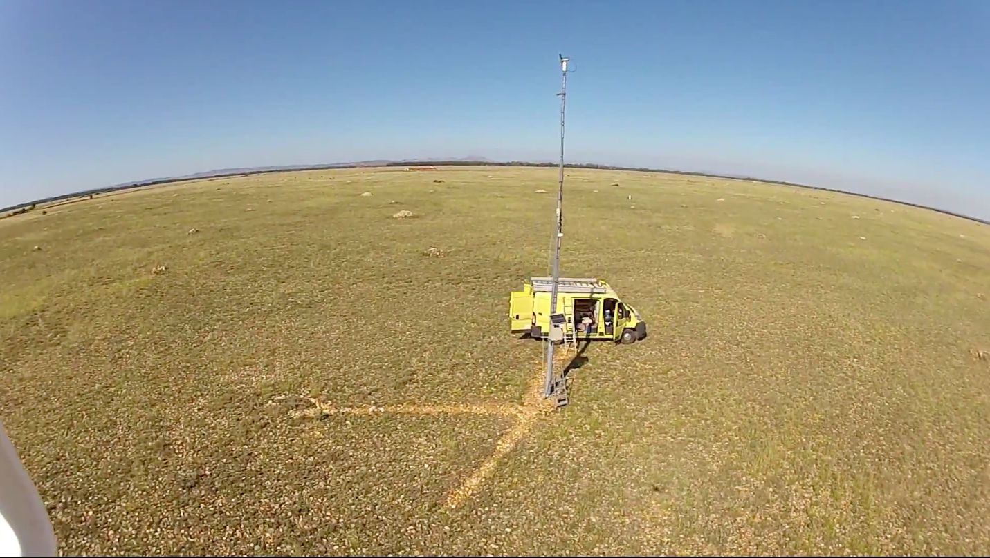
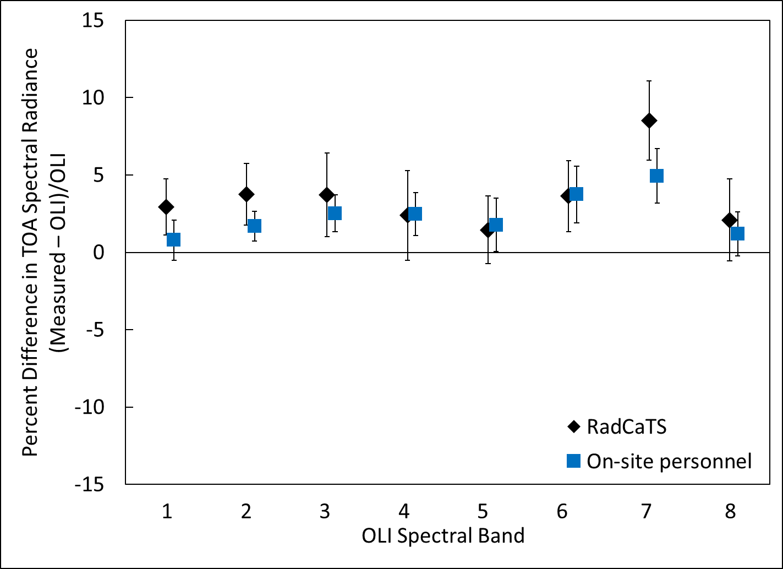
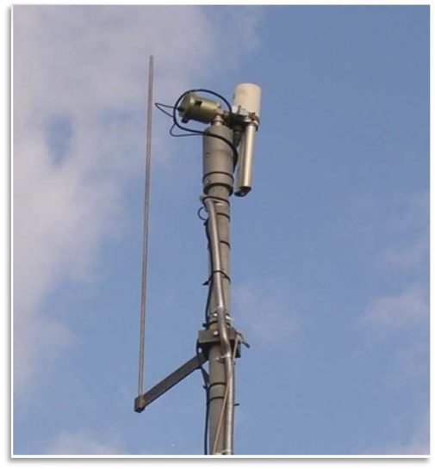
Automated measurements increases number of data points
RadCaTS at Railroad Valley Playa, USA
Automated field collections have been shown to provide results of similar accuracy as on-site personnel
ROSAS at La Crau, France
Landsat 8 OLI comparison
between automated and on-site
personnel approaches

Slide 17
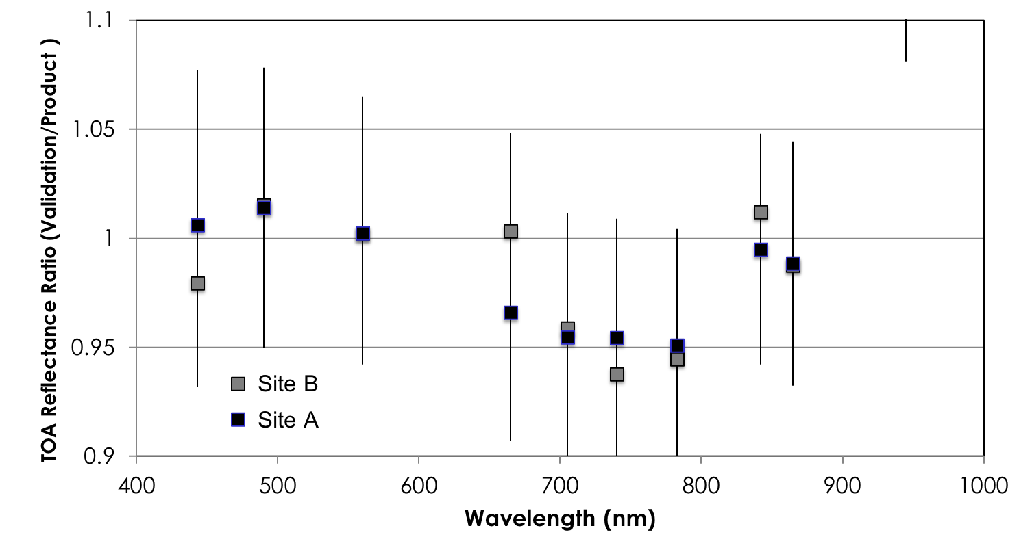
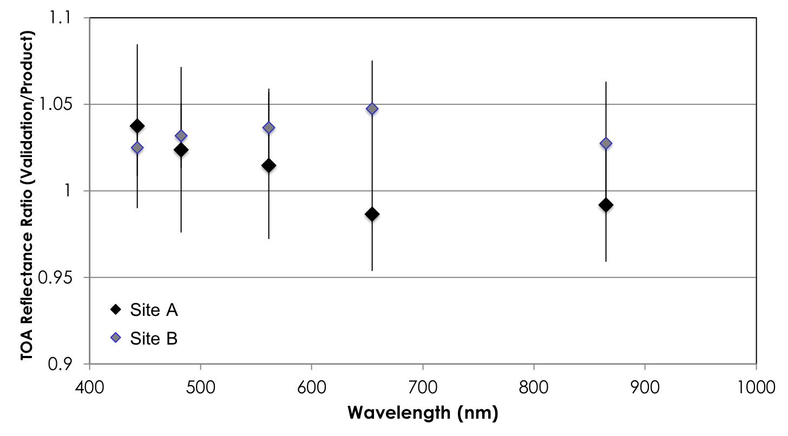
Systematic versus random
Sensor 1
Sensor 2
RadCalNet results for two sites and two different on-orbit sensors
Site A absolute uncertainty (k=1) shown in red and Site B in blue
Error bars are standard deviation of average of all points over time
Largest disagreements are at 650 nm for both sensors
  Systematic effect between the sites?
  If so, what is the cause?
  CPF would provide one more clue leading to improved site understanding

Slide 18
Sensor under test effects
Intercomparison between green bands of Terra MODIS and ASTER
  Same platform
  Identical views and times
  Some spectral band differences
Top plot is Railroad Valley only while bottom includes multiple CEOS sites
Results show degradation of ASTER that is well known
Results also variations of several percent that is much larger than can be explained spectral effects
Sensor MTF has been shown to improve results but not at the level to account for all differences
Sensor cross-calibration with
simultaneous view at single site
Multiple sites, simultaneous views

Slide 19
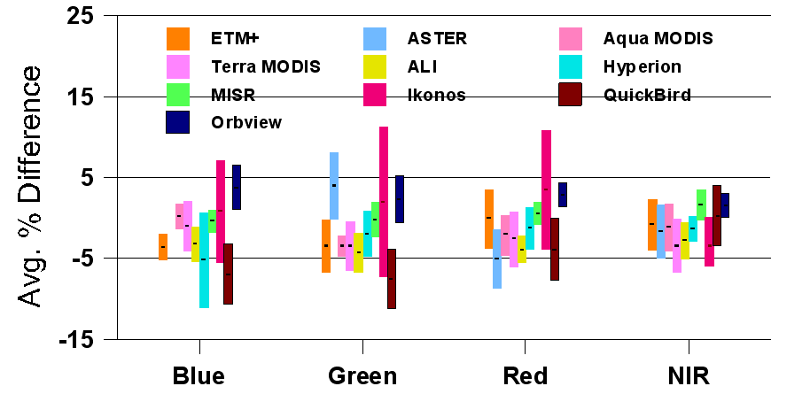
Sensor under test effects
Several sensors show much larger standard deviations than can be explained by statistical sampling
All sensors show better agreement in NIR
All sensors met their absolute radiometric calibration requirement
In situ method results for 10 sensors from the EOS era
Error bars are standard deviation of average percent difference of reported sensor spectral radiance to predicted vicarious value
CPF would help to understand if the NIR agreement is a real effect and whether due to on-orbit sensor SNR, ground-based instrument SNR, smaller atmospheric influences, unknown surface reflectance effect

Slide 20
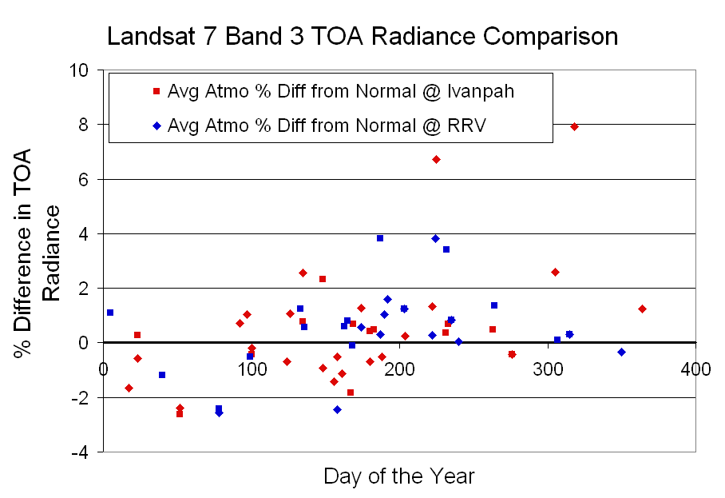
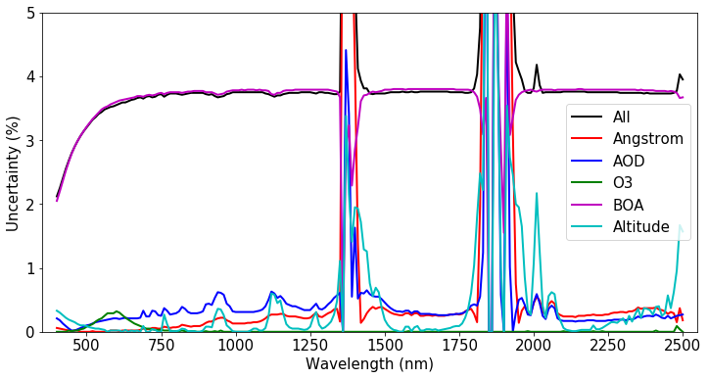
Atmospheric effects
Atmospheric effects are not a dominant uncertainty factor at most vicarious calibration test sites
  High surface reflectance
  Low aerosol loading
Can still be systematic effects
  Unresolved clouds in sensor under test
  Aerosol absorption depends on aerosol type
CPF’s hyperspectral data (and high accuracy) will help to determine impacts from atmospheric uncertainties

